Slide 1
Increasing the Effectiveness of Courtesy Boat Inspections by Examining 20 Years of Data
Chris Reily, MEDEP Invasives Unit

Slide 2
20 Years of Inspections
Notes:
Invasives have been here for decades
Over 20 years ago a boat inspection program was put in place to prevent or reduce the spread
Grew each year for a decade until reaching a consistent # of participating groups and inspections
-2004: 27 groups performed 30,229 inspections
-2022: 60 groups performed 88357 inspections
-Grand prize winner: 2020 saw 102,822 inspections

Slide 3
Current Status
Over 1.3 million inspections
Over 45,000 inspections where one or more plant fragments were found
3,580 invasives prevented from entering or leaving
Great work, but…
Maine has over 6,000 lakes and ponds and 30,000 miles of rivers and streams
321 Waterbodies have dedicated lake associations
60 groups conducted inspections on 118 waterbodies last year
Two ways to widen the net:
Spatially – inspections on more lakes
Temporally – inspections over a longer and/or more targeted seasonal and weekly timeframe
Notes:
-118 is under 2% of lakes

Slide 4
Focus on Time Frames
Notes:
How do we use the available data to improve our ability to protect the resource? Shoot for less coverage for longer, or shift the window?
-Daily shifts
-Weeks
-Months
Two data sets – all data and 2014-to-2022 subset
All Data
wide variation and outliers in earlier years
Skews some of the conclusions
invasives found are still considered valid saves
2014-2022 subset
number of invasives level off
Natural, or at least convenient, break in the data
What we see moving forward will likely be similar to this subset.
Spoiler Alert – a lot of what you all already suspected is true. Now we have the numbers to back it up.
-Amy Smagula in NH pointed out similar issue in their data

Slide 5
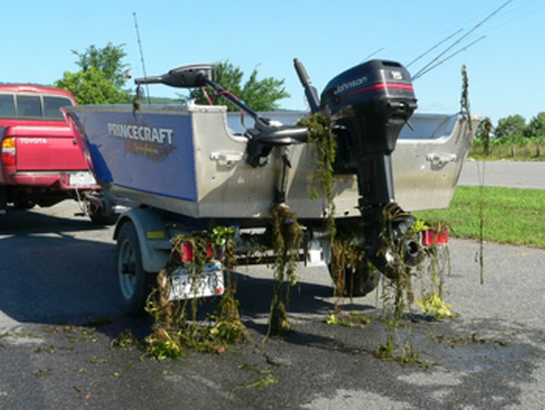
What Variables were Examined
A lot of avenues for exploration
Focus on the following variables
Time of day to the hour
Day of the week
Month
Beginning and End of Season Dates
Counts and Percentages
Percent of inspections where plants were found
Notes:
CBI data set also includes LLV, time of day to the moment of inspection -> hours, weeks, reg numbers for tracking, infested vs uninfested, site-specific, geospatial, organization-specific, State Reg, compared against weather patterns, gas prices, etc.
Counts
Totals provide overall picture
may obscure some information
Percentages
Relays value and probability for a single unit of effort
Normalizes effort for varying amounts of coverage
Plants per inspection
-Means boats are in contact with plants
-No plant means no invasive
-Plant found means there is a chance it is invasive (3% overall, but higher for infested lakes)

Slide 6
Time of Day
Notes:
-Shows the peak times for inspections – roughly equal to peak usage
-Some early morning launches and late evening retrievals
-10 AM-6 PM window covers 70% of boats entering and 86% of boats leaving
-Uninfested – shift a little earlier to catch more entries
-Infested – shift a little later to catch more retrievals.

Slide 7
Day of the week
Notes:
-By count, Saturday, Sunday, and Friday are the most important
-Compare rates
-Not necessarily more likely to see plants on the weekend than during the week
-You are just about equally likely to encounter a plant fragment in any given inspection

Slide 8
Month
Notes:
-Absolute numbers -June, July, and August
-Similar number of inspections
-September plant count 3x higher than May
-Fewer groups in May during LESS plant growth
-Fewer groups in September while there is still SIGNIFICANT BIOMASS AND GROWTH.

Slide 9
Notes:
-By rate
-May is still not comparable to other months
-September reigns supreme
-With a rate like this, imagine how much higher the plant count would be if September had coverage similar to mid-summer levels

Slide 10
Beginning and End of Coverage
Notes:
-Mirror image of May
-But remember the rates!
-Coverage drops sharply after Labor Day
-Less than 50% of groups still inspecting by Labor Day
-Less than 24% of groups inspecting until the end of the third week

Slide 11
May vs. September
Notes:
-May and September are mirror images of each other, the difference being vegetative growth in the first half of May. There are simply fewer plants.
-What would the counts be if we weren’t missing 70% of our coverage by week 38?
-Weighing early season education and outreach against more plants and invasive fragments found later
-Plants per inspection remains high for the groups still conducting inspections
-What are we missing?
-Inspections through at least the third week in September
Volunteer coverage
Fewer hours during the week

Slide 12
Conclusions
Each inspection has similar probability of finding plants
June/July/August, and Saturday/Sunday still very important
More inspections = more saves
September coverage should be a priority
Sacrifice mid-week coverage for end of season weekends
Challenge to find coverage
More invasives prevented from entering other waters

