Slide 1
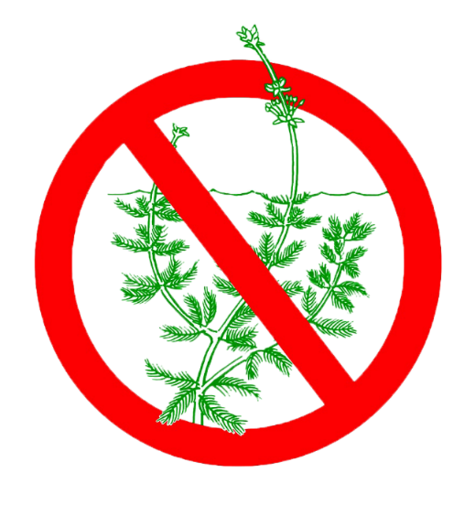
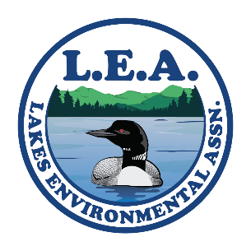
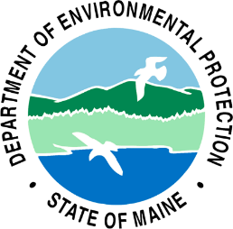
Courtesy Boat Inspector
Coordinator Training
Mary Jewett – Lakes Environmental Association
Chris Reily- Maine Department of Environmental Protection

Slide 2
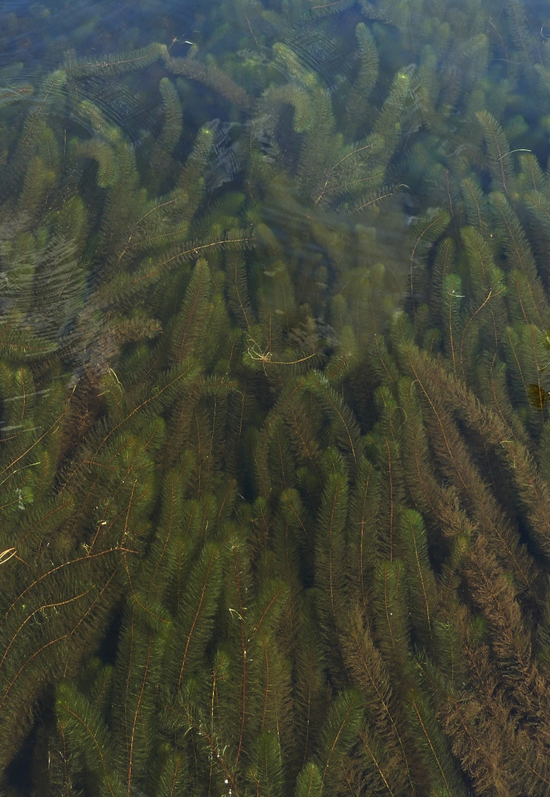
Why are aquatic invasive species (AIS) a threat to lakes, ponds, rivers and streams?
AIS have multiple reproductive strategies & no natural enemies; grow vigorously; out-compete natives.
Blanket lake surface, impeding recreational uses; lower property values; change ecology
Can rarely be eradicated; are expensive to manage (an “everafter” cost); threaten all other fresh waters.
CBI Handbook page 1
Notes:
It is very important for all inspector to have a basic knowledge of the impact invasives have on a lake ecosystem.

Slide 3
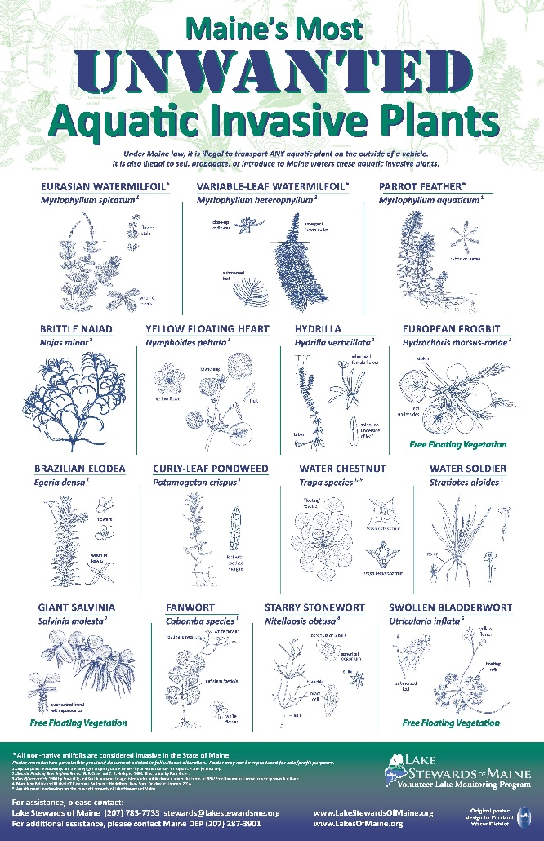
Maine AIS Law
MRS Title 38 Subsection 419-c
Prohibition.
A person may not:
Transport any aquatic plant or plant part on the outside of any vessel on a public road
Posses, import, cultivate, transport, or distribute any invasive plant (15 on list)
Drain or release water into any inland water source
Draining of watercraft and equipment.
Just prior to launching and when removing a watercraft a person:
Shall remove or open any hull drain plugs, bailers, valves, live wells, ballast tanks, and other devices designed for routine removal or opening and closing to encourage water to drain
Notes:
New in June 2023 – boater must drain between lakes

Slide 4
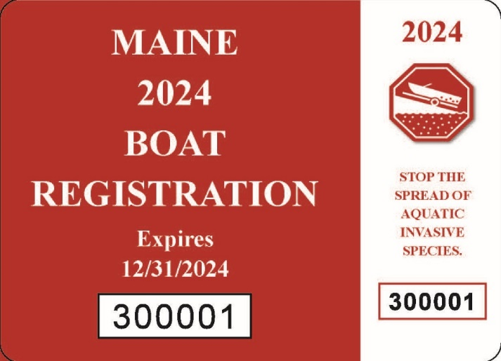
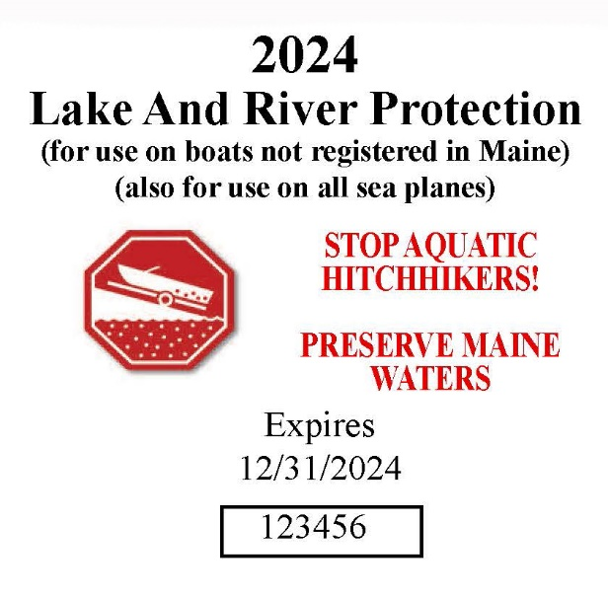
Maine AIS Law
Penalties.
Violations may result in fines up to $500, and $2500 for subsequent violations. This includes fines for failure to display the current years Lake and River Protection Sticker.
Funding.
Funding Mechanism: Sticker revenue goes into dedicated state fund, 70% to DEP, 30% to DIFW, Funds are used for plant removal, early detection, and invasives prevention
CBI Handbook page 1
Notes:
Inspectors should be aware of the penalties so they can share that information with boaters. Reluctant boaters may be more inclined to welcome inspection and self-inspect if they know the law.

Slide 5
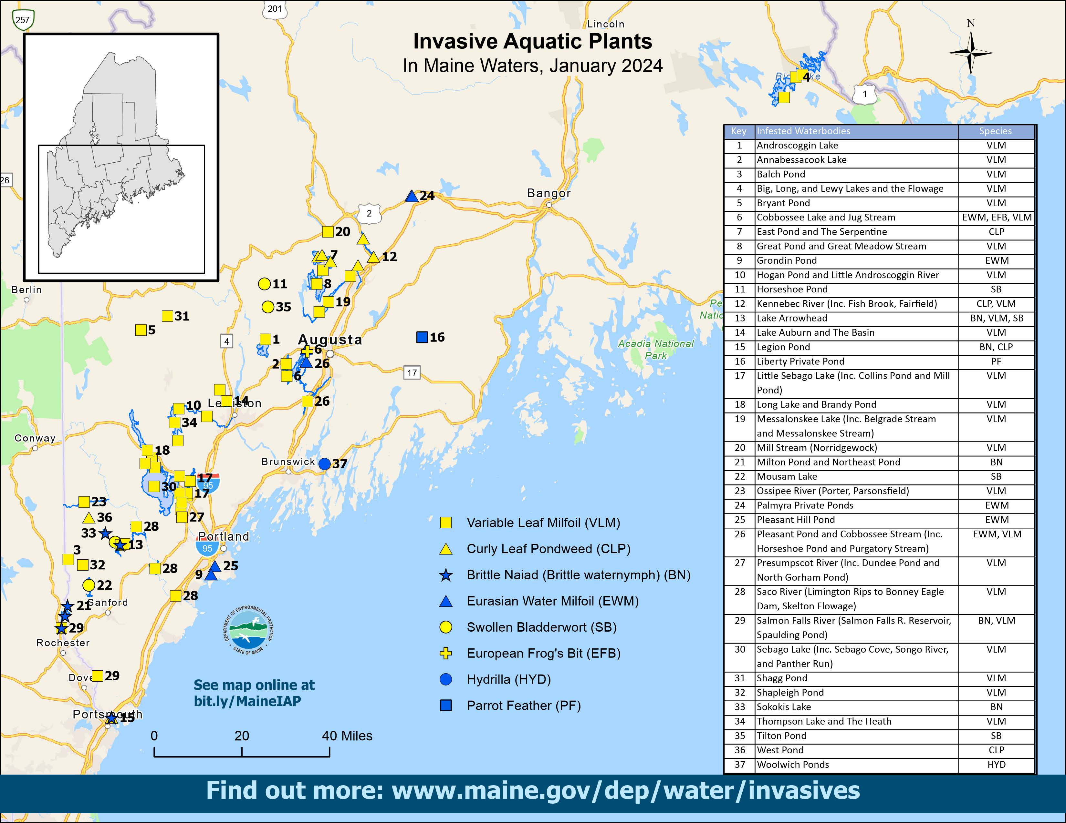
Notes:
Pay particular attention to “bad” infestations. Lake Arrowhead is especially bad

Slide 6
Notes:
New invasive plant added to the list. Swollen bladderwort

Slide 7
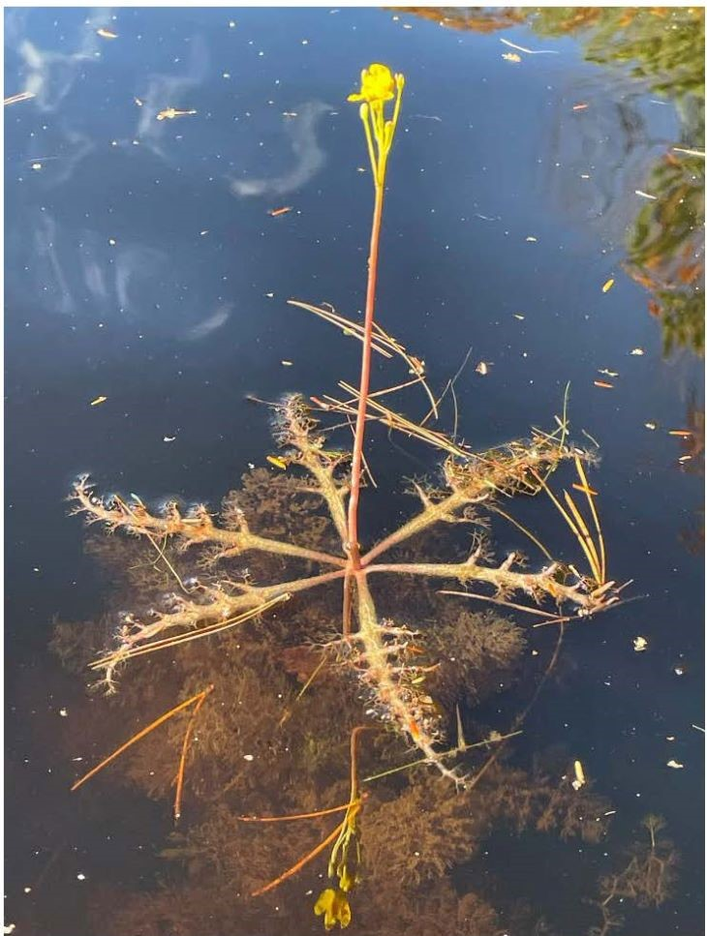
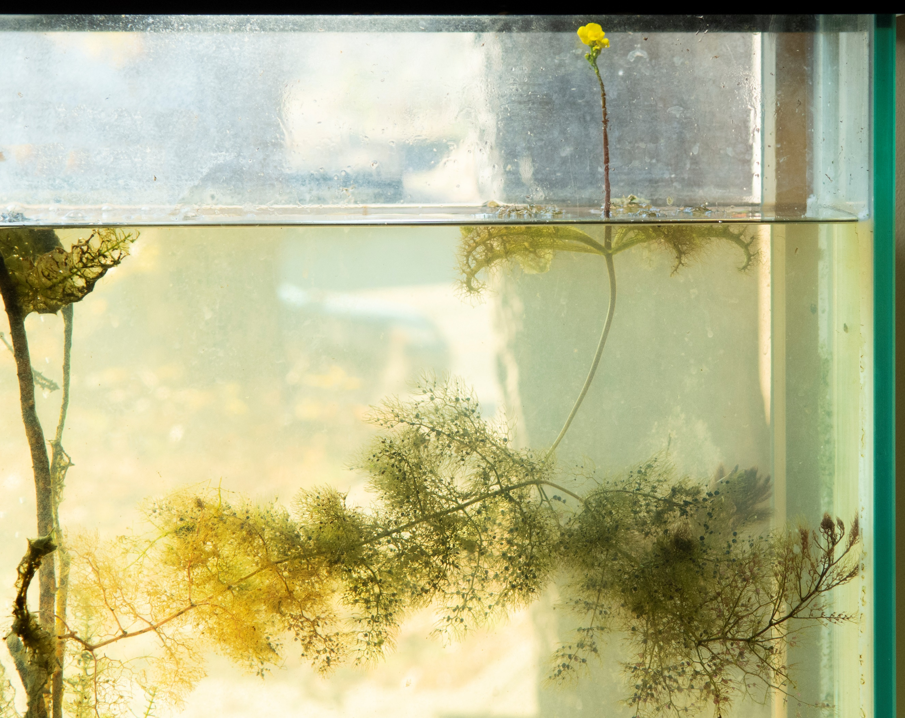
Swollen Bladderwort
Notes:
January 2021 Map - Notable recent (new) infestations:
Kennebec River, 2019 (#11): not 1 but 2 invasive plants- Variable water-milfoil and curly-leaf pondweed. Surveys and found upstream & downstream of Hinckley ramp
Cobbossee Lake 2018 & 2020 November (#5): Eurasian water-milfoil and European Frog’s-bit – EWM treated herb. Discovered in same area (northern end at Lakeside Cabins, in November 2020
New 2020: Androscoggin, VLM , September, north of Wayne ramp. Scattered; removed October; complete survey planned in 2021
Arrowhead (#12)– heavy infestation VLM. August 2020 Brittle Naiad – very different from VLM. Problematic b/c breaks apart easily and floats taking tiny seeds with it.
Rapid response and long term management:
Pickerel Pd (hydrilla), Salmon Lake (Eurasian water milfoil), Middle Range (variable water milfoil): all removed from the infested list.
Recent rapid response: Cobbossee EWM and Milton Three Ponds (Brittle naiad)
Meaningful gains in mechanical removal projects run by lake associations.
Considering cases where limited herbicides warranted to knock back populations.

Slide 8
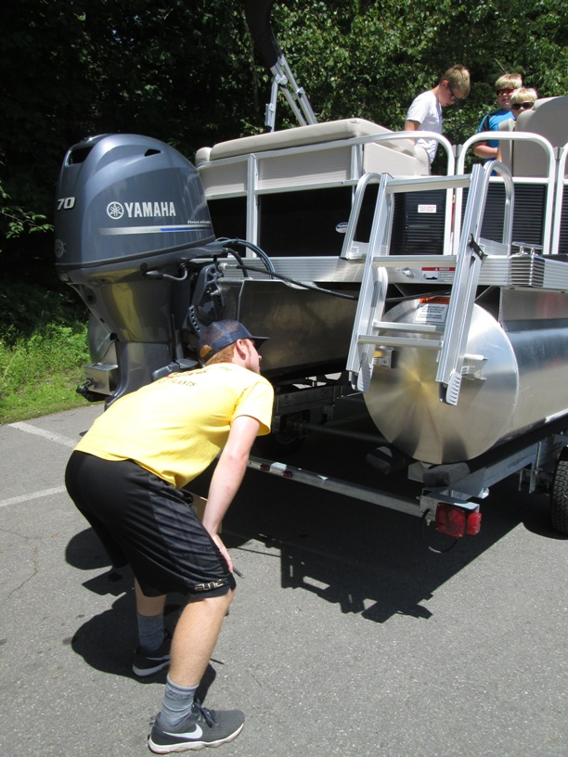
What makes a good inspection?
Be courteous
Be informative but not overwhelming.
Do a thorough inspection:
  Inspectors will need to crouch down in order to see the entire underside of the boat - just the prop is not enough!
  Ask if you can look inside boat – did they drop anchor?
  Is the drain plug pulled?
Stickerless motorized boats: tell boater about penalty and where to get stickers locally.
  Can be bought online – link in the handbook
Boater refuses inspection: politely ask them to do it and step aside
CBI Handbook pages 3-9

Slide 9
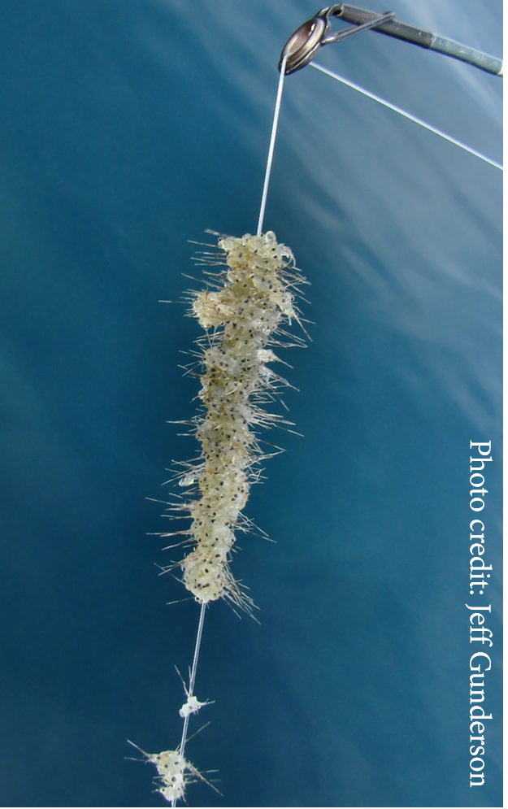
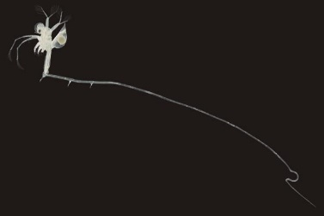
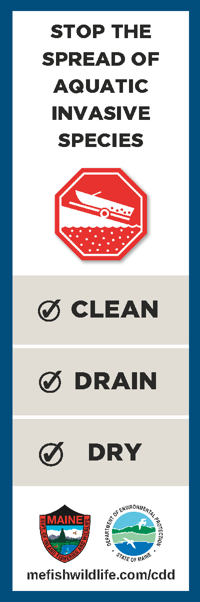
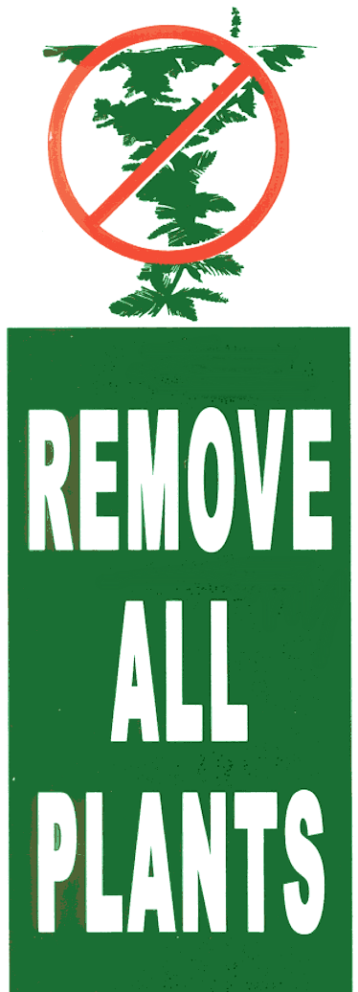
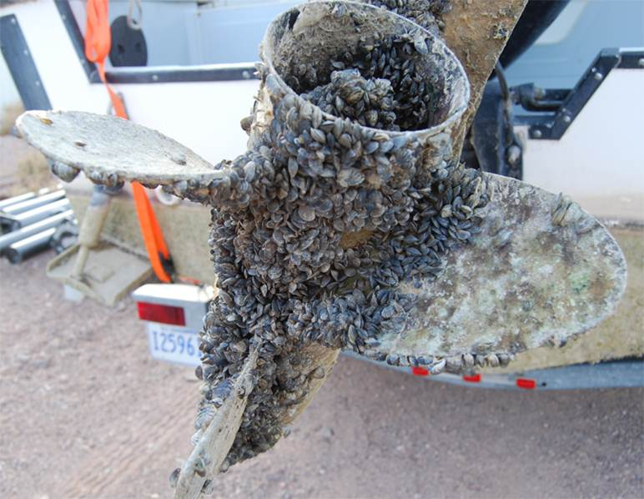
Clean, Drain, Dry
CBI Handbook pages 12-15
Notes:
When the program first started the focus was on removing plants, as the milfoil law states. In recent years we have started focusing on also draining and drying boats, to reduce the risk of small bodied organisms, like spiny water flea, fishhook flea, and zebra mussels (pictured).

Slide 10
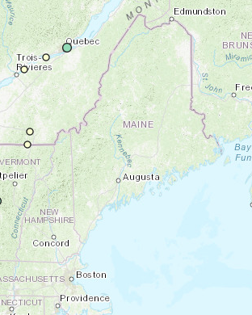
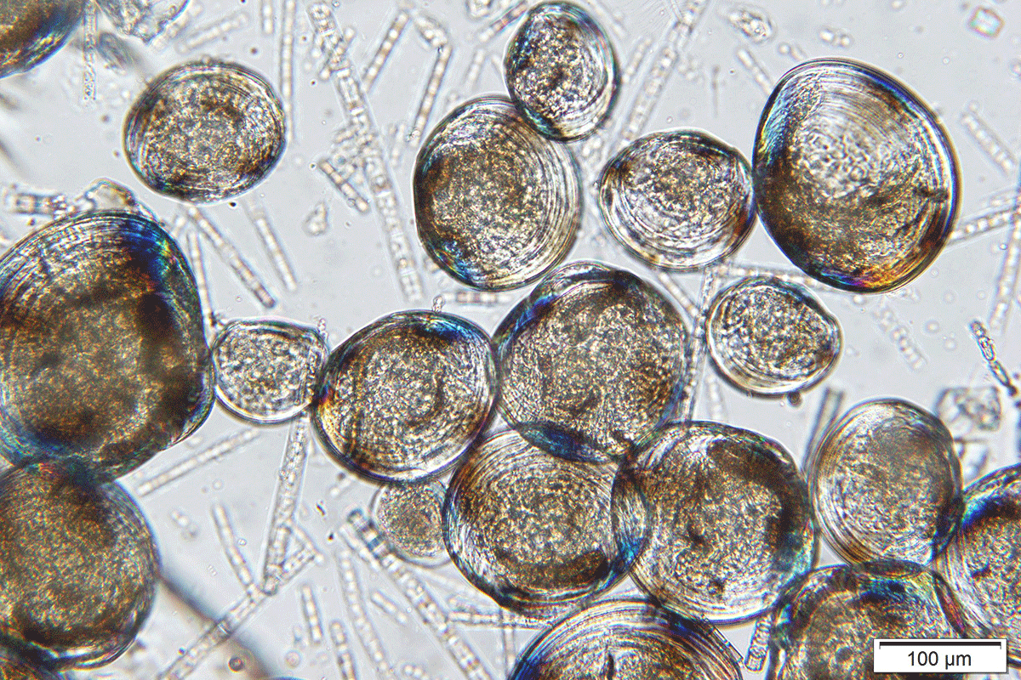
Zebra Mussels
Zebra mussels
Photo: Marc Murrell
Spiny water flea
A rod and reel submerged for one month in an infested Kansas lake
Notes:
Zebra mussels have been found just over the border in Canada, and are in many other states. They are native to Eurasia. These mussels grow tightly together and can clog pipes and cover surfaces, like boats, beaches etc. Their larvae, called veligers (last photo) are microscopic and can survive in standing water for long periods of time. This is why it is so important to drain water from boats. Spiny water flea has been found in Lake Winnipesaukee

Slide 11
Graphic: Aquatic Nuisance Species Task Force
Notes:
Any part of a boat, trailer, anchor, fishing gear, etc should be looked at

Slide 12
Graphic: Aquatic Nuisance Species Task Force
Notes:
Bass fishing boats can have additional places to inspect, like live wells, trolling motors, and power poles

Slide 13
Graphic: Aquatic Nuisance Species Task Force
Notes:
We do inspect non motorized boats

Slide 14
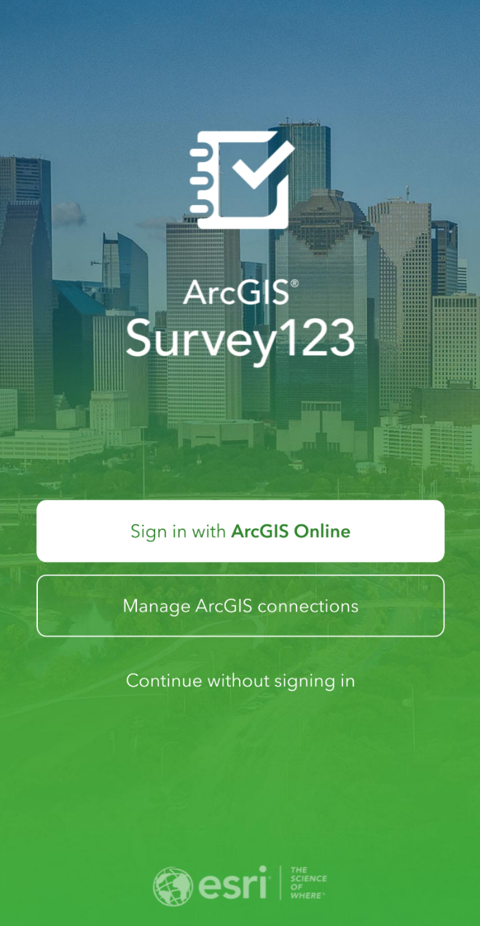
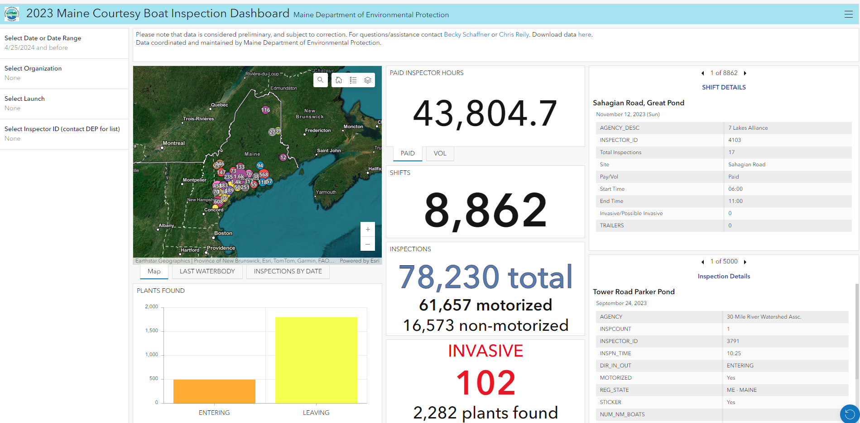
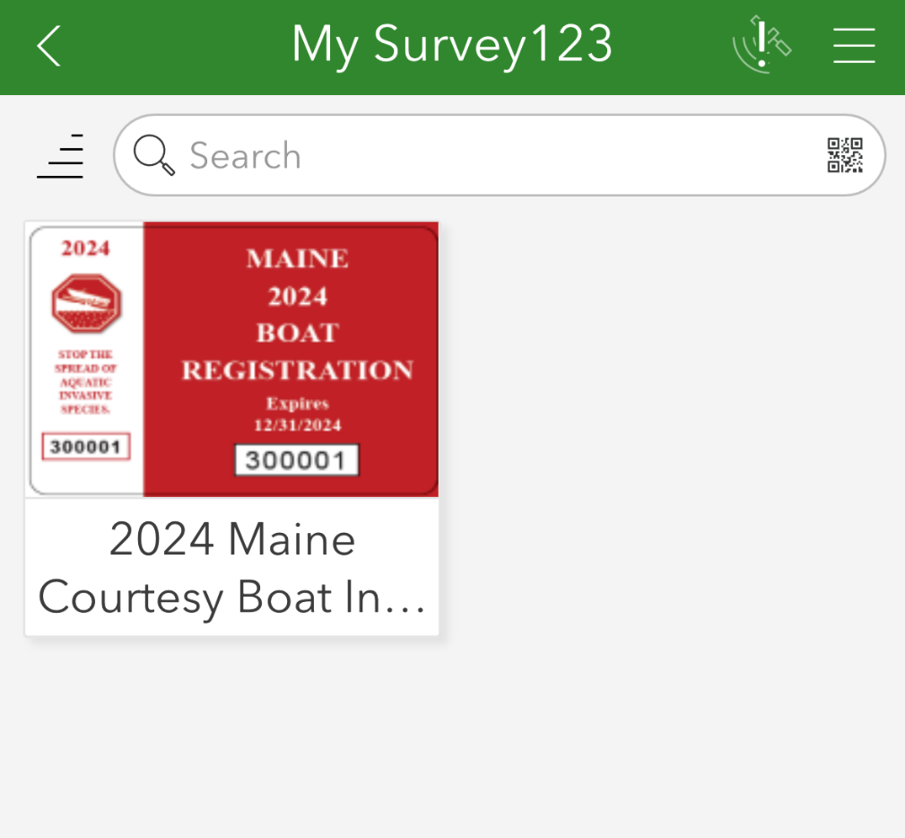
Data Collection App
CBI App Training
Wednesday, May 22nd at 6pm

Slide 15
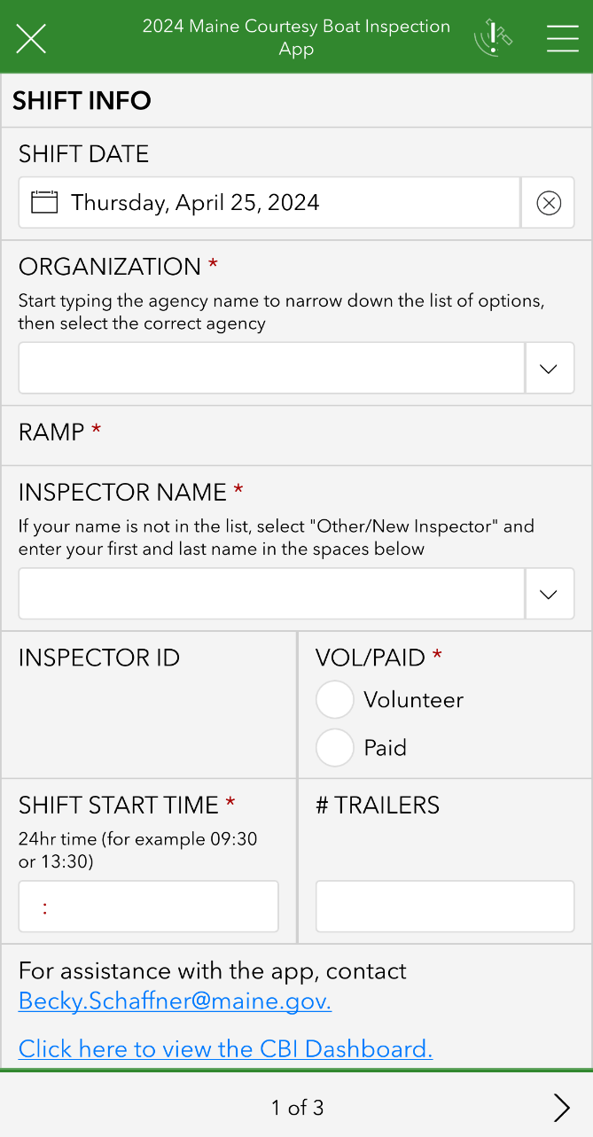
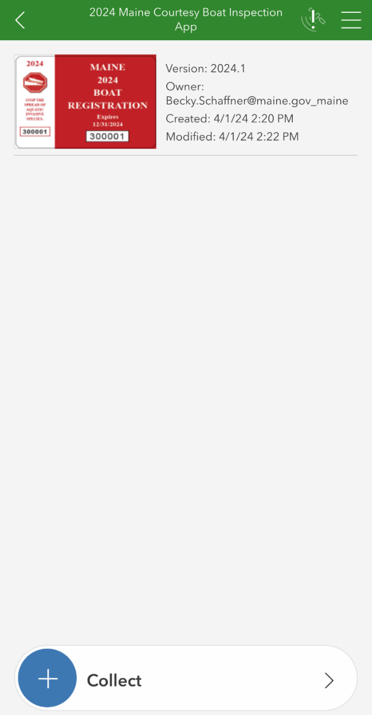
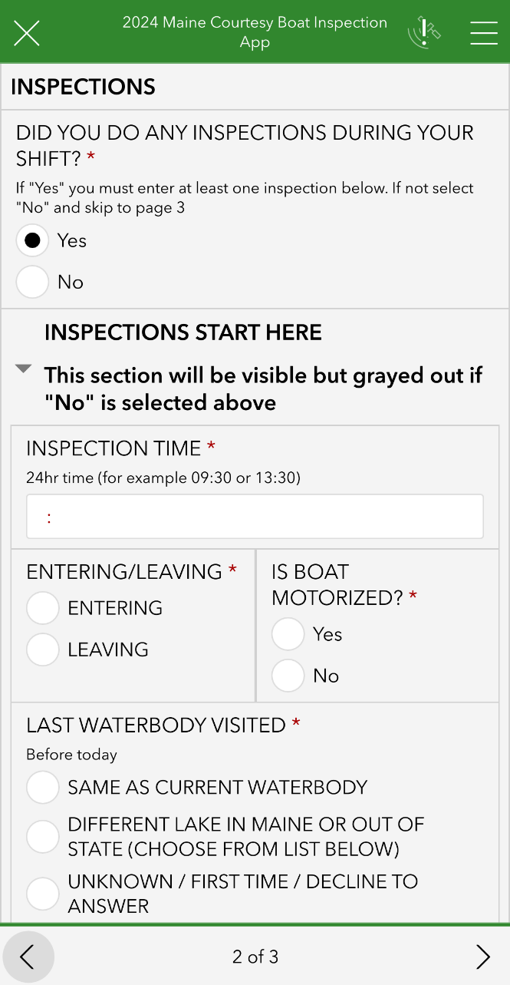
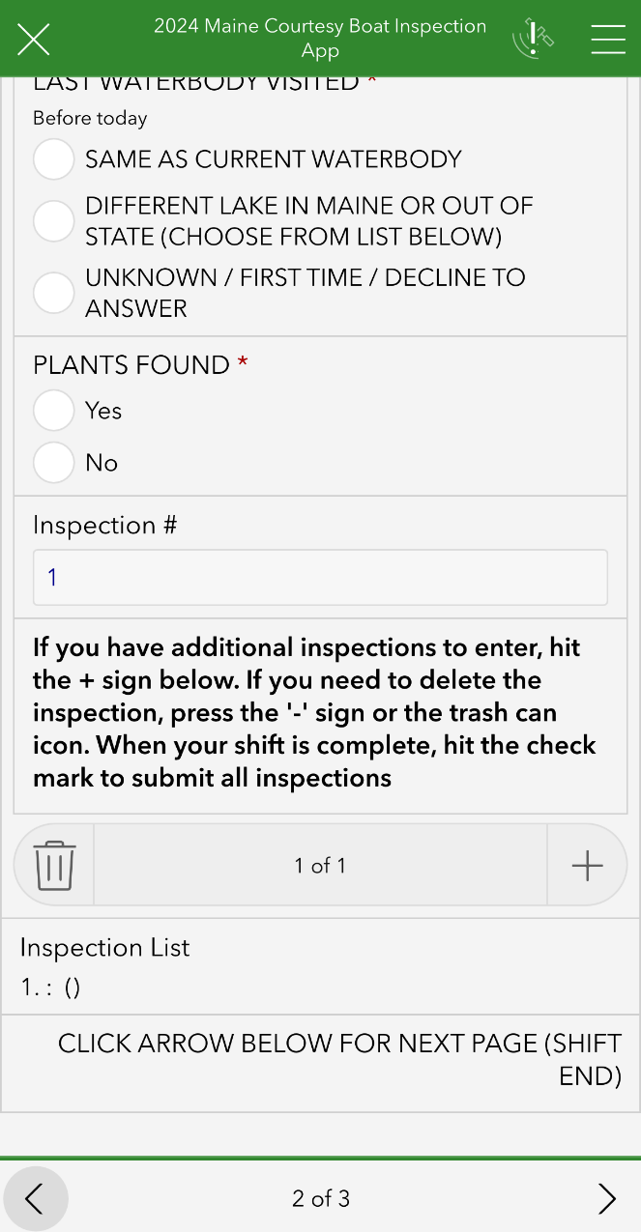

Slide 16
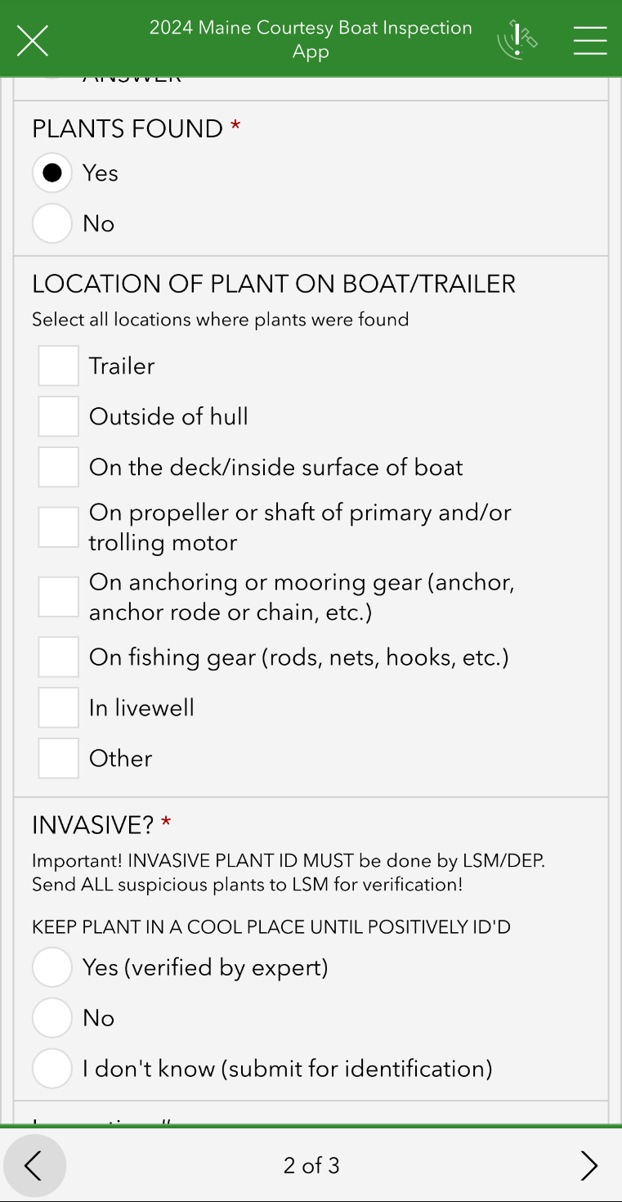
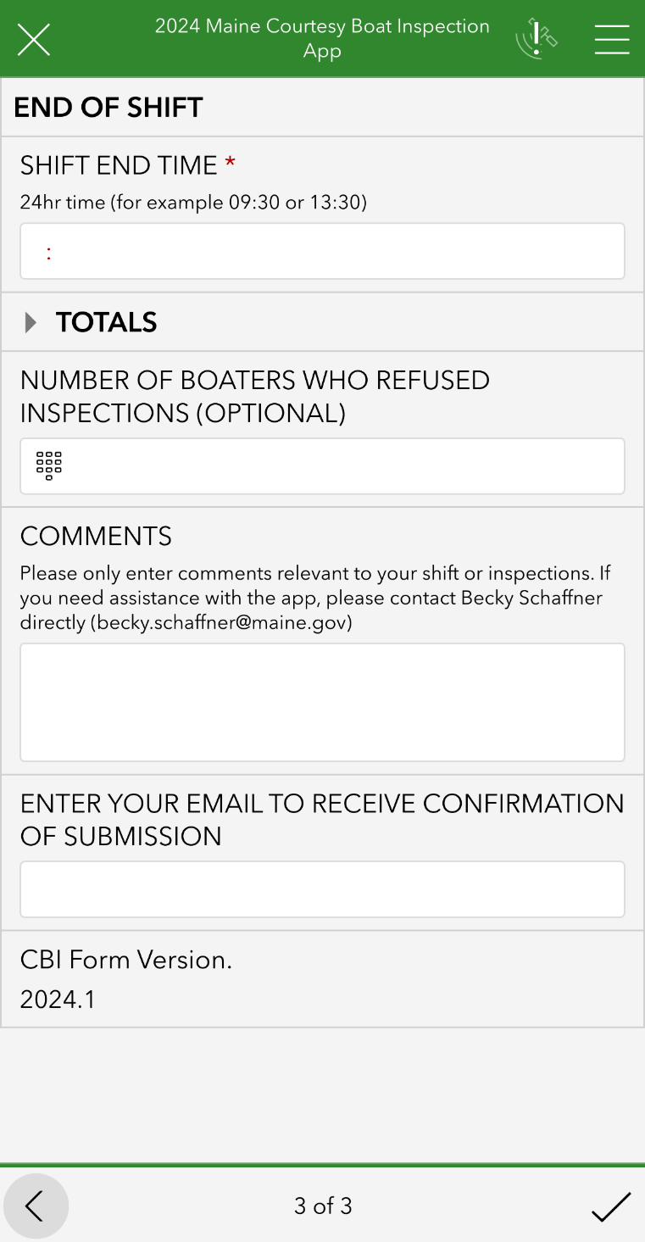

Slide 17
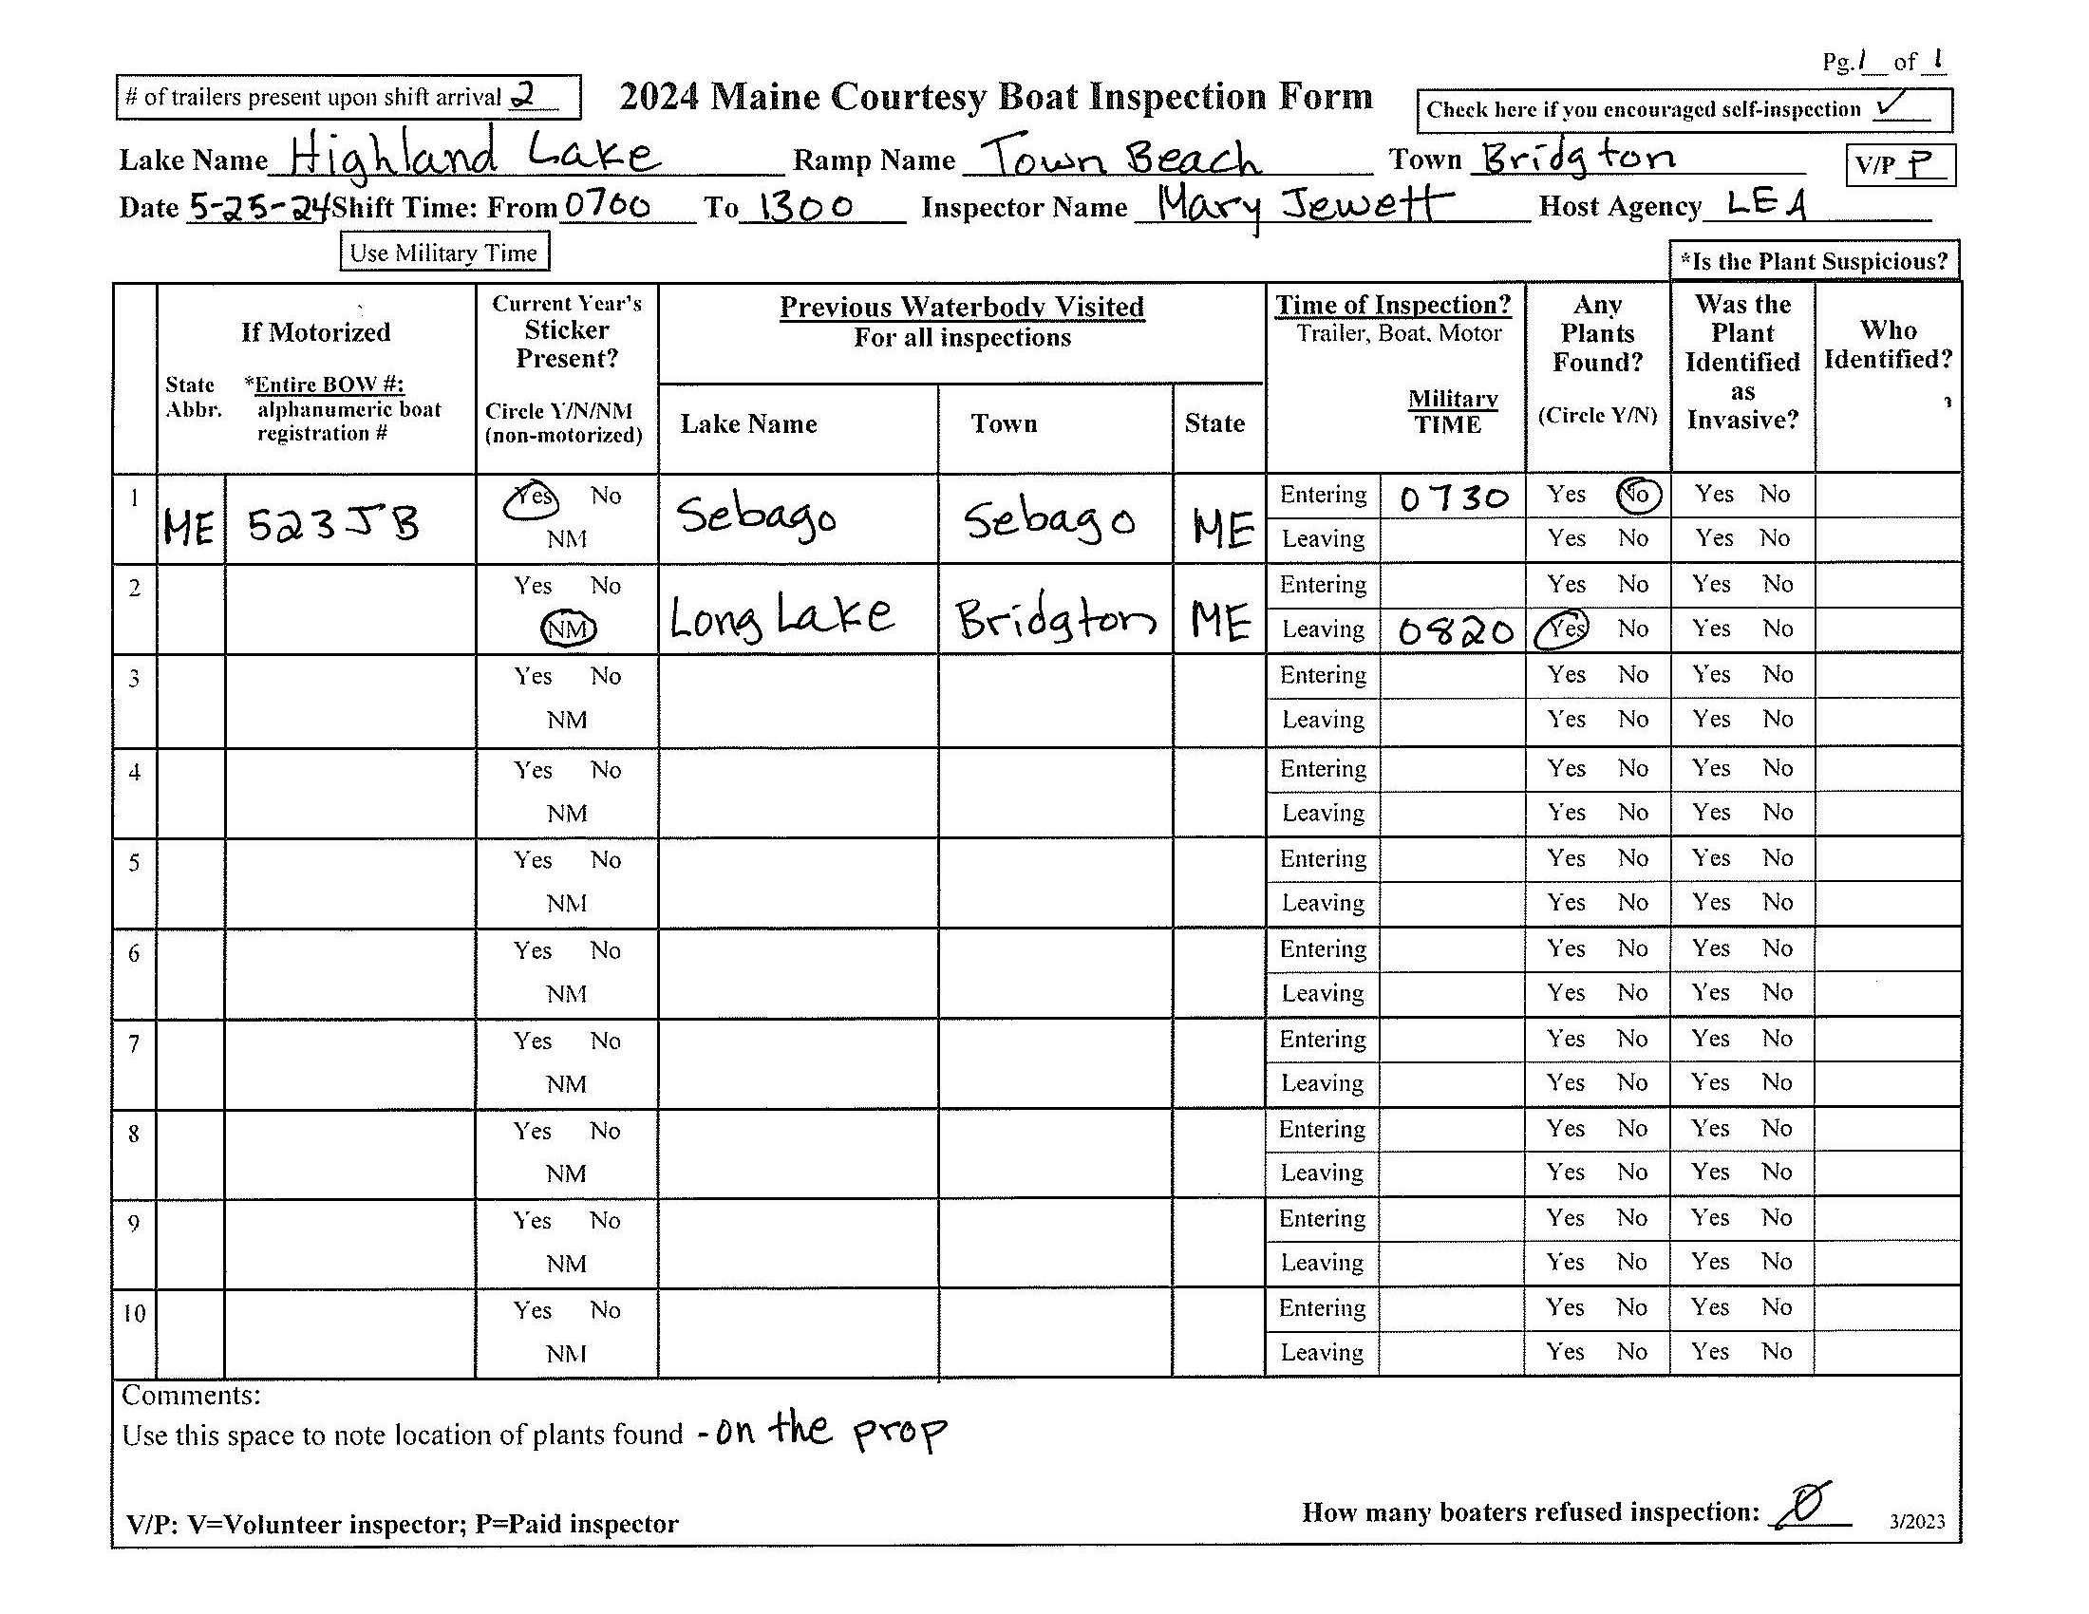
Inspection form

Slide 18
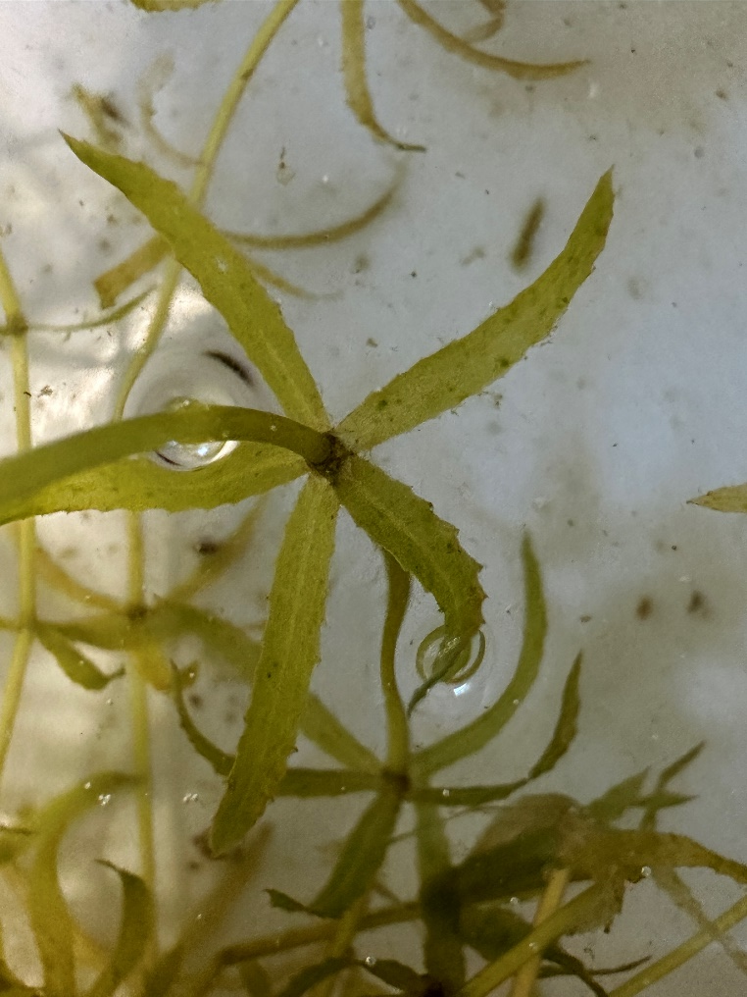
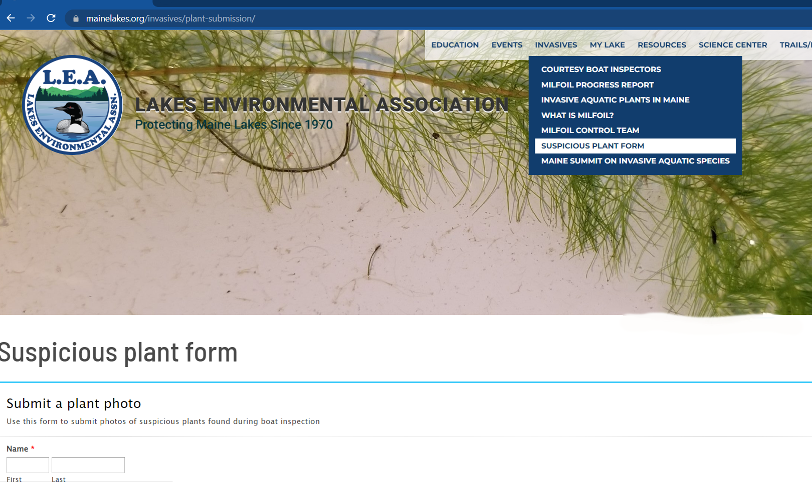
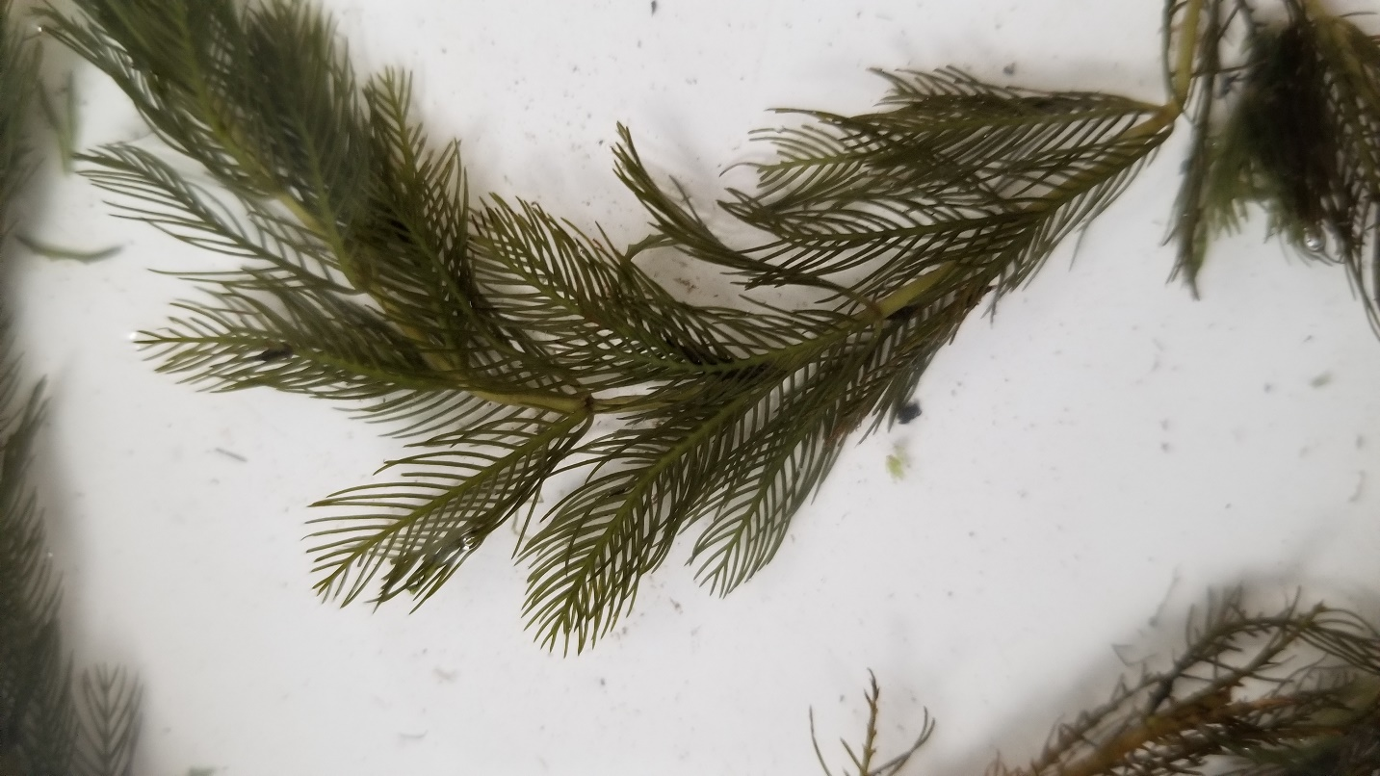

Suspicious Plant Found
Inspector decides if it’s suspicious
Gives plant sample to coordinator
If coordinator can’t ID – send photo to LEA
Go to photo submission page on LEA website
Keep sample in fridge

Slide 19
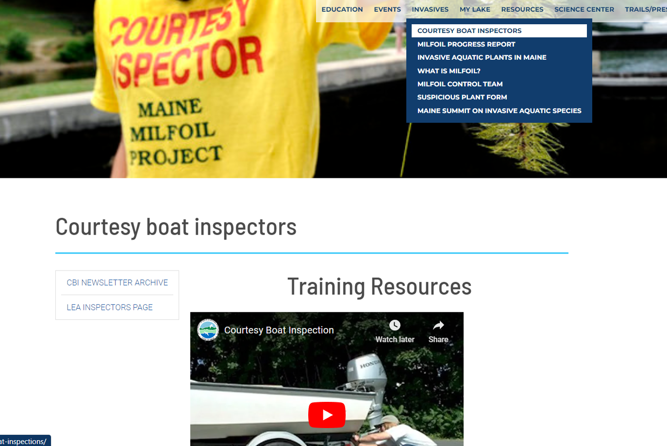

Slide 20


Courtesy Boat Inspector
Coordinator Training
If you have additional questions, feel free to contact us via email.
Mary Jewett – mary@mainelakes.org
Chris Reily – Chris.Reily@Maine.gov

