Slide 1
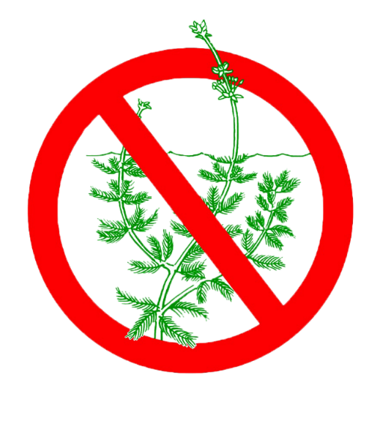
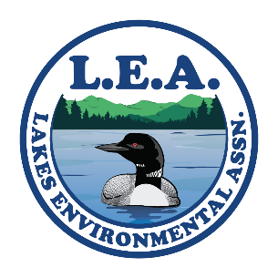

Courtesy Boat Inspector
Coordinator Training
Mary Jewett – Lakes Environmental Association
Chris Reily- Maine Department of Environmental Protection

Slide 2
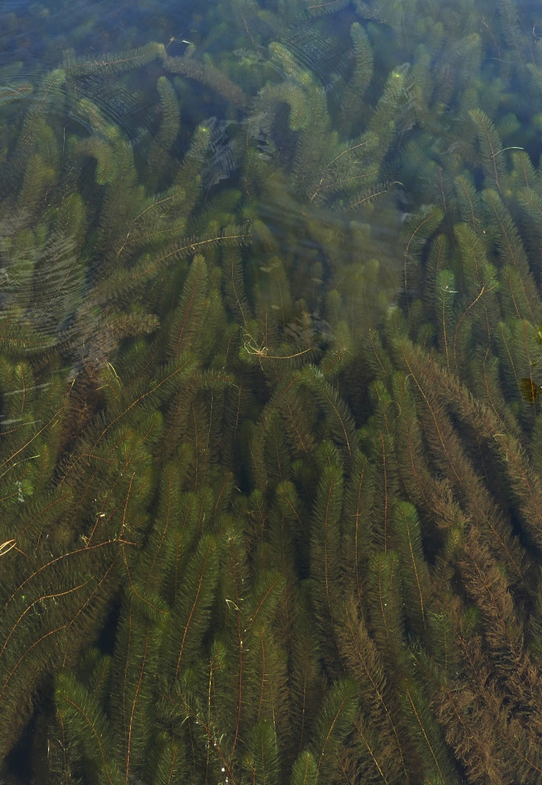
Why are invasive aquatic plants (IAS) a threat to lakes, ponds, rivers and streams?
IAS have multiple reproductive strategies & no natural enemies; grow vigorously; out-compete natives.
Blanket lake surface, impeding recreational uses; lower property values; change ecology
Can rarely be eradicated; are expensive to manage (an “everafter” cost); threaten all other fresh waters.
CBI Handbook page 1
Notes:
It is very important for all inspector to have a basic knowledge of the impact invasives have on a lake ecosystem.

Slide 3
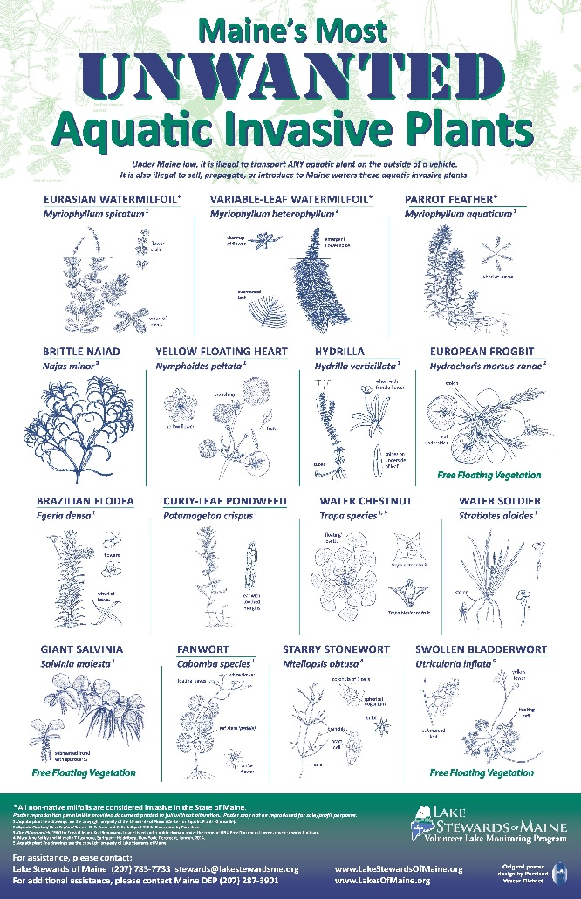
Maine AIS Law
MRS Title 38 Subsection 419-c
Prohibition.
A person may not:
Transport any aquatic plant or plant part on the outside of any vessel on a public road
Posses, import, cultivate, transport, or distribute any invasive plant (15 on list)
Drain or release water into any inland water source
Draining of watercraft and equipment.
Just prior to launching and when removing a watercraft a person:
Shall remove or open any hull drain plugs, bailers, valves, live wells, ballast tanks, and other devices designed for routine removal or opening and closing to encourage water to drain

Slide 4
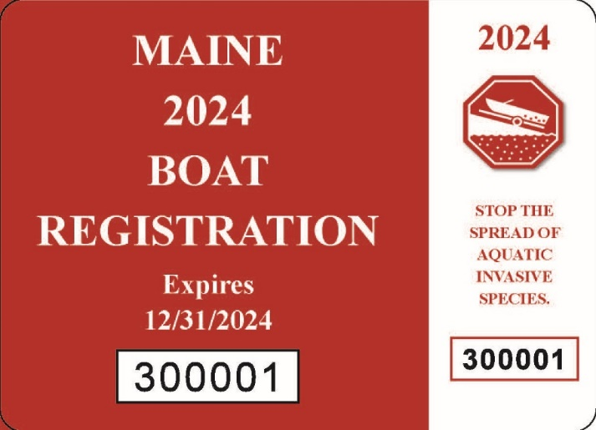
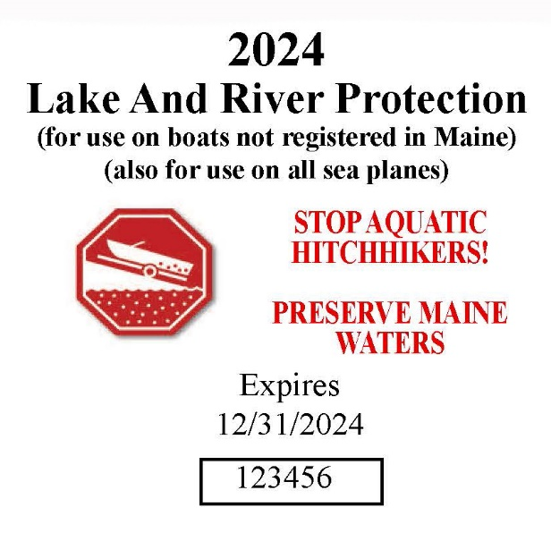
Maine AIS Law
Penalties.
Violations may result in fines up to $500, and $2500 for subsequent violations. This includes fines for failure to display the current years Lake and River Protection Sticker.
Funding.
Funding Mechanism: Sticker revenue goes into dedicated state fund, 70% to DEP, 30% to DIFW, Funds are used for plant removal, early detection, and invasives prevention
CBI Handbook page 1
Notes:
Inspectors should be aware of the penalties so they can share that information with boaters. Reluctant boaters may be more inclined to welcome inspection and self-inspect if they know the law.

Slide 5
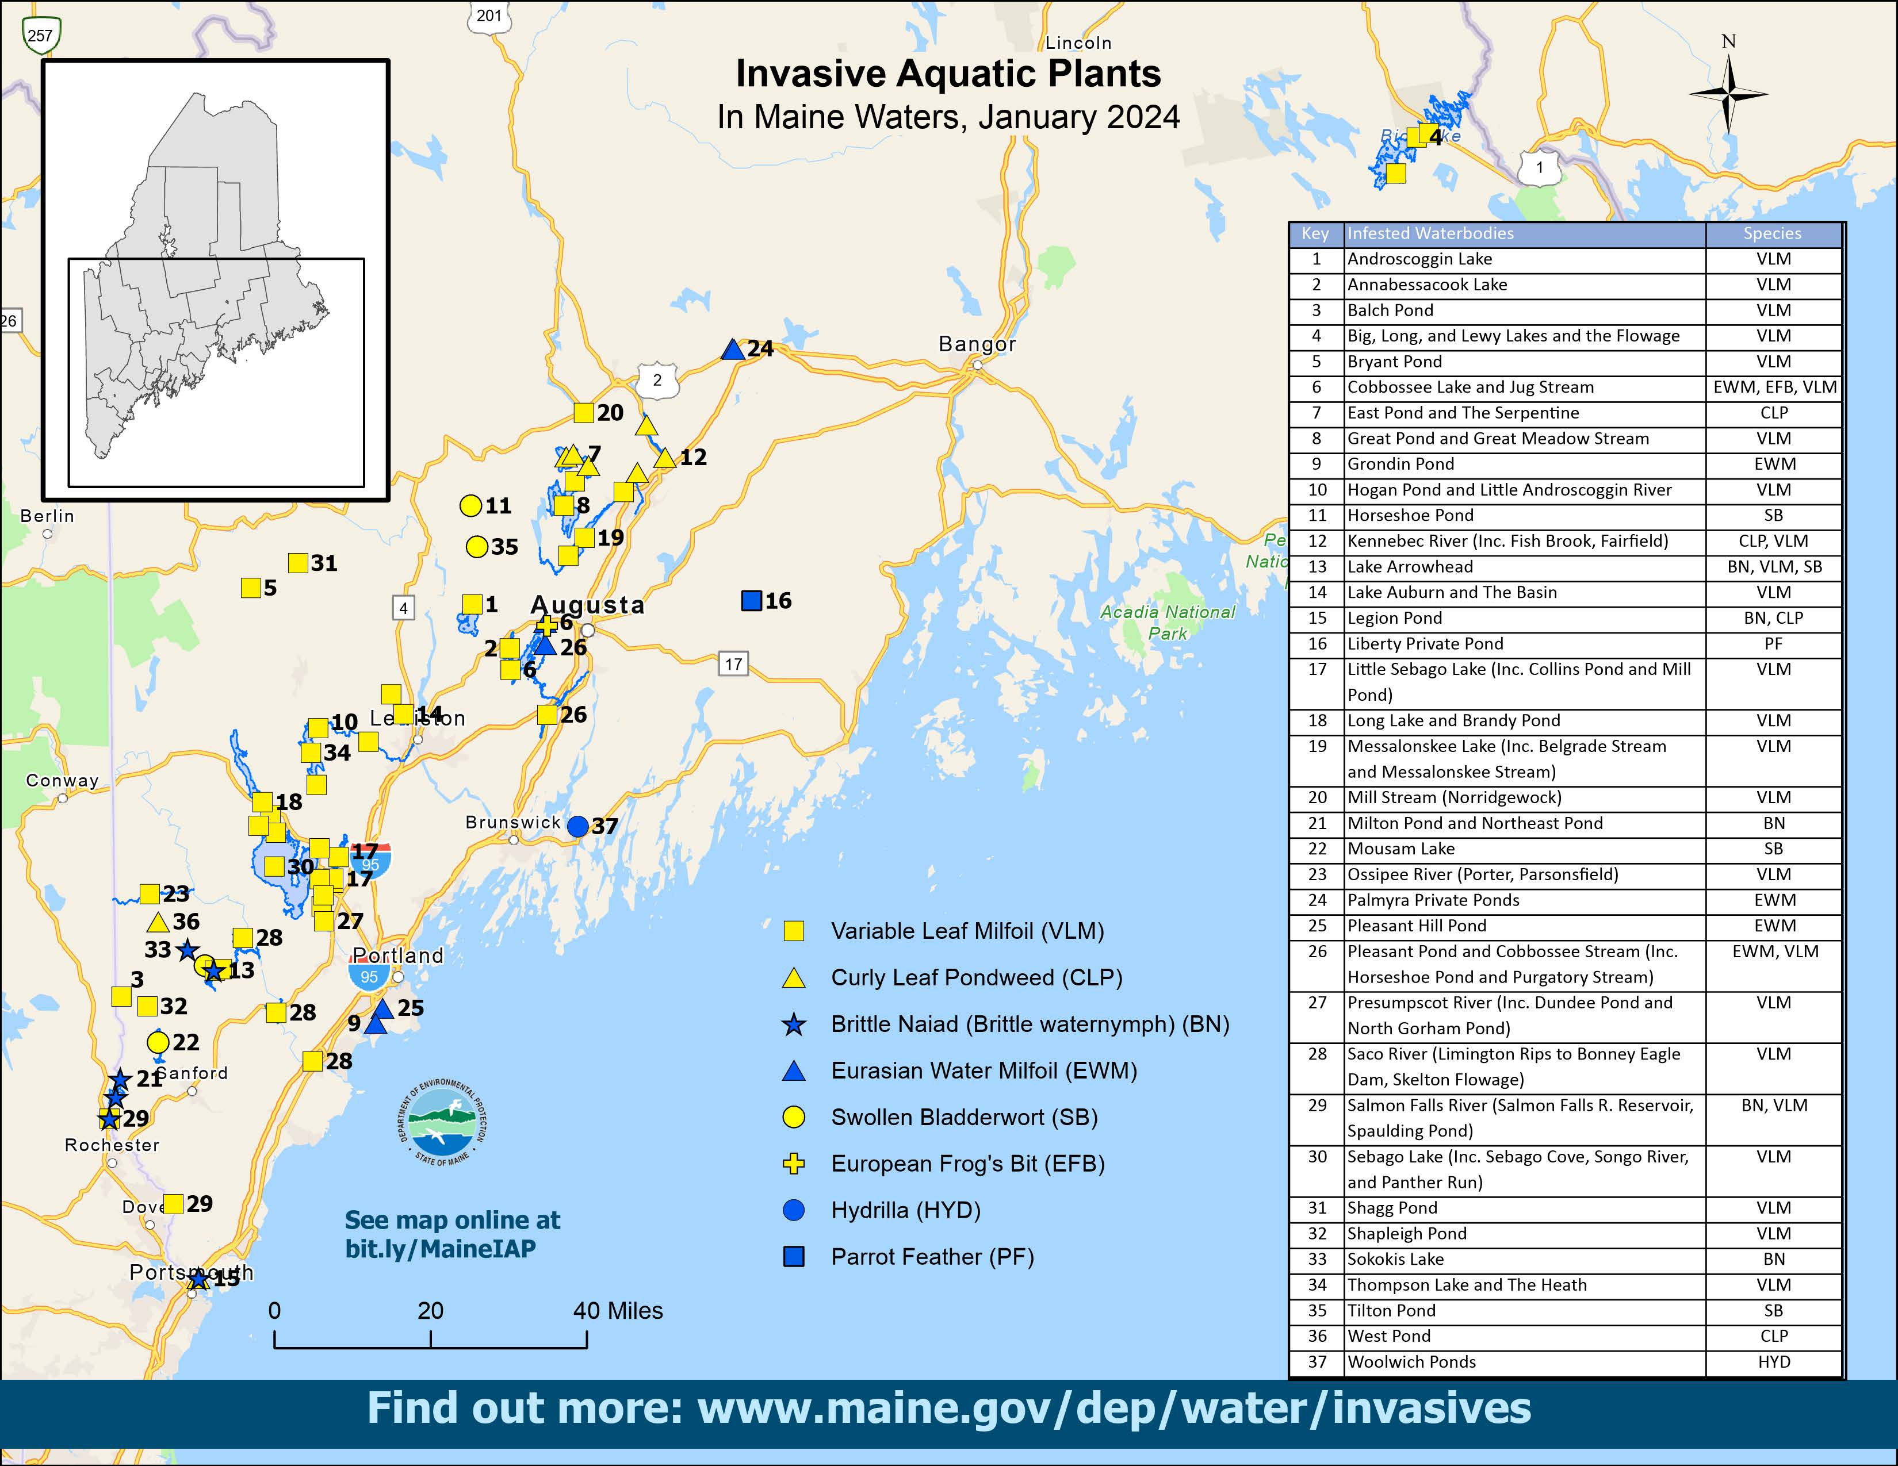
Notes:
January 2021 Map - Notable recent (new) infestations:
Kennebec River, 2019 (#11): not 1 but 2 invasive plants- Variable water-milfoil and curly-leaf pondweed. Surveys and found upstream & downstream of Hinckley ramp
Cobbossee Lake 2018 & 2020 November (#5): Eurasian water-milfoil and European Frog’s-bit – EWM treated herb. Discovered in same area (northern end at Lakeside Cabins, in November 2020
New 2020: Androscoggin, VLM , September, north of Wayne ramp. Scattered; removed October; complete survey planned in 2021
Arrowhead (#12)– heavy infestation VLM. August 2020 Brittle Naiad – very different from VLM. Problematic b/c breaks apart easily and floats taking tiny seeds with it.
Rapid response and long term management:
Pickerel Pd (hydrilla), Salmon Lake (Eurasian water milfoil), Middle Range (variable water milfoil): all removed from the infested list.
Recent rapid response: Cobbossee EWM and Milton Three Ponds (Brittle naiad)
Meaningful gains in mechanical removal projects run by lake associations.
Considering cases where limited herbicides warranted to knock back populations.

Slide 6
Notes:
January 2021 Map - Notable recent (new) infestations:
Kennebec River, 2019 (#11): not 1 but 2 invasive plants- Variable water-milfoil and curly-leaf pondweed. Surveys and found upstream & downstream of Hinckley ramp
Cobbossee Lake 2018 & 2020 November (#5): Eurasian water-milfoil and European Frog’s-bit – EWM treated herb. Discovered in same area (northern end at Lakeside Cabins, in November 2020
New 2020: Androscoggin, VLM , September, north of Wayne ramp. Scattered; removed October; complete survey planned in 2021
Arrowhead (#12)– heavy infestation VLM. August 2020 Brittle Naiad – very different from VLM. Problematic b/c breaks apart easily and floats taking tiny seeds with it.
Rapid response and long term management:
Pickerel Pd (hydrilla), Salmon Lake (Eurasian water milfoil), Middle Range (variable water milfoil): all removed from the infested list.
Recent rapid response: Cobbossee EWM and Milton Three Ponds (Brittle naiad)
Meaningful gains in mechanical removal projects run by lake associations.
Considering cases where limited herbicides warranted to knock back populations.

Slide 7
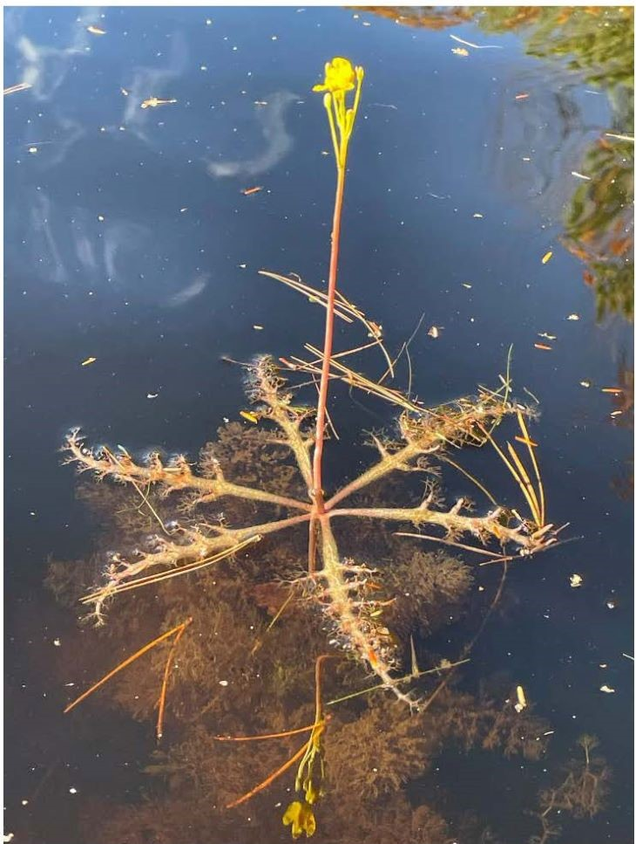
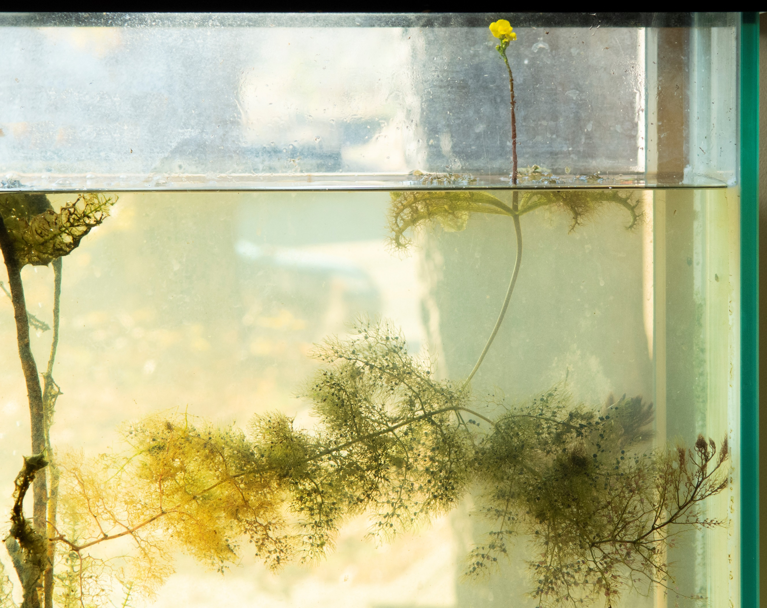
Swollen Bladderwort
Notes:
January 2021 Map - Notable recent (new) infestations:
Kennebec River, 2019 (#11): not 1 but 2 invasive plants- Variable water-milfoil and curly-leaf pondweed. Surveys and found upstream & downstream of Hinckley ramp
Cobbossee Lake 2018 & 2020 November (#5): Eurasian water-milfoil and European Frog’s-bit – EWM treated herb. Discovered in same area (northern end at Lakeside Cabins, in November 2020
New 2020: Androscoggin, VLM , September, north of Wayne ramp. Scattered; removed October; complete survey planned in 2021
Arrowhead (#12)– heavy infestation VLM. August 2020 Brittle Naiad – very different from VLM. Problematic b/c breaks apart easily and floats taking tiny seeds with it.
Rapid response and long term management:
Pickerel Pd (hydrilla), Salmon Lake (Eurasian water milfoil), Middle Range (variable water milfoil): all removed from the infested list.
Recent rapid response: Cobbossee EWM and Milton Three Ponds (Brittle naiad)
Meaningful gains in mechanical removal projects run by lake associations.
Considering cases where limited herbicides warranted to knock back populations.

Slide 8
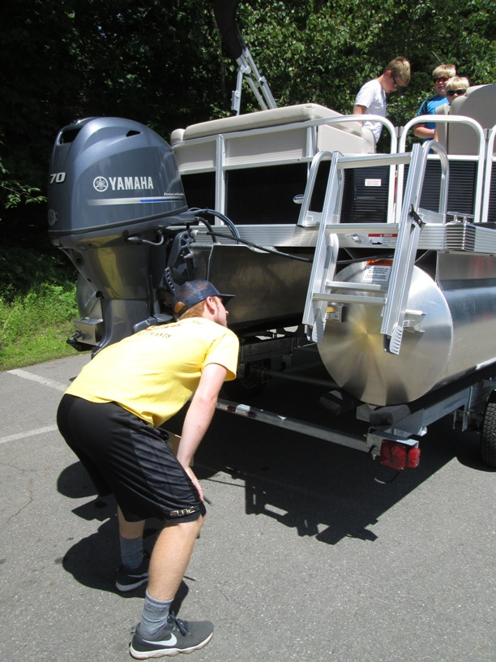
What makes a good inspection?
Be courteous
Be informative but not overwhelming.
Do a thorough inspection:
  Inspectors will need to crouch down in order to see the entire underside of the boat - just the prop is not enough!
  Ask if you can look inside boat – did they drop anchor?
  Is the drain plug pulled?
Stickerless motorized boats: tell boater about penalty and where to get stickers locally.
  Can be bought online – link in the handbook
Boater refuses inspection: politely ask them to do it and step aside
CBI Handbook pages 3-9

Slide 9
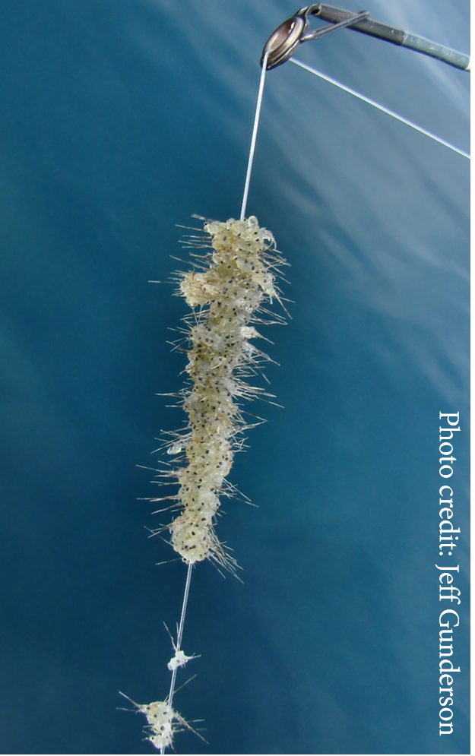
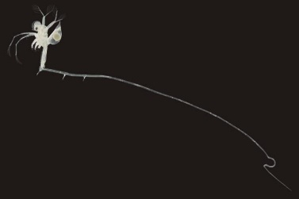
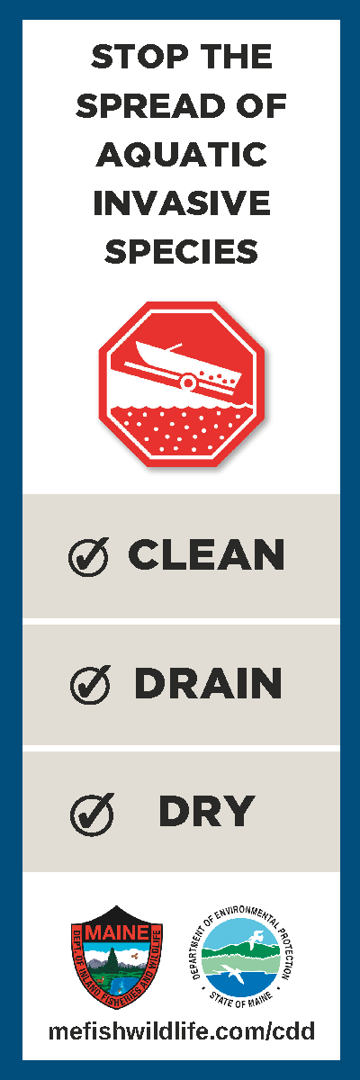
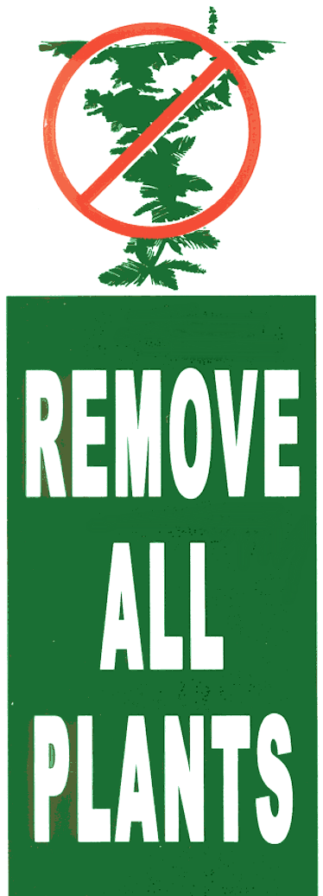
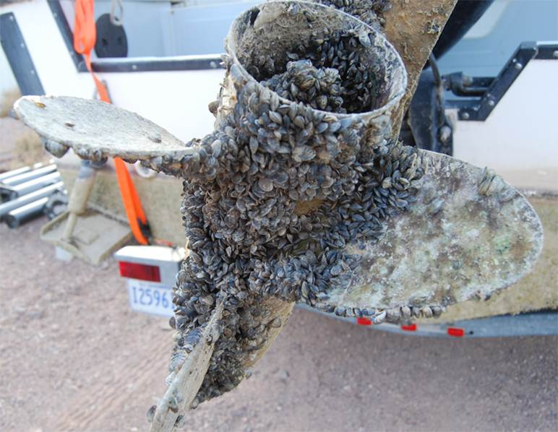
Clean, Drain, Dry
CBI Handbook pages 12-15
Notes:
When the program first started the focus was on removing plants, as the milfoil law states. In recent years we have started focusing on also draining and drying boats, to reduce the risk of small bodied organisms, like spiny water flea, fishhook flea, and zebra mussels (pictured).

Slide 10
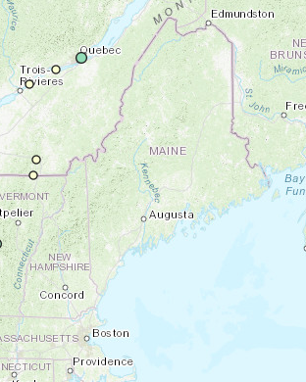
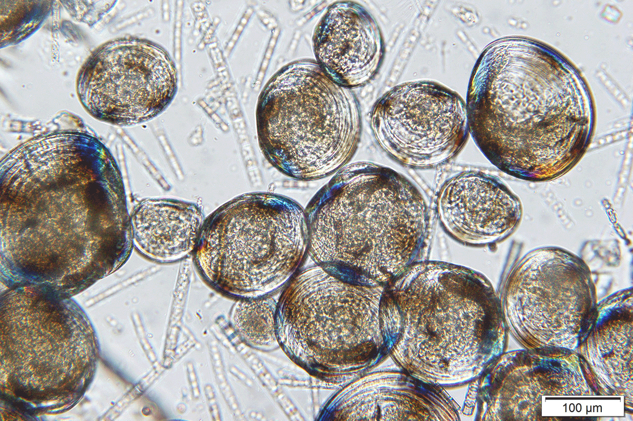
Zebra Mussels
Zebra mussels
Photo: Marc Murrell
Spiny water flea
A rod and reel submerged for one month in an infested Kansas lake
Notes:
Zebra mussels are found in many states around the country, and are thought to originate in the Great Lakes. They are native to Eurasia. These mussels grow tightly together and can clog pipes and cover surfaces, like boats, beaches etc. Their larvae, called veligers (last photo) are microscopic and can survive in standing water for long periods of time. This is why it is so important to drain water from boats.

Slide 11
Graphic: Aquatic Nuisance Species Task Force

Slide 12
Graphic: Aquatic Nuisance Species Task Force

Slide 13
Graphic: Aquatic Nuisance Species Task Force

Slide 14
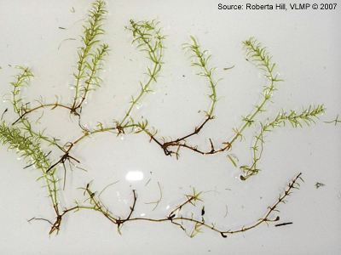
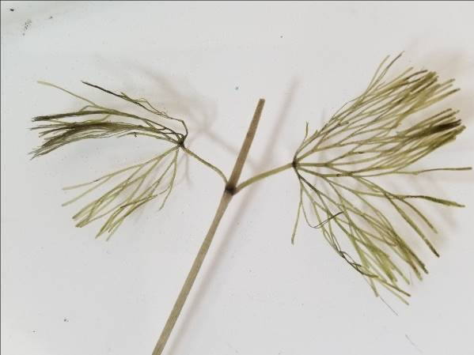
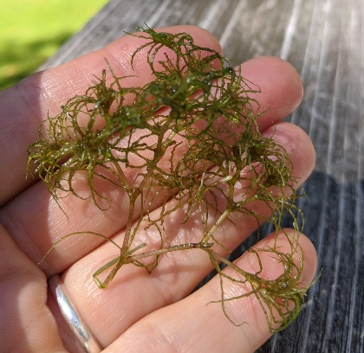
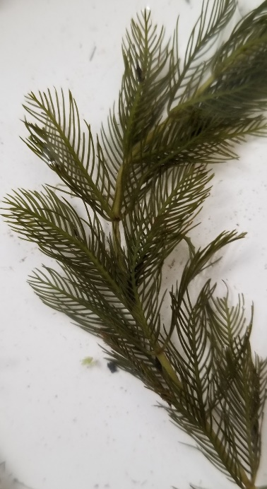
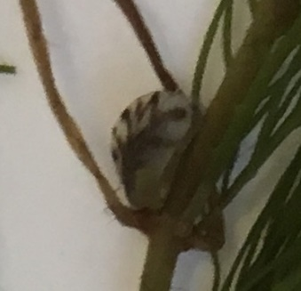
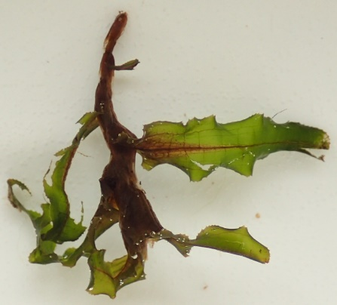
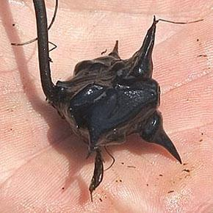
Hydrilla
“Saves”
2021
Fanwort (Long)
European Naiad
2020
Eurasian Milfoil (Kezar)
Eurasian Milfoil
2019
Hydrilla (Sebago Lake)
2018
Eurasian Milfoil + Zebra (Pennesseewassee)
2018
Eurasian Milfoil (Toddy Pond)
2016
Curly Leaf Pondweed (Salmon Lake)
2015
Eurasian Milfoil (Wilson Pond)
2014
Water Chestnut (Square Pond)
2012
Water Chestnut (Mousam)
2011
Eurasian Milfoil (Salmon Lake)
2010
Eurasian Milfoil (Salmon Lake)
2009
Zebra Mussel
Fanwort (Salmon Lake)
2006
Eurasian Milfoil (Mousam)
2005
Water Chestnut (Unity)
2004
European Naiad (Sebago)
2004
Curly-leaf pondweed (Sebago)
2001
Eurasian Milfoil from New York (Crystal)
Curly-leaf pondweed
Water Chestnut

Slide 15
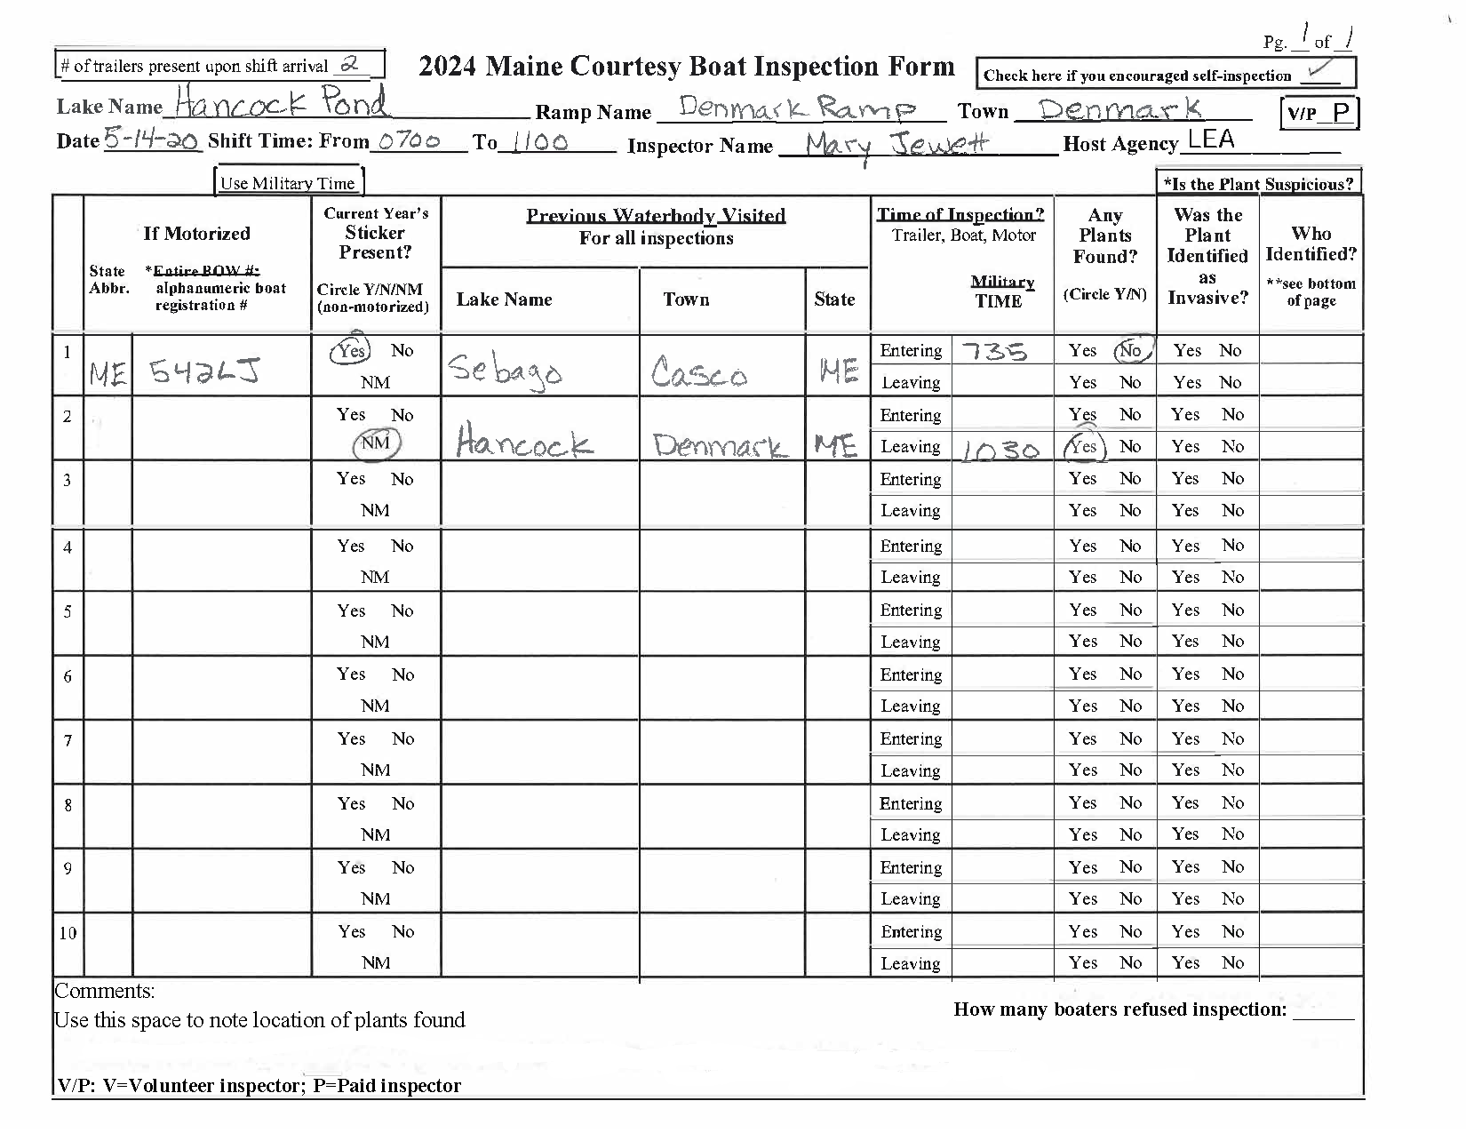
Inspection form

Slide 16
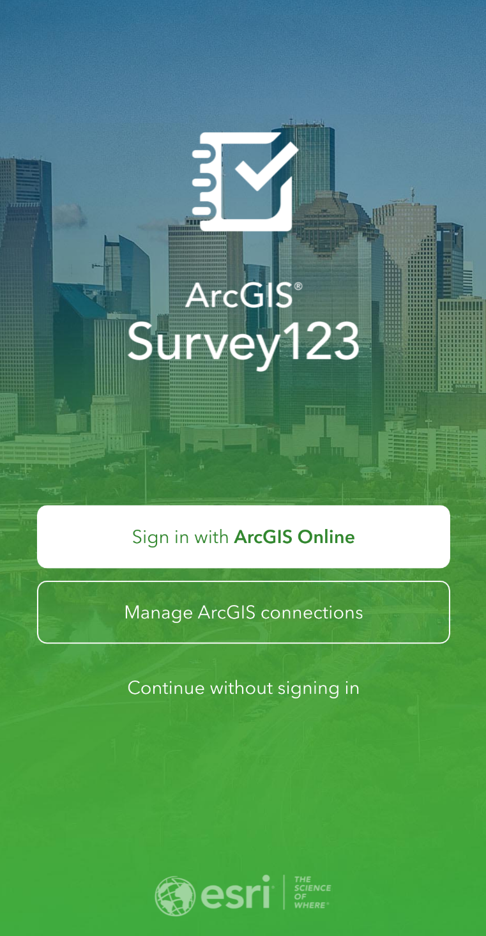
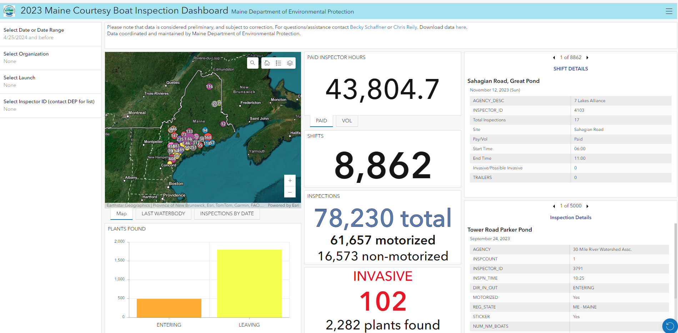
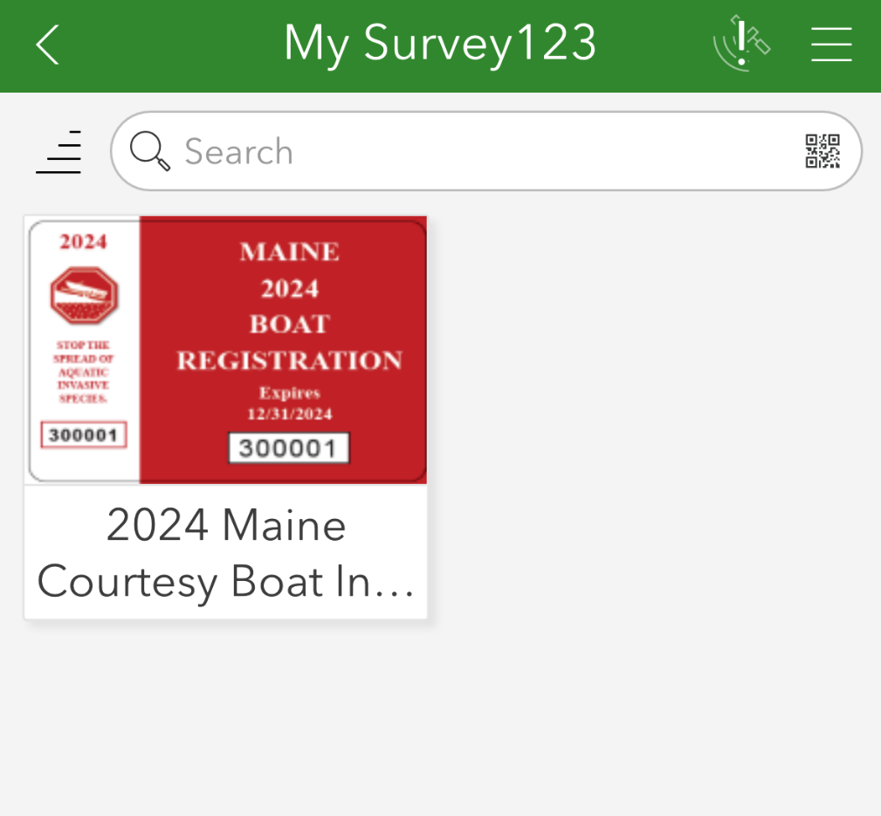
Data Collection App

Slide 17
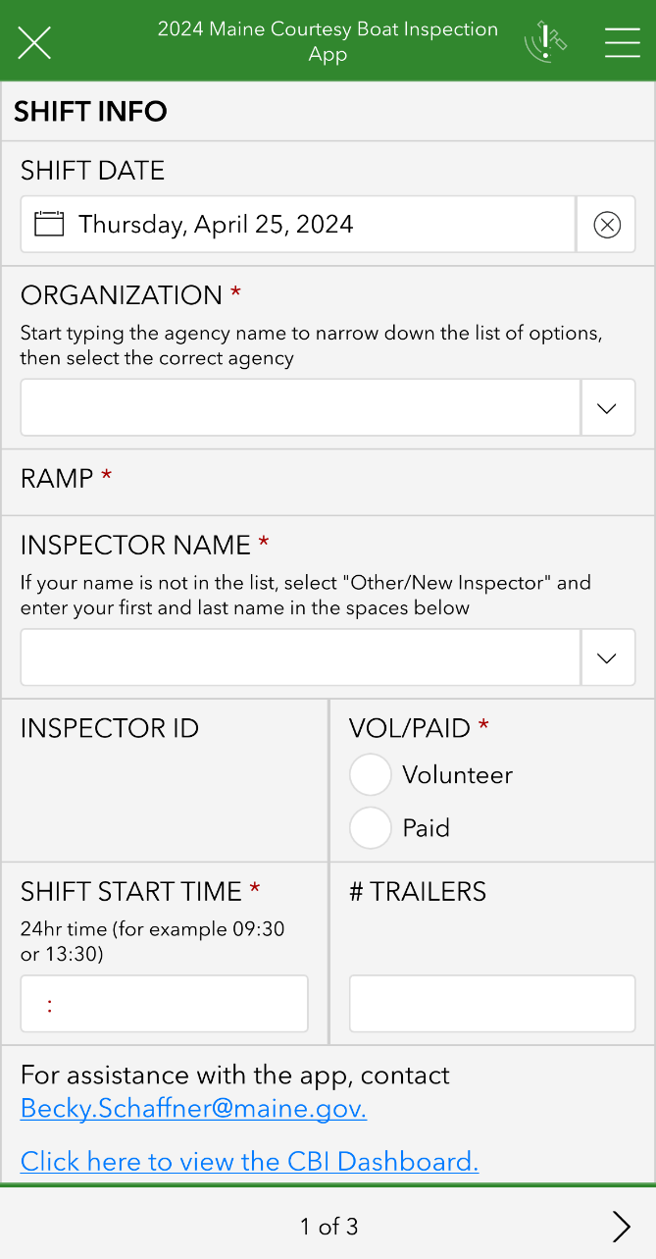
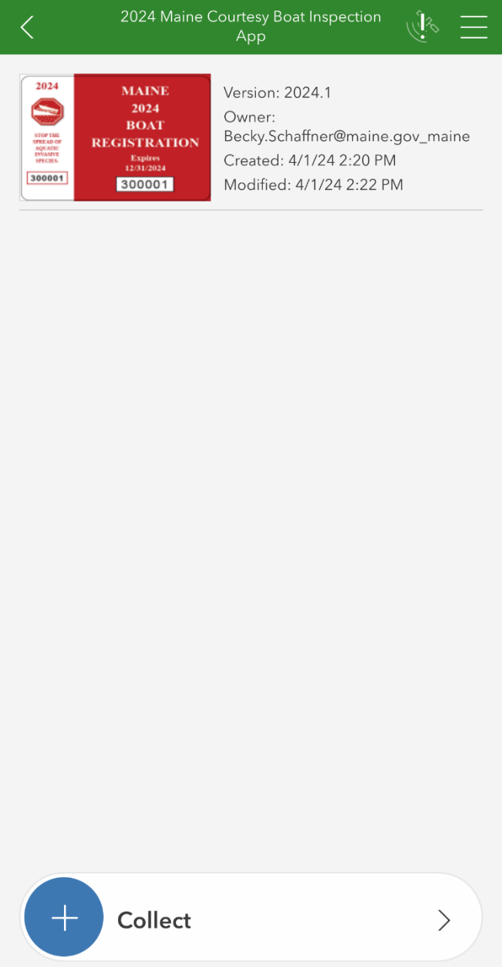
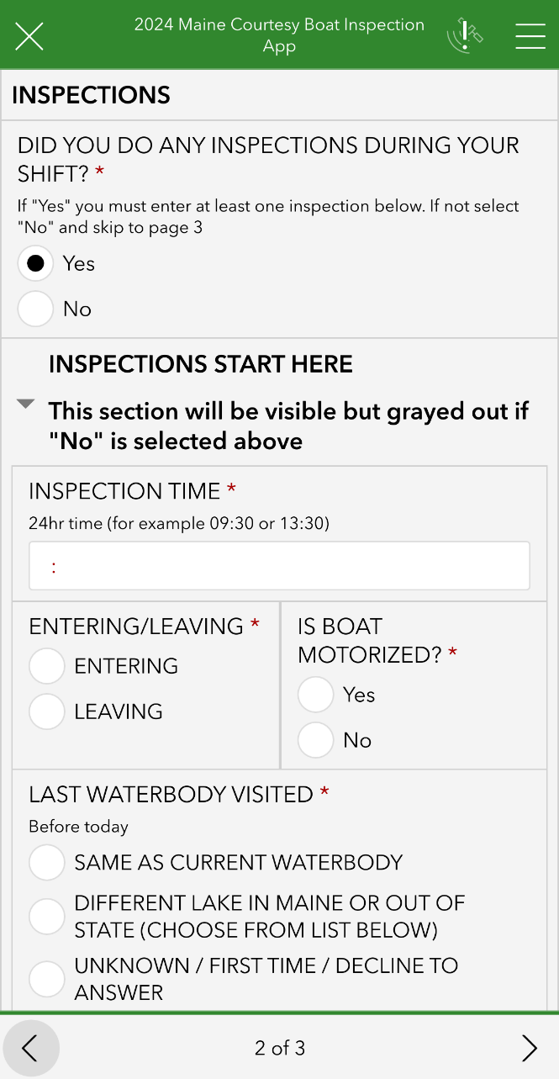
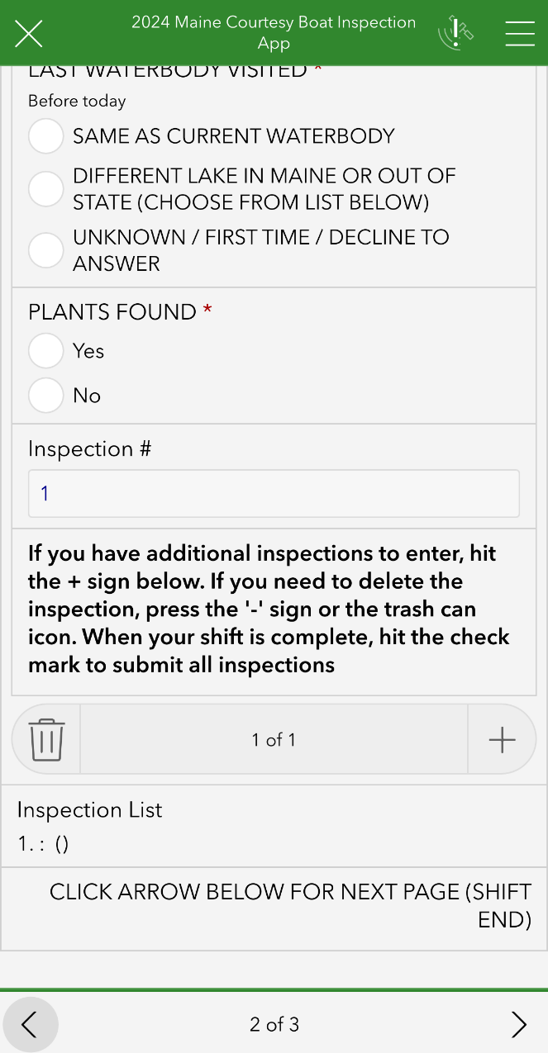

Slide 18
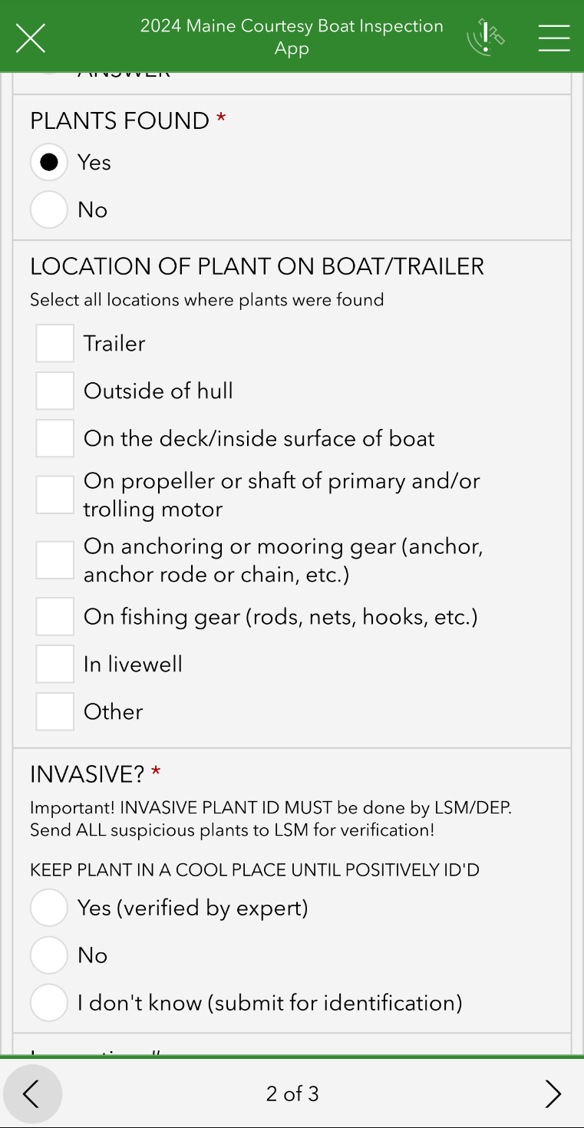
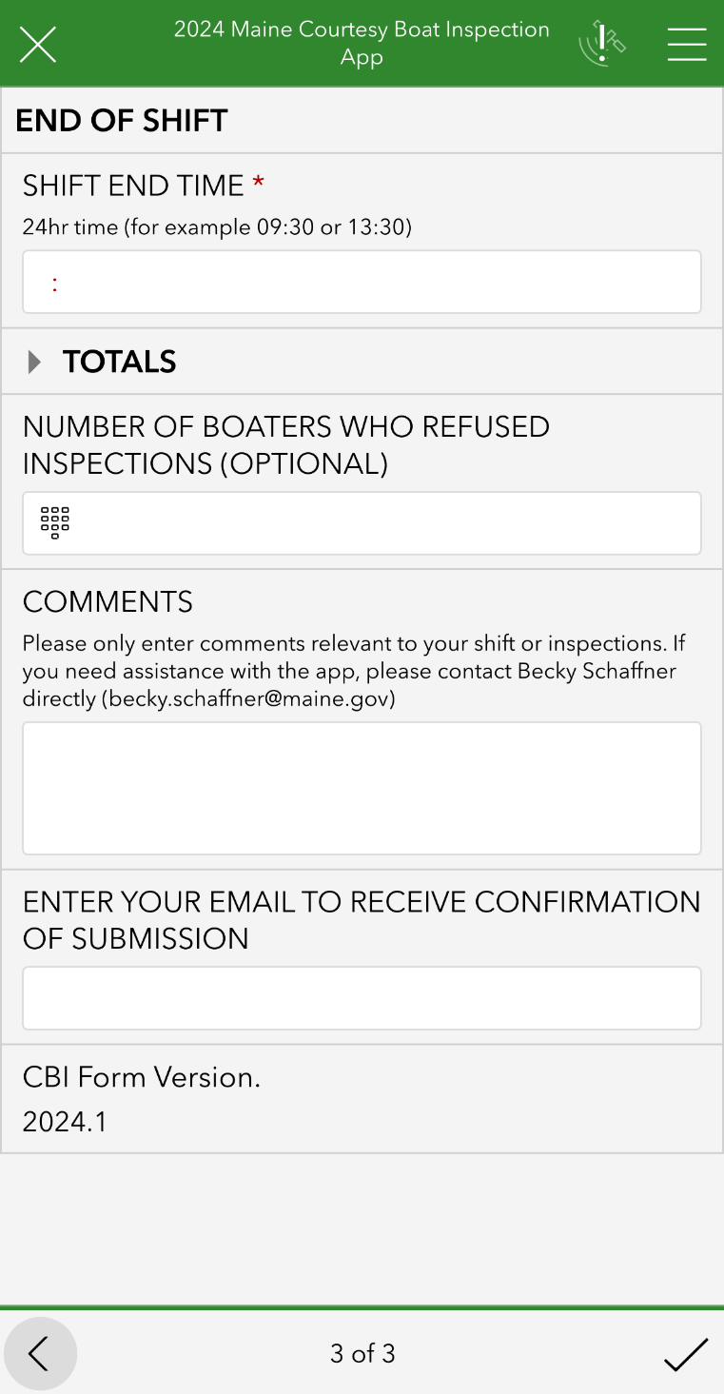

Slide 19
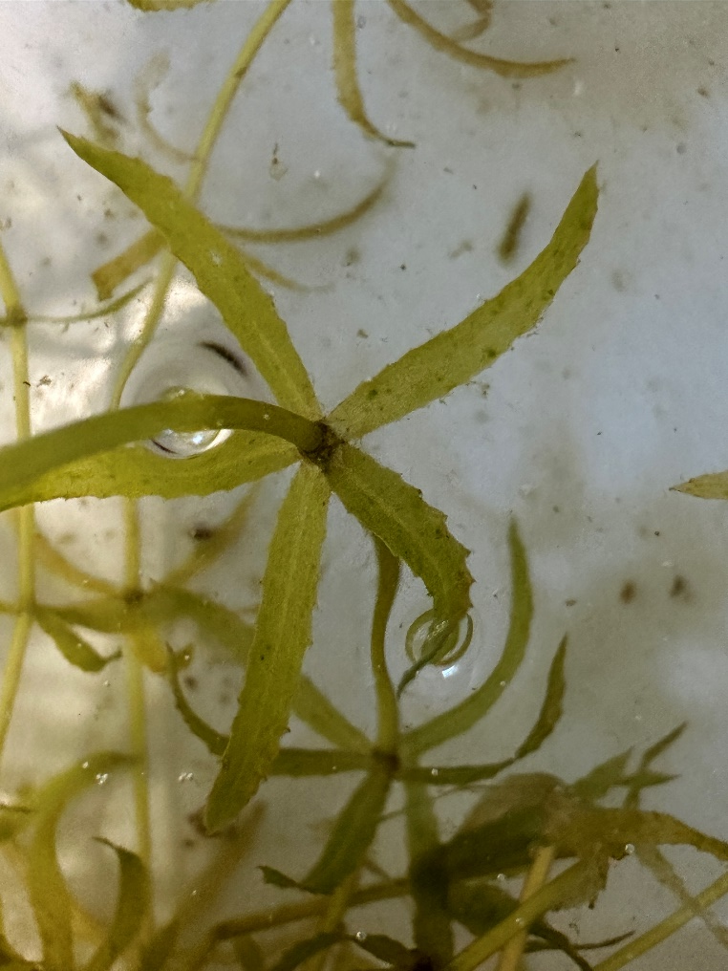
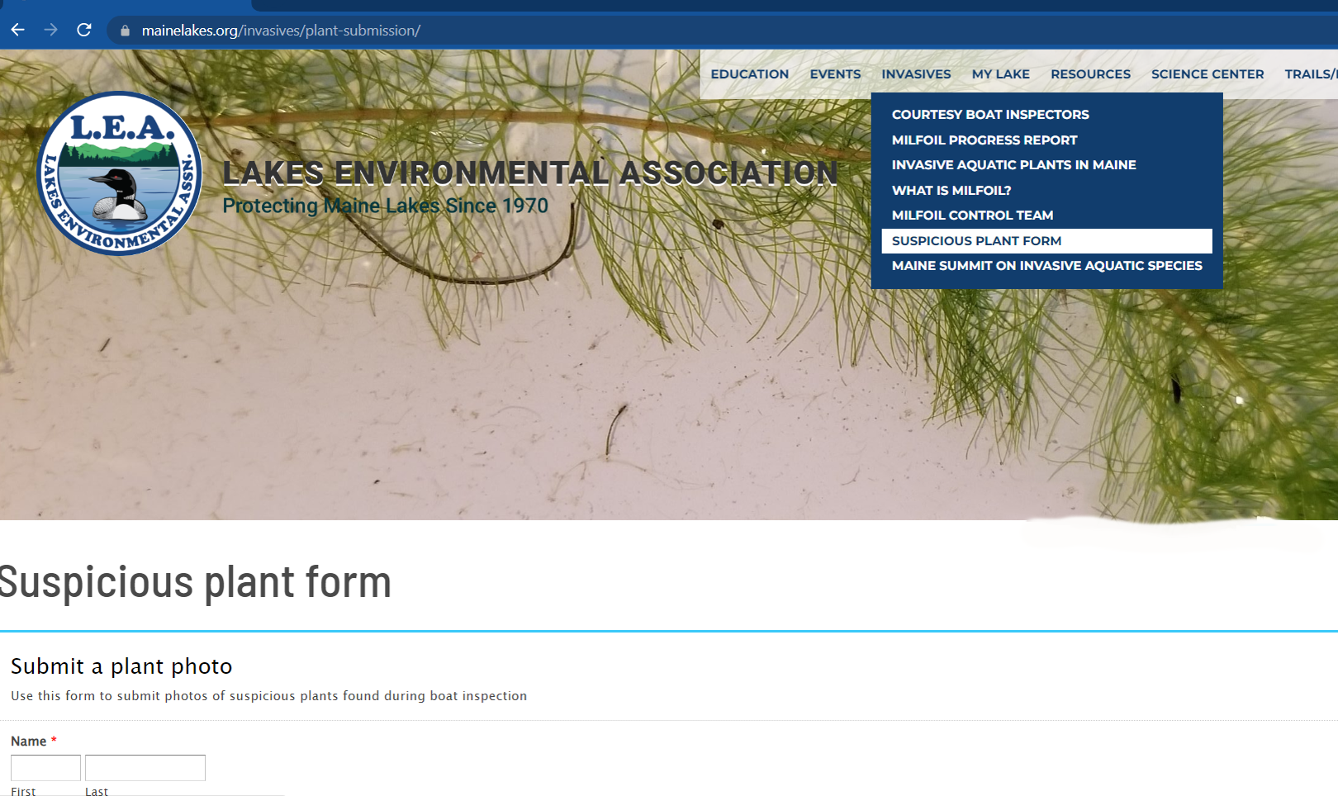
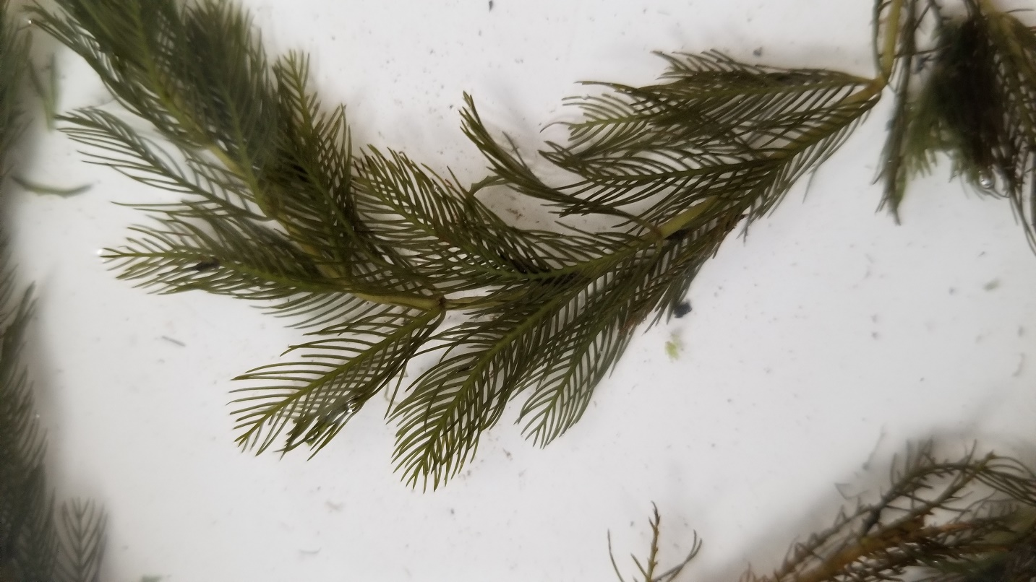

Suspicious Plant Found
Inspector decides if it’s suspicious
Gives plant sample to coordinator
If coordinator can’t ID – send photo to LEA
Go to photo submission page on LEA website
Keep sample in fridge

Slide 20
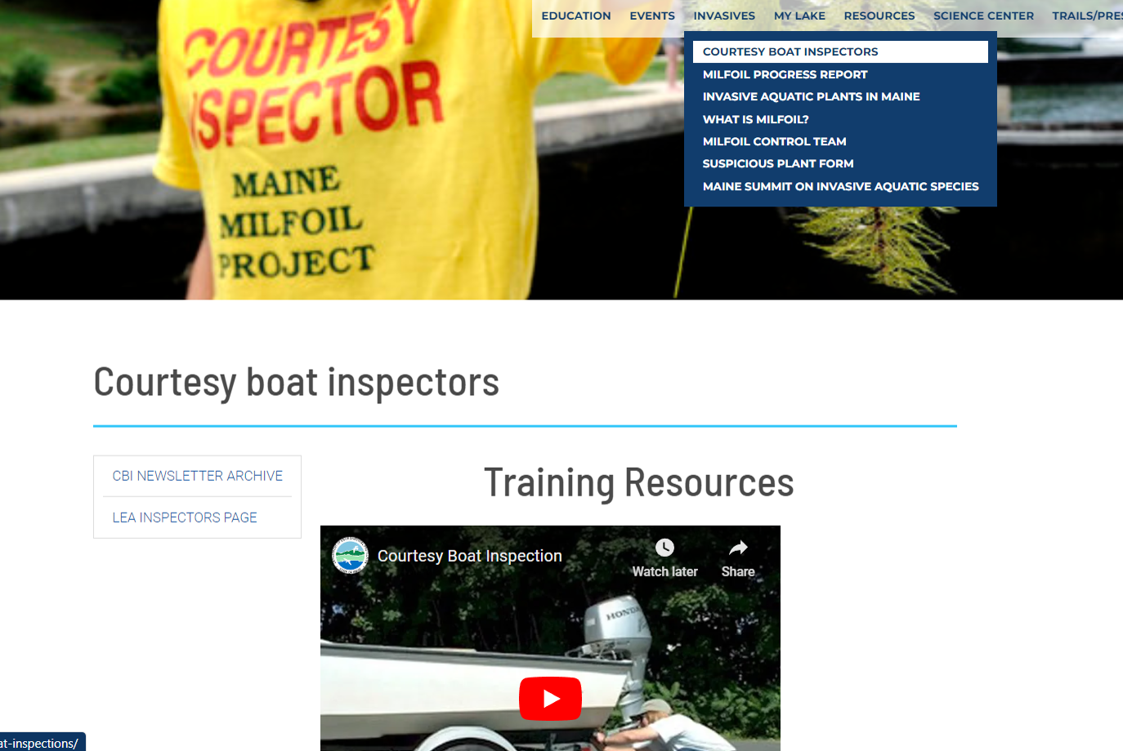

Slide 21
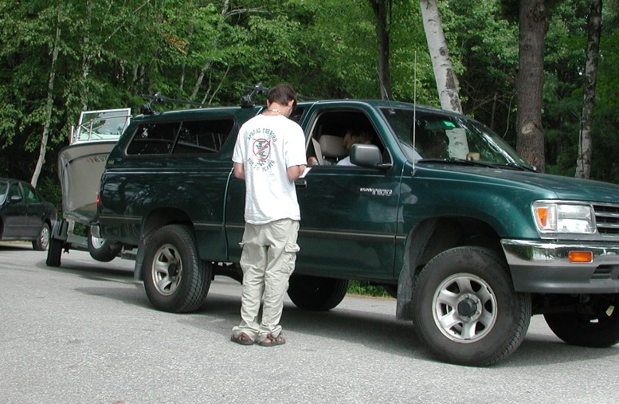
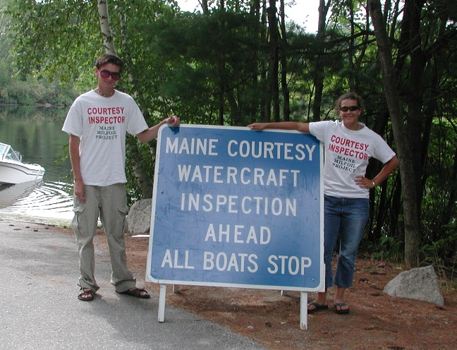
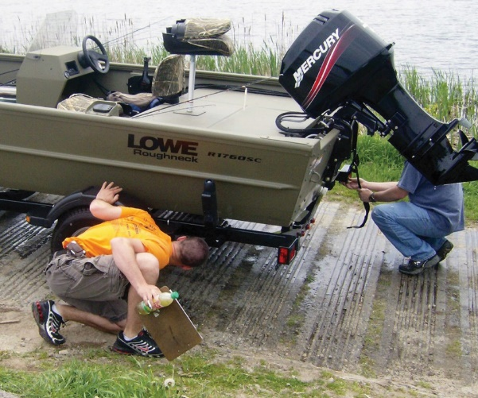
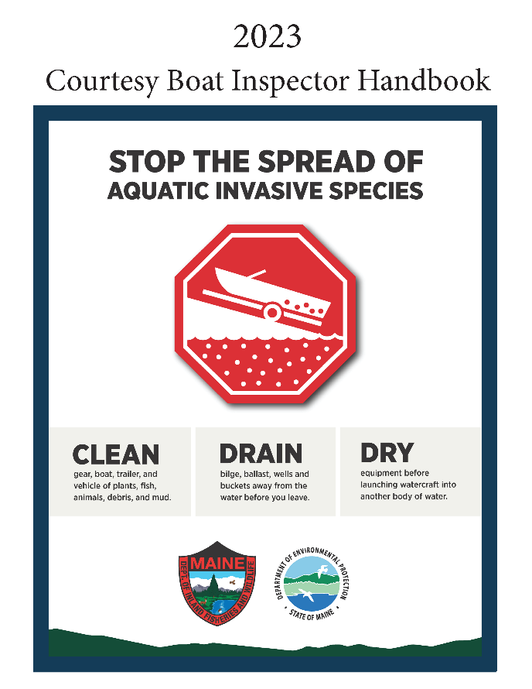

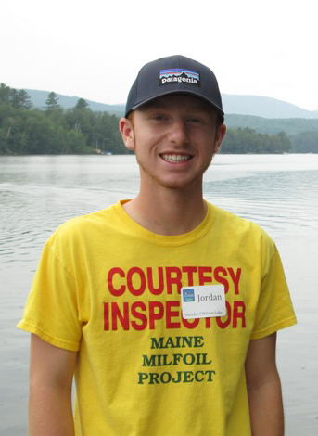
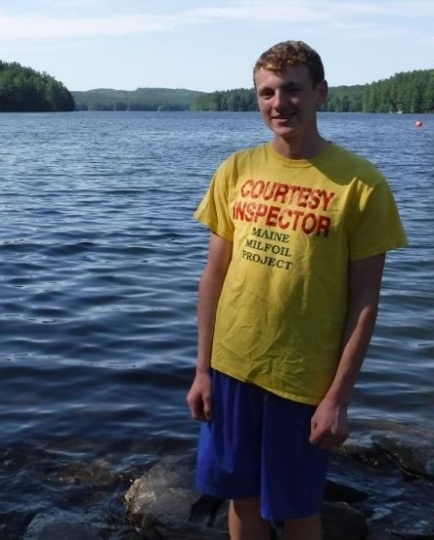
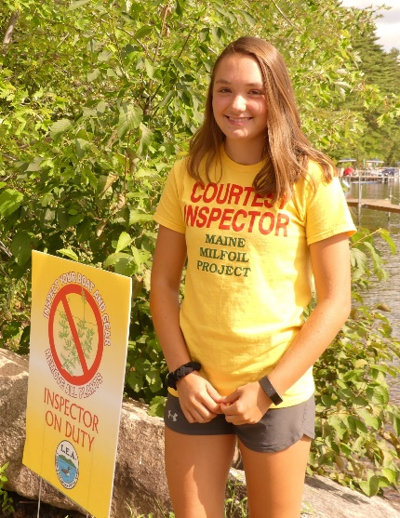
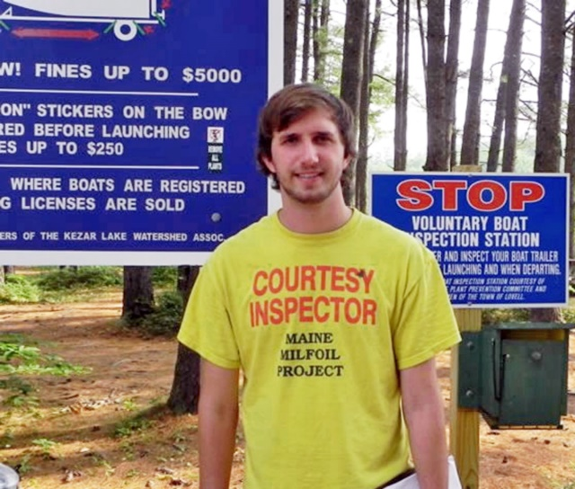
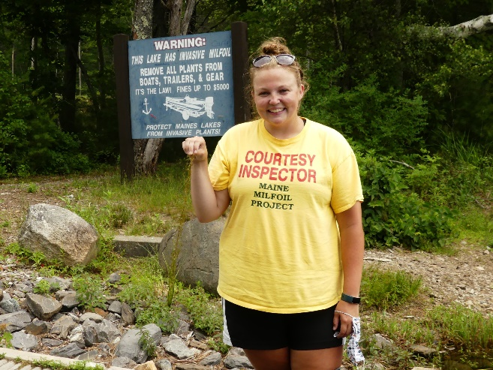
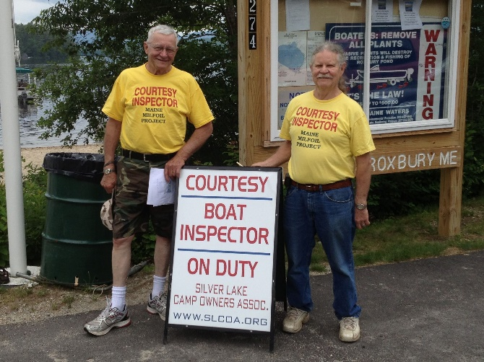
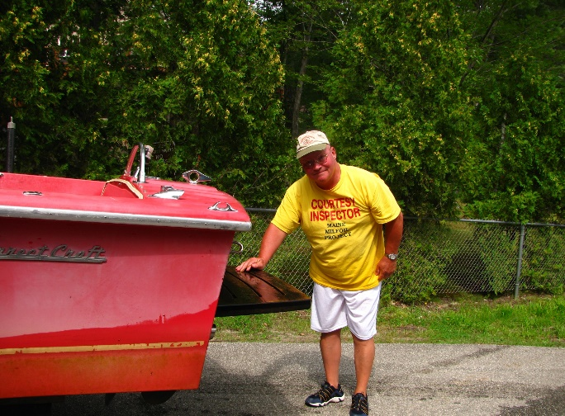

Slide 22


Courtesy Boat Inspector
Coordinator Training
If you have additional questions, feel free to contact us via email.
Mary Jewett – mary@mainelakes.org
Chris Reily – Chris.Reily@Maine.gov

