Slide 1
Aquatic Invasive Plants: Four new Invaders
Keeping a watchful eye on the health
of Maine lakes since 1971

Slide 2
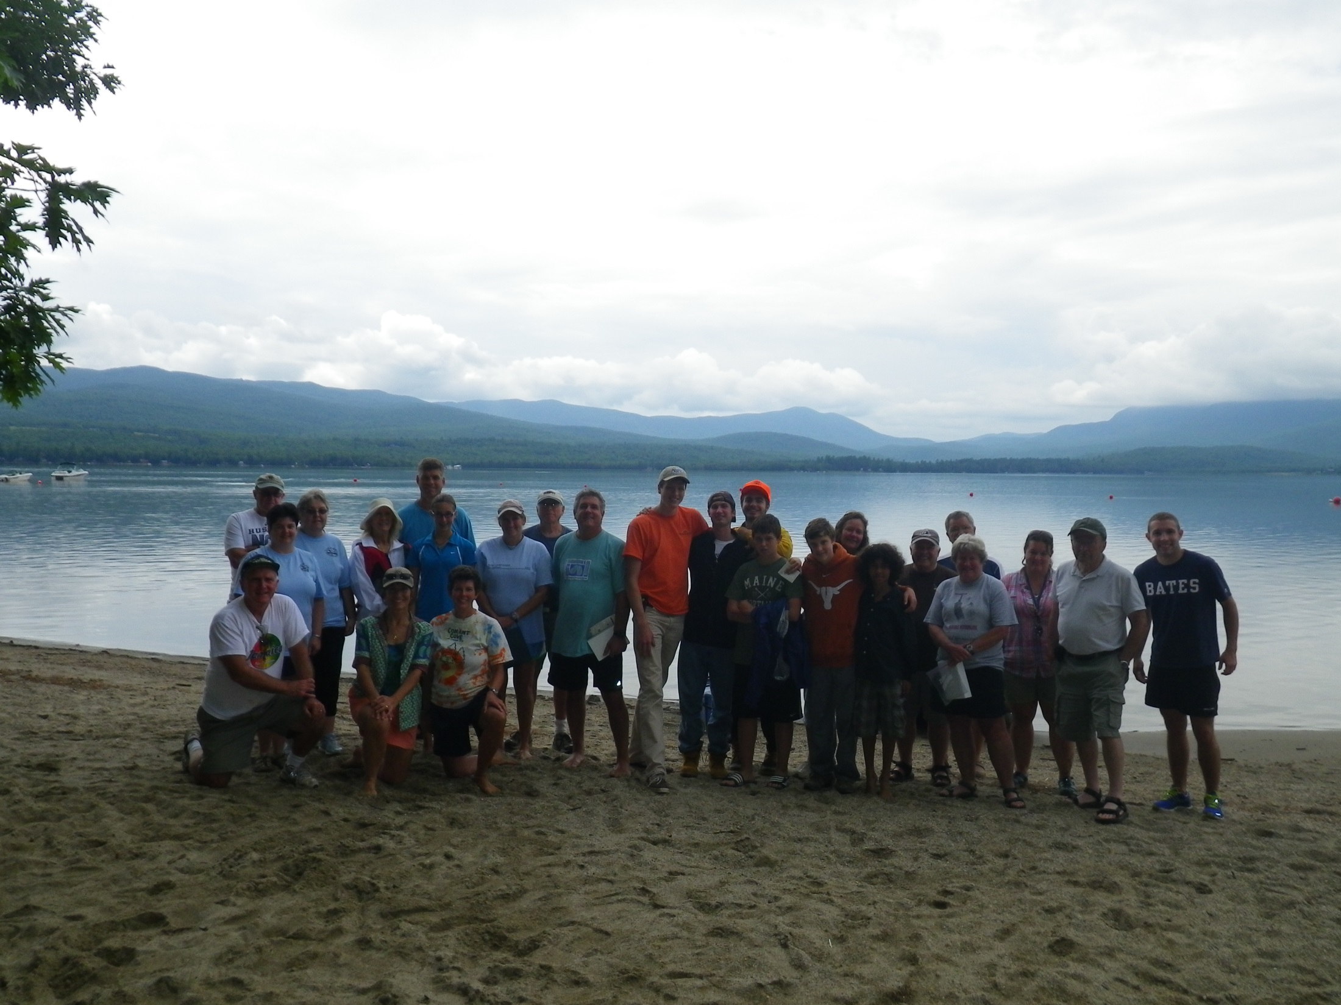
Our Mission To help protect Maine lakes and to foster lake stewardship through widespread citizen participation in the gathering and dissemination of credible scientific information pertaining to lake health
Notes:
Mention mission Lake Stewards of Maine is the oldest and one of the largest citizen lake monitoring programs in the US. LSM provides training and technical support for thousands of citizen scientists statewide
1200 certified lake scientists monitoring ~500 Maine lakes! Primary collector of statewide lake data

Slide 3
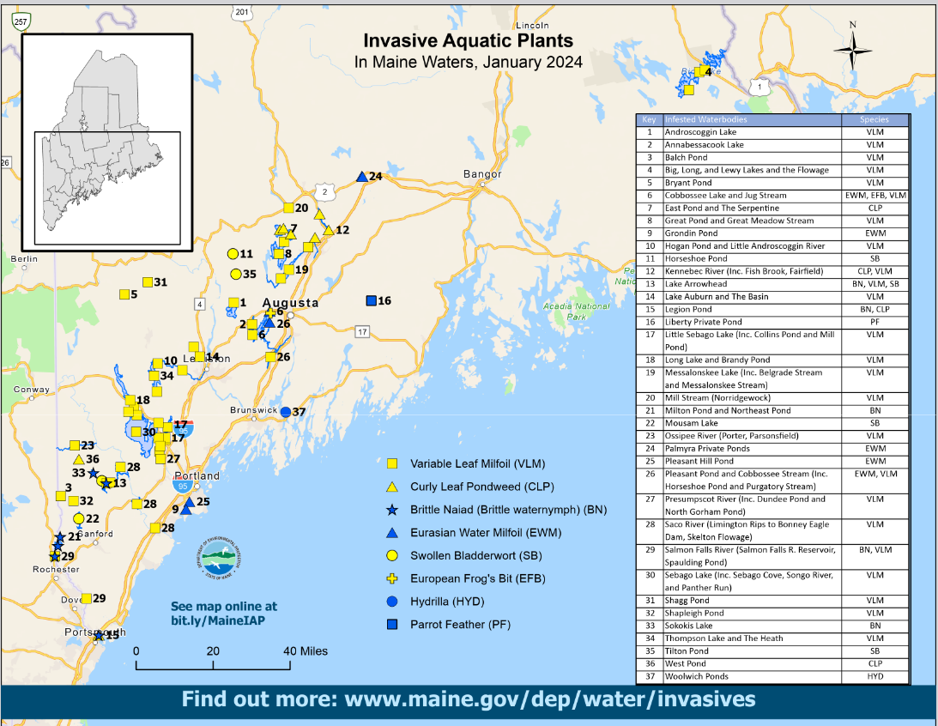
Notes:
Maine currently has 38 known infestations with 8 plants.
HOWEVER>>>>
Out of over 6000 lakes and ponds, Maine only has under 40 infestations as of Jan 2024 – less than 1%!
Several infested water bodies have been delisted, and some are on their way to being delisted.
Alamoosook was delisted this year for VWM, while new infestations were added for swollen bladderwort

Slide 4
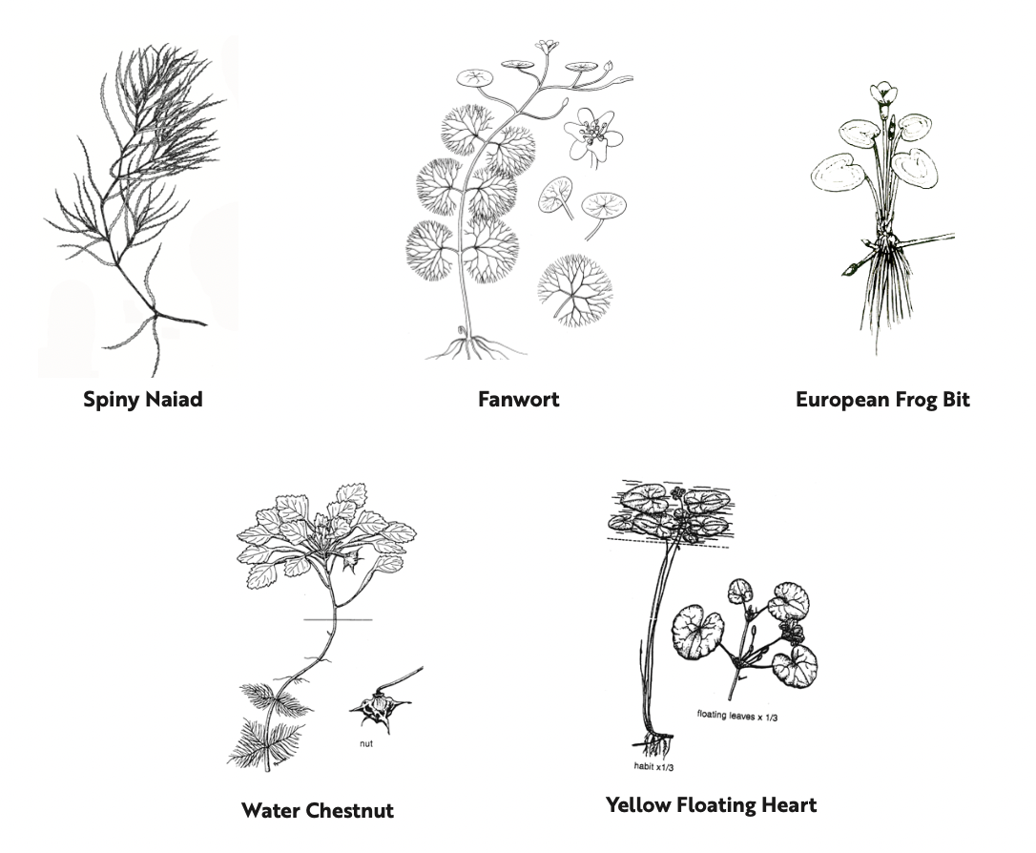
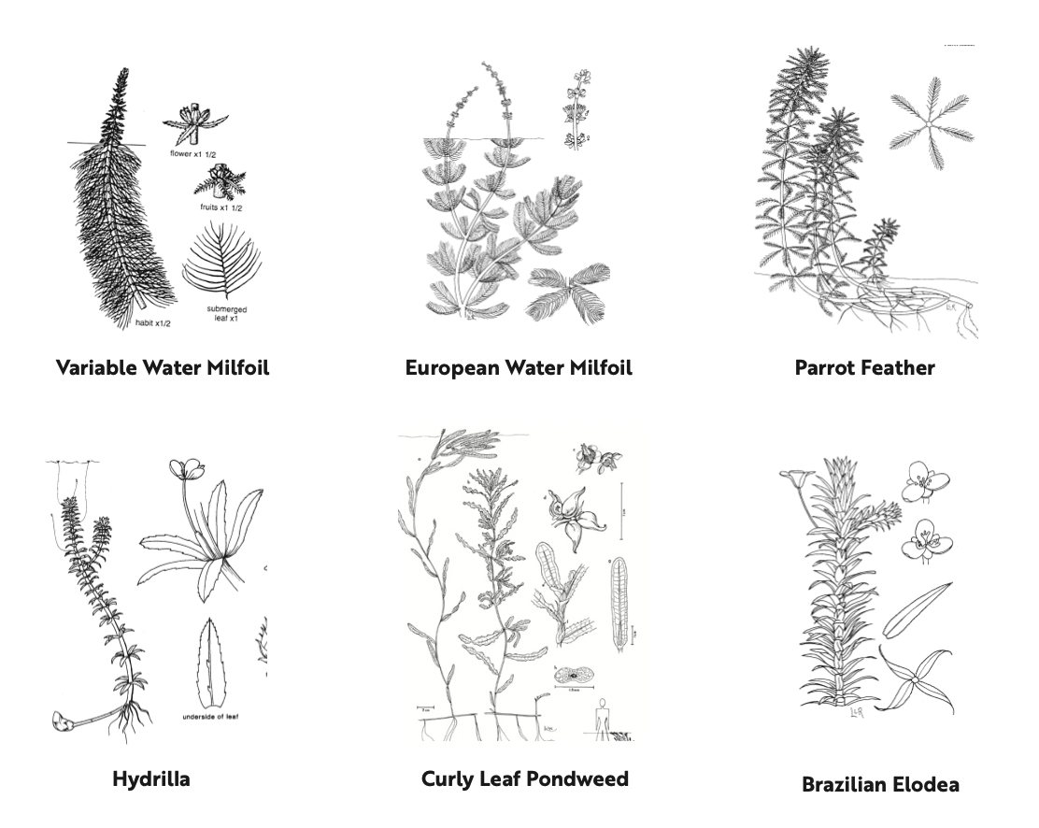
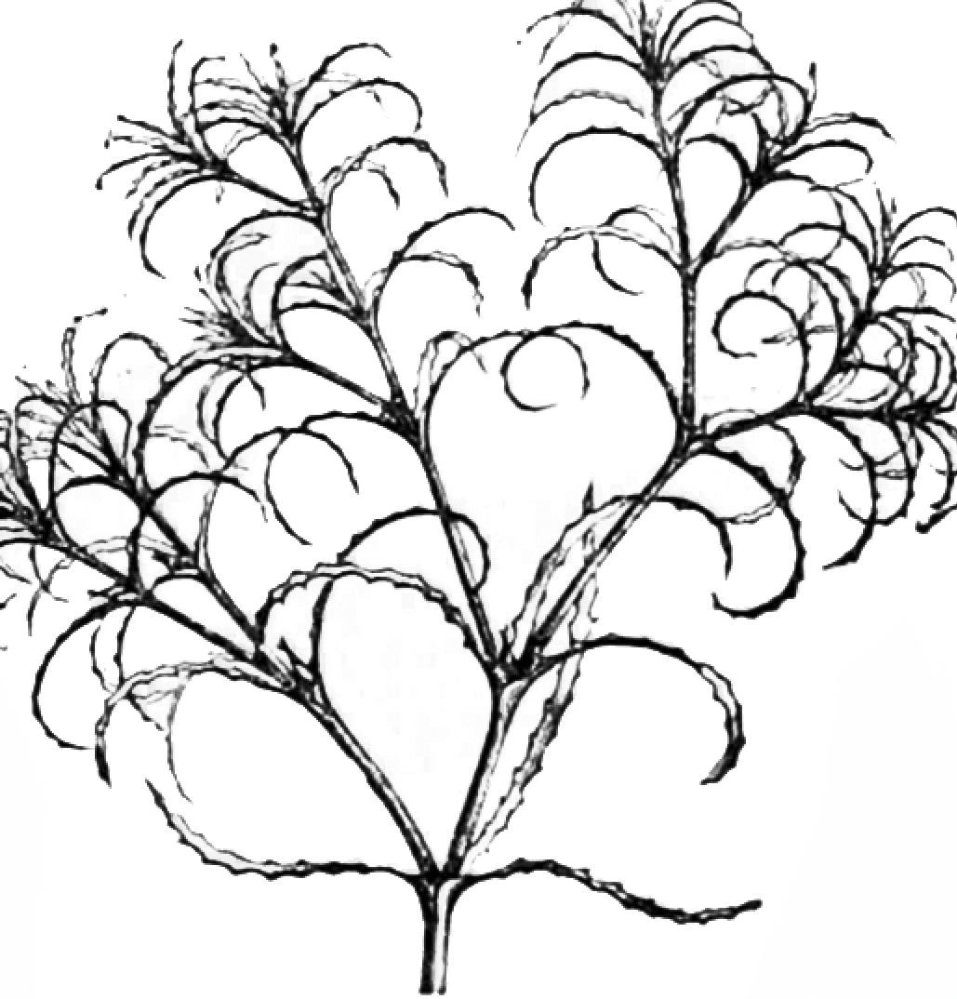
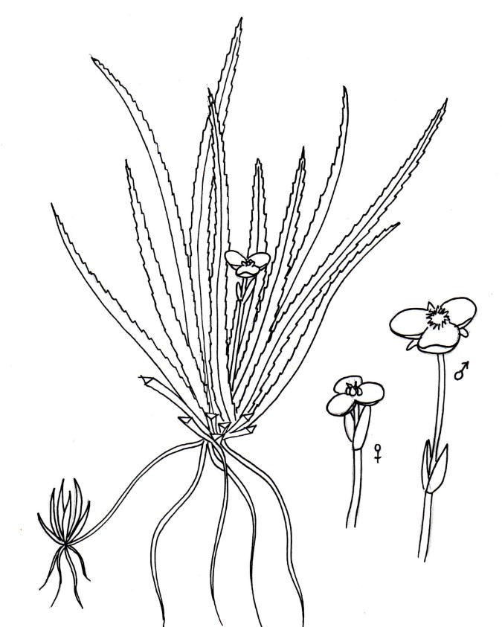
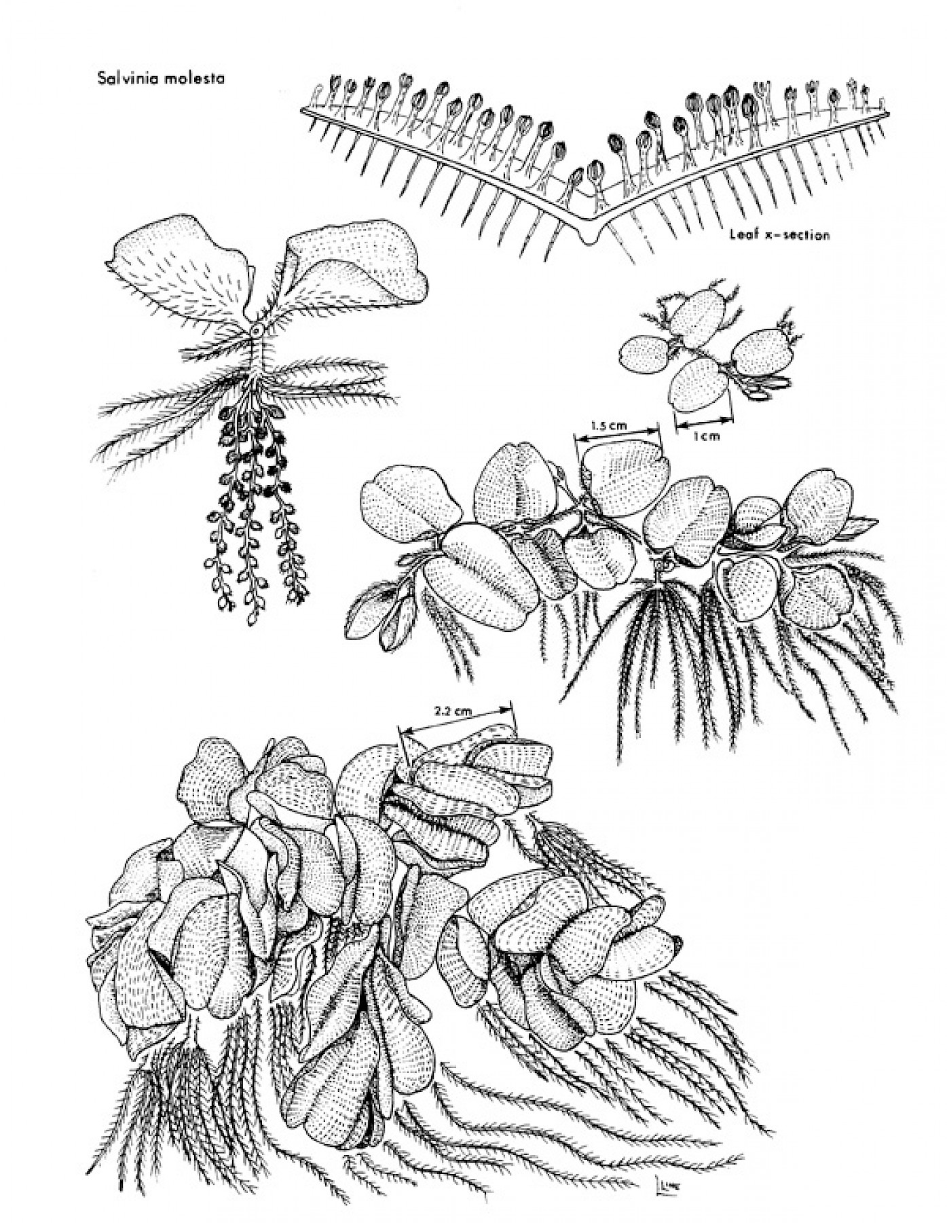
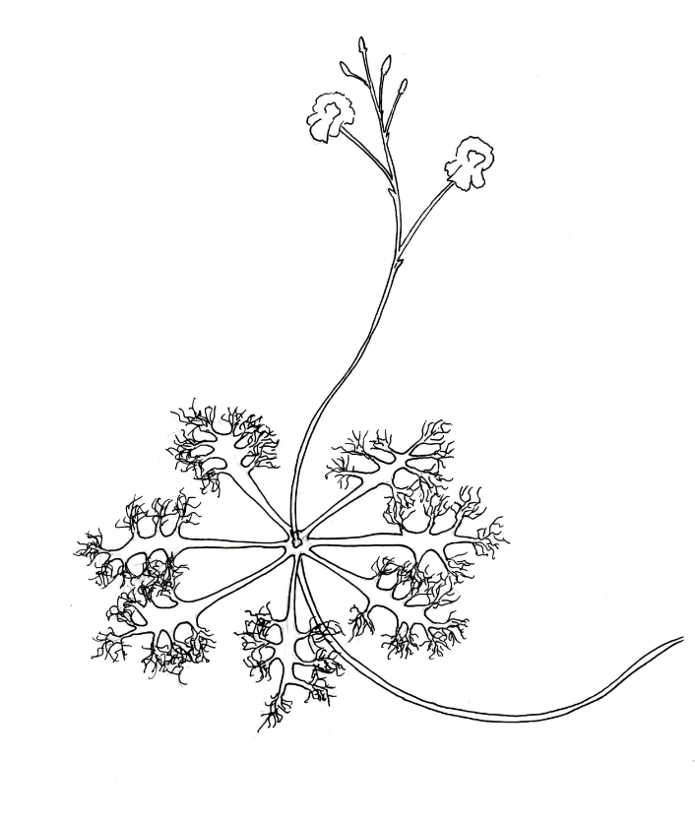
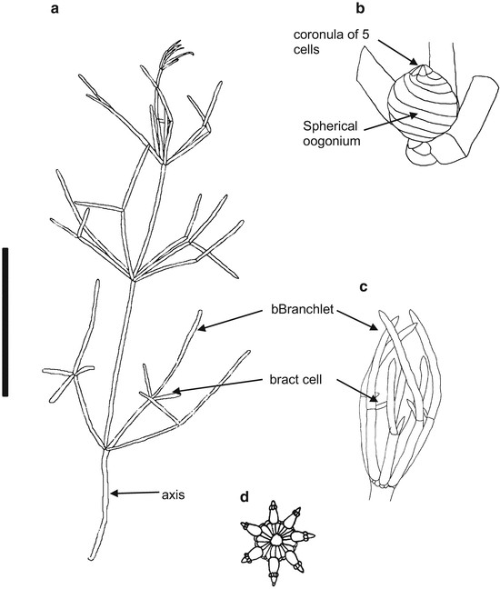
Giant Salvinia
Swollen Bladderwort
Water Soldier
Starry Stonewort
Notes:
These are the 15 plants on Maine’s state watch list. The red plants are ones that are confirmed in Maine – Variable water milfoil, European water milfoil, parrot feather,spiny or brittle naiad, European frogbit, hydrilla, curly leaf pondweed, and swollen bladderwort
Maine has 8 confirmed aquatic invasive plants – 15 total on our watch list Variable Water Milfoil, European Water Milfoil, Parrotfeather – all milfoils
Spiny or Brittle Naiad, European Frogbit Hydrilla Curly leaf pondweed Swollen bladderwort – 3 new infestations found in 2023, 5 total in state. Could be a growing nuisance in Maine. VARIABLE WATER MILFOIL IS THE MOST COMMON More information on fine identifying characteristics of these plants will be provided later in the training

Slide 5
Giant Salvinia
Swollen Bladderwort
Water Soldier
Starry Stonewort
Notes:
In this talk we’re cover these four new plants – Giant Salvinia, Swollen bladderwort, Water Soldier, Starry Stonewort While three of these plants are not yet in Maine, one is now confirmed in 5 lakes across the state – swollen bladderwort
And we’ll talk about how volunteers are crucial to Monitor maine’s lakes and to the early detection and rapid response of AIS infestations

Slide 6
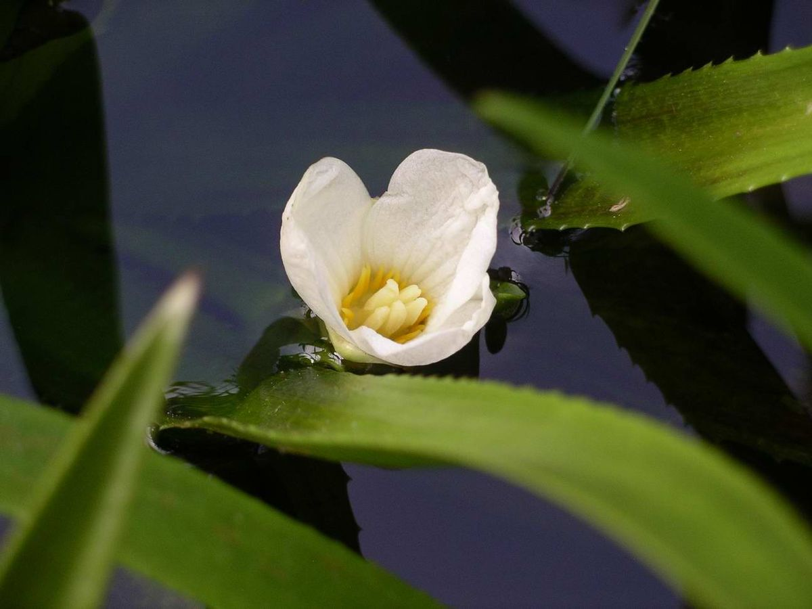
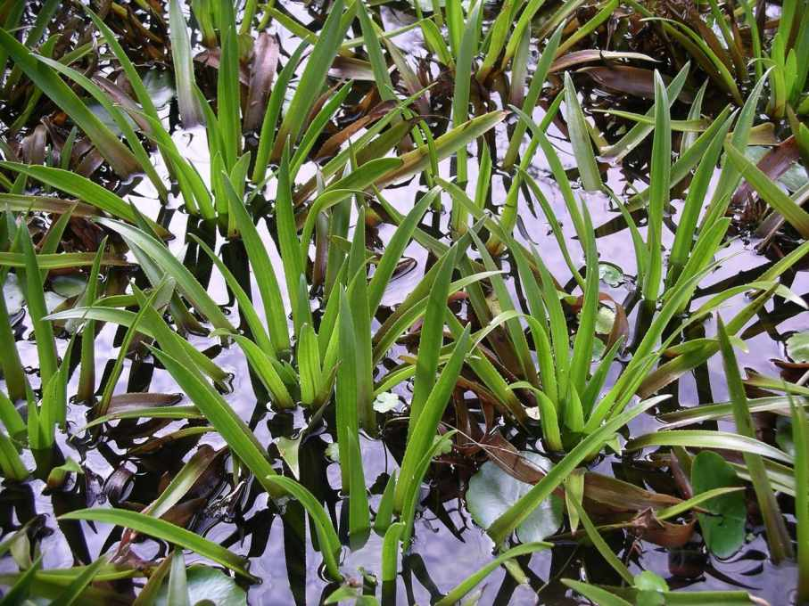
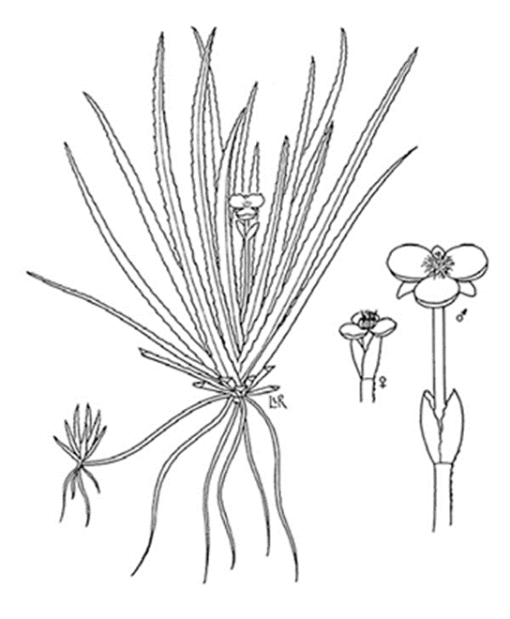
Water Soldier Stratiotes aloides
Notes:
First Plant - Water Soldier. Native to Europe and Asia. Submersed plant with a floating morph. Invasive in many parts of the world. Not yet found in Maine but located in Ontario, CA.
Resembles an aloe plant – large lance shaped leaves with serrations- most distinguishing feature. Can be harmful to touch! Ouch! Flowers have 3 white petals, with a single flower on a stalk. Plant forms dense mats that crowd out other vegetation. Spreads through fragmentation. Starts in substrate in basal rosette, but in deep water can float up to surface and form mat on surface in spring and summer! Wild transformation!!!! Serrations are so sharp they can cut if handled incorrectly, can grow in dense patches and inhibit wildlife movement.
Not yet found in Maine CLOSEST NATIVE LOOKALIKES - Arrowhead (Sagittaria), Bur-reed (Sparganium), Eelgrass (Vallisneria) Source: https://www.invasivespeciescentre.ca/invasive-species/meet-the-species/invasive-aquatic-plants/water-soldier/ These look-alikes are most similar when young and/or when not in flower.

Slide 7
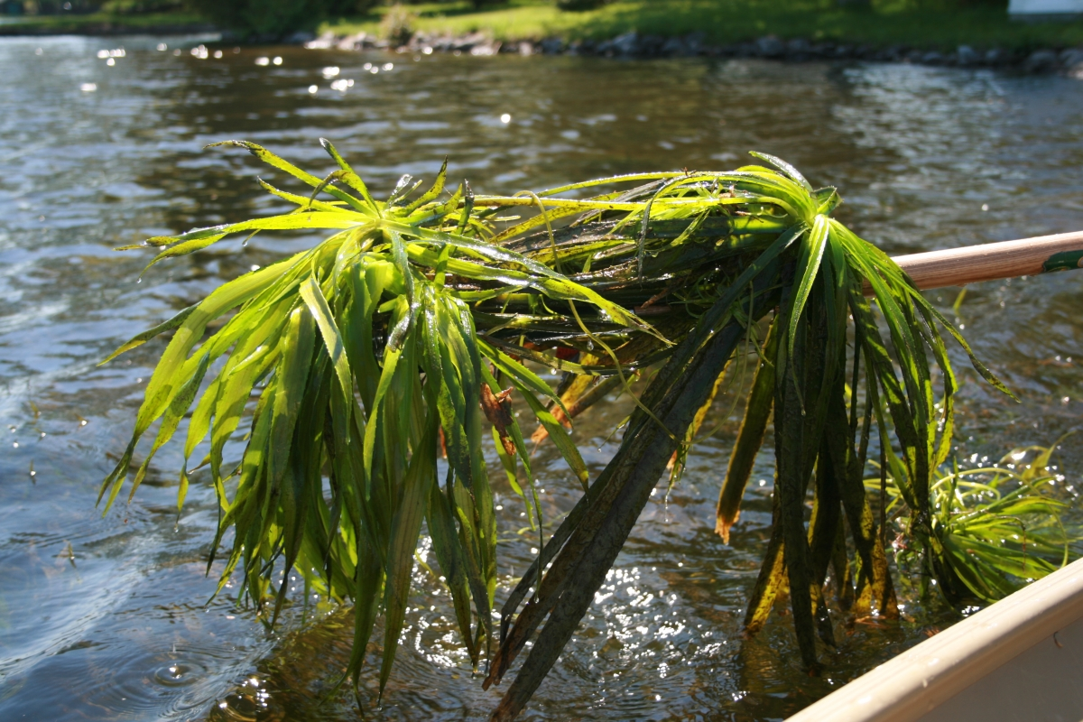
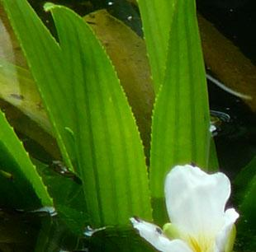
Finely serrated leaves, stiff.
Floating morph in spring/summer
Notes:
Though OFFICIALLY a submersed plant,, this plant is MOST obvious when forming floating maps after changing form.
In summer the plant detaches from substrate and floats to surface, where it continues to live as a free-floating plant. This morph eventually sinesses and sinks to bottom of substrate, where it can spread through fragments. Decay can change water chemistry and oxygen levels.

Slide 8
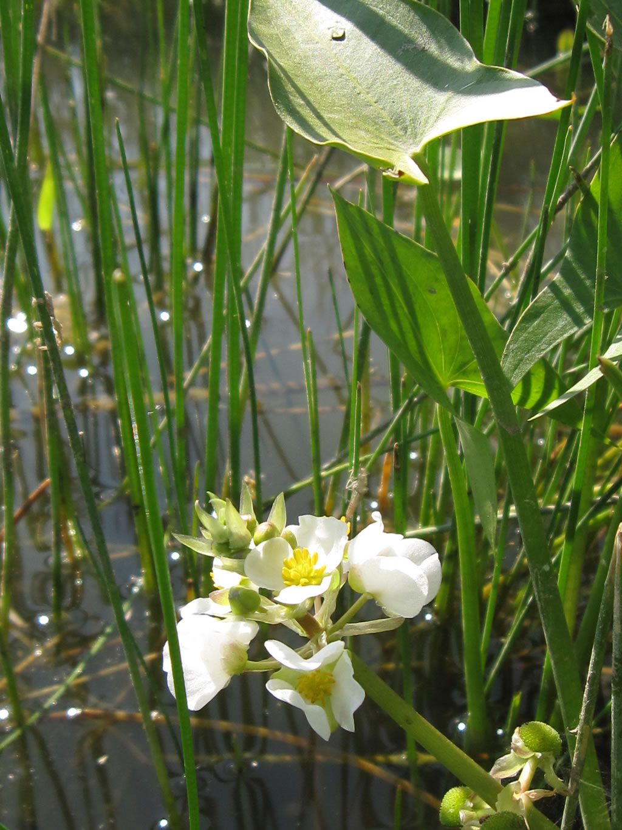
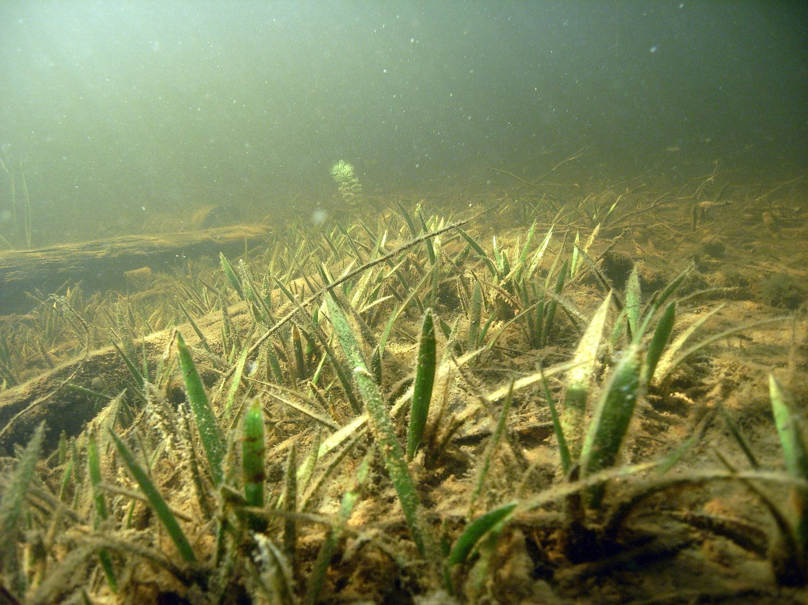
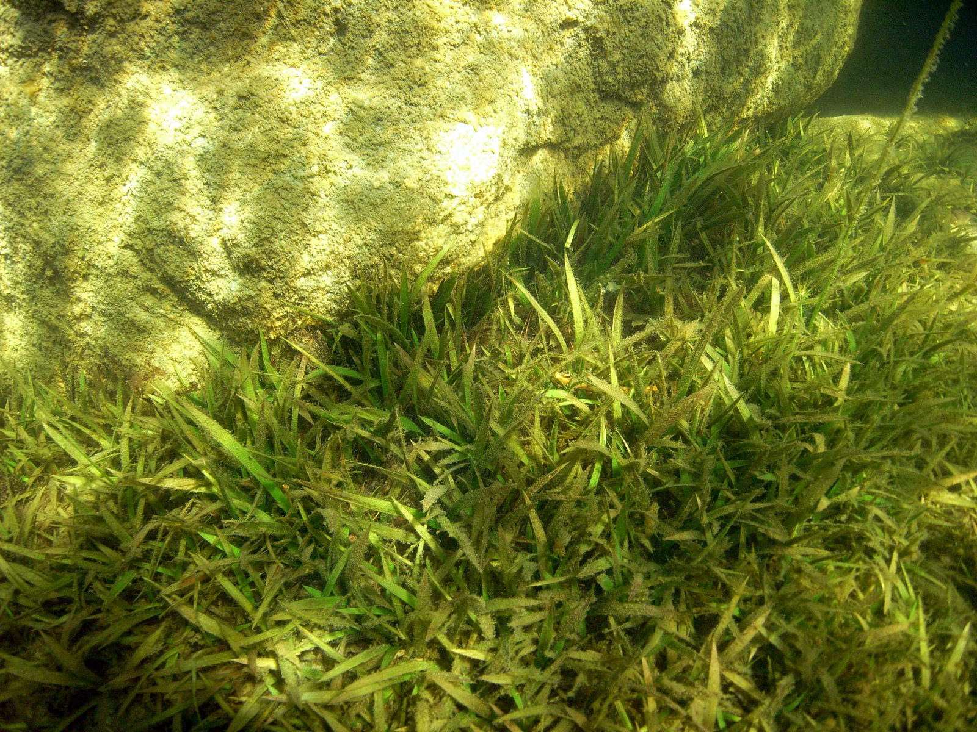
Arrowhead Sagittaria spp.
Notes:
Arrowhead - mostly known for its arrowhead shaped emergent leaves.
Arrowhead species (Sagittaria) can be confused with water soldier because of their basal rosette when immature.
Stiff leaves hold shape out of water, but sterile (basal rosette) leaves are NOT creased along along mid-rib and edges are entire without serrations.
Flowers are also three-petaled and white but occur in WHORLS of three along the flowering stalks.
Fruits are green and bulbous. Three common species of arrowhead in Maine: S. graminea (grass-leaved arrowhead), S. latifolia (common arrowhead), and S. cuneata (northern arrowhead)

Slide 9
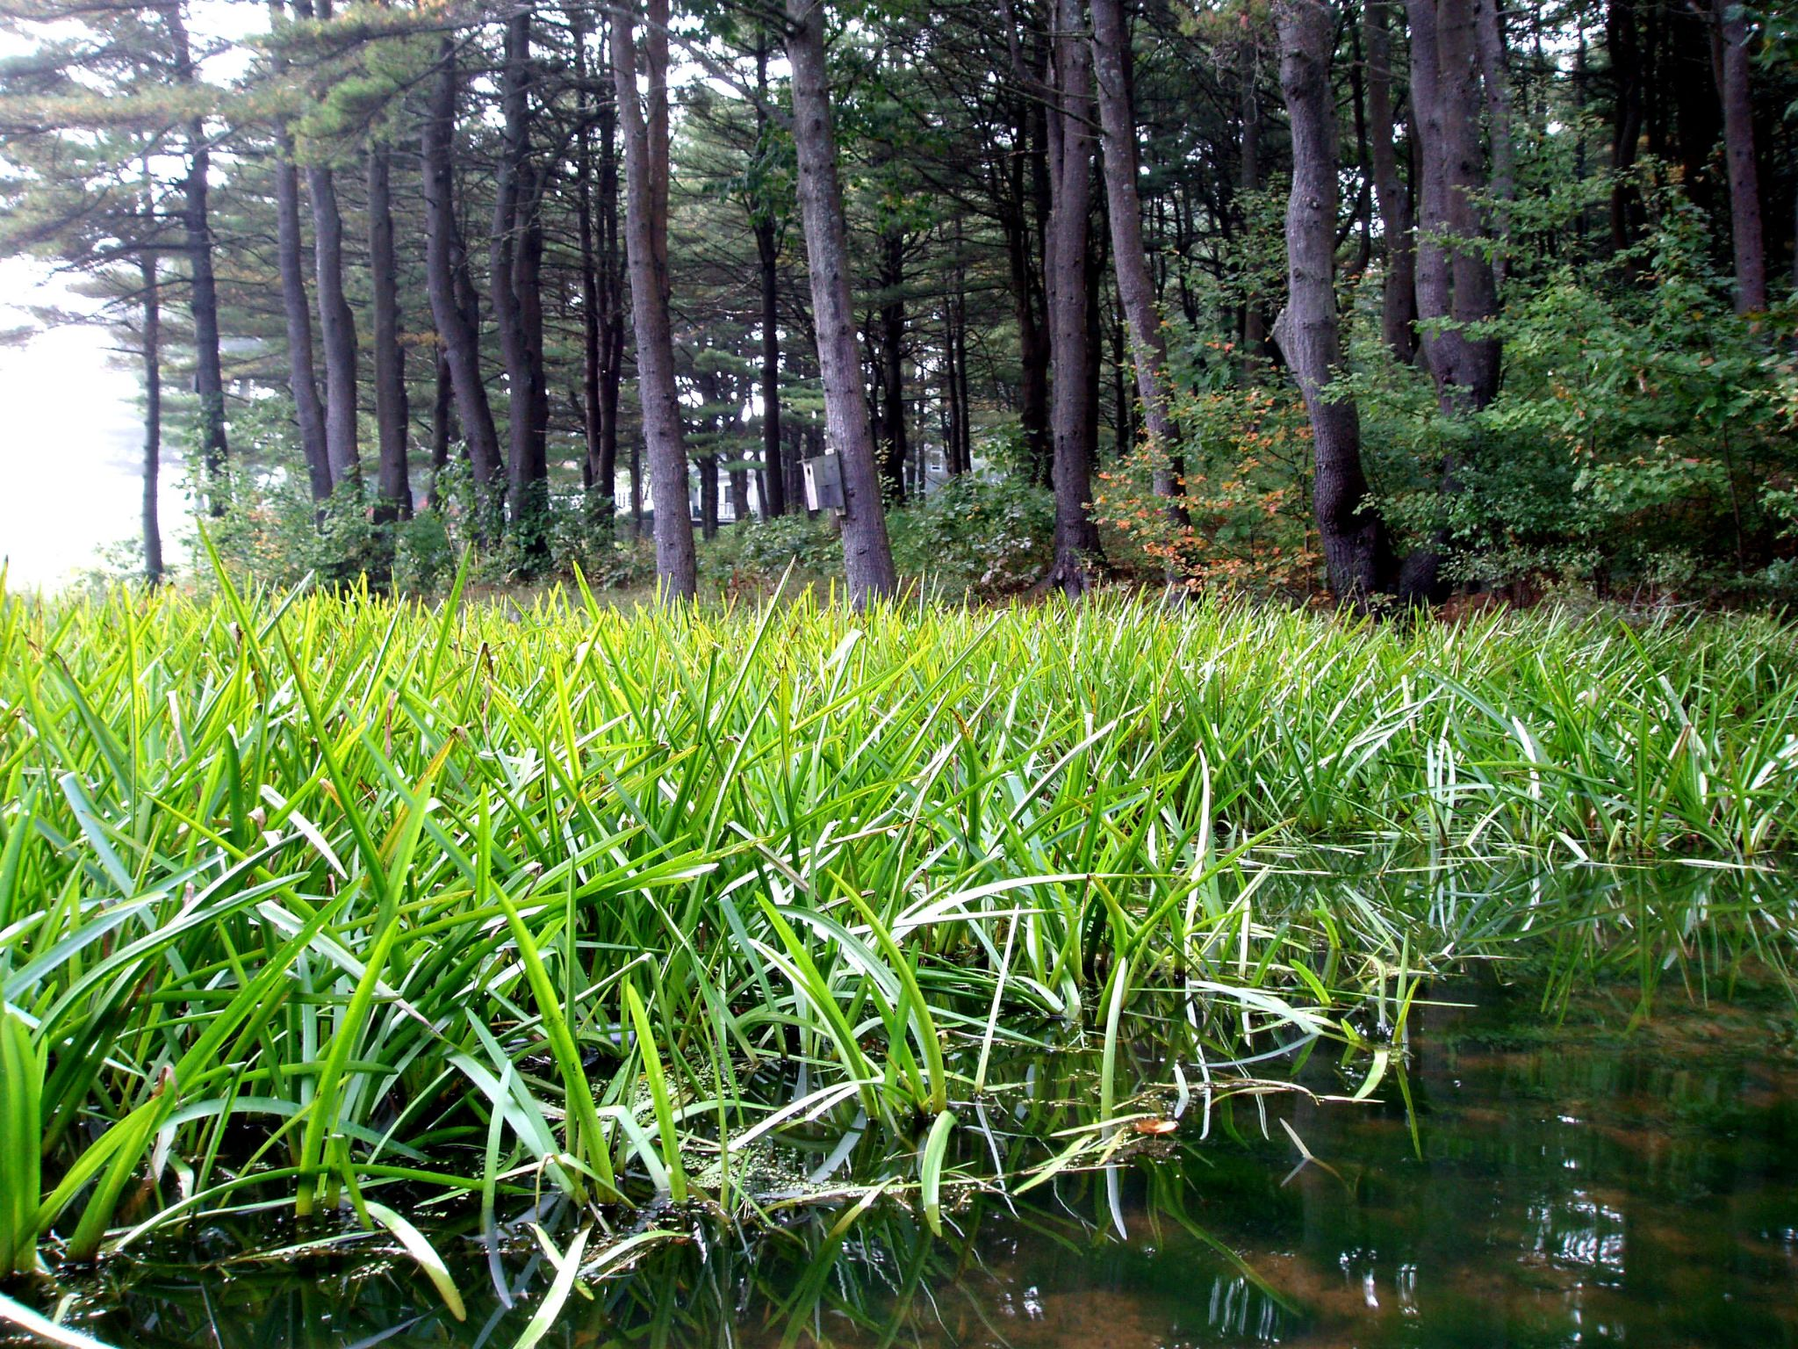
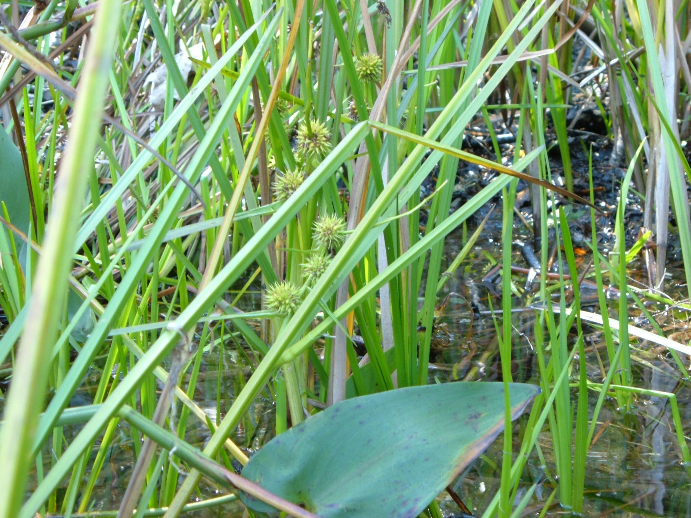
Bur-reeds Sparganium spp.
Notes:
Bur-reeds, or Sparganium species can be confused when emergent.
Can be submersed when young, but become emergent for species likely to be mistaken for water soldier. Leaves are spongy and keeled giving them a triangular appearance in cross-section, edges entire.
Flowers are alternately arranged on the flower spike, with pistillate flowers appearing below the staminate flowers. Fruiting heads give the plant its name, resembling burdock burrs or maces.
Two common species likely to be mistaken for water soldier in Maine: S. americanum (American bur-reed) and S. emersum (European or simple-stemmed bur-reed)

Slide 10
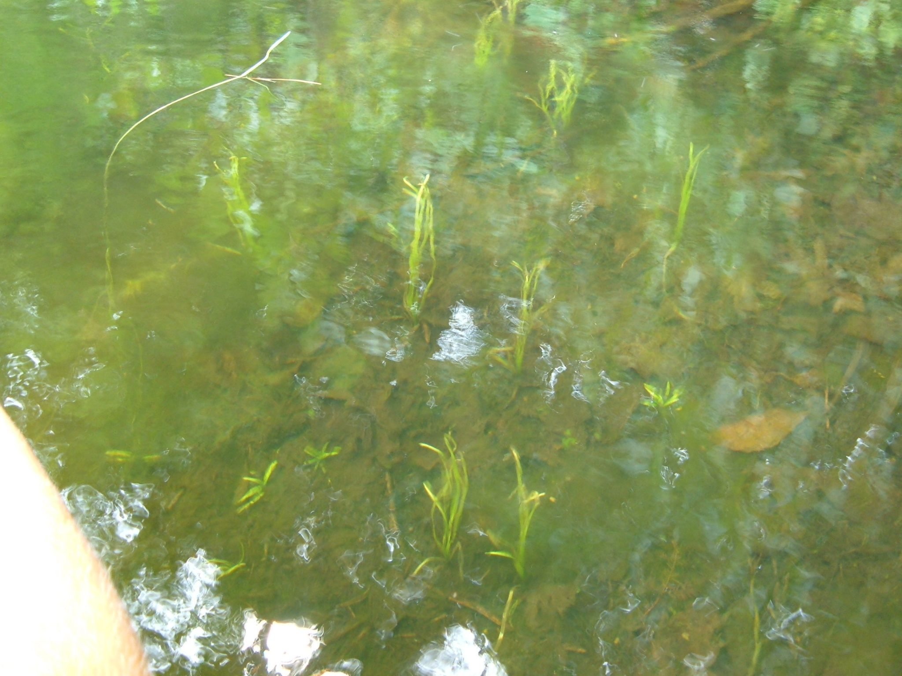
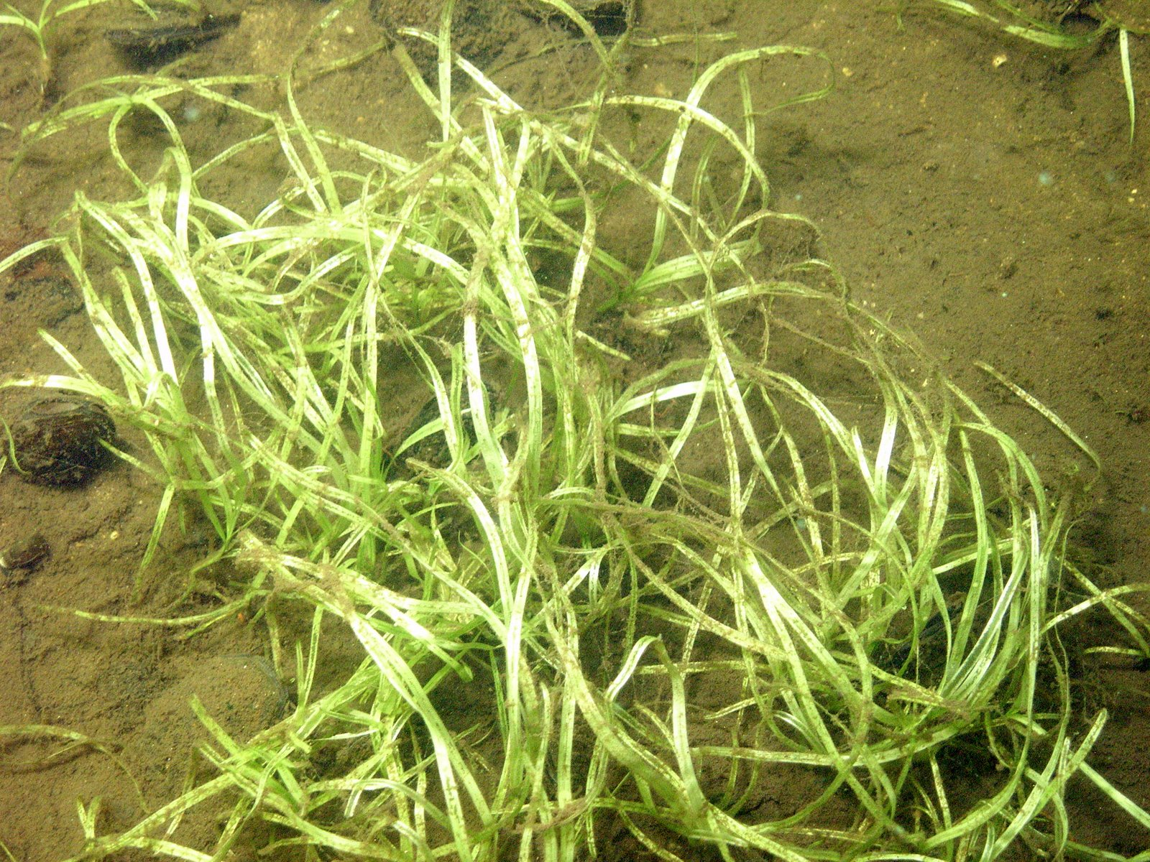
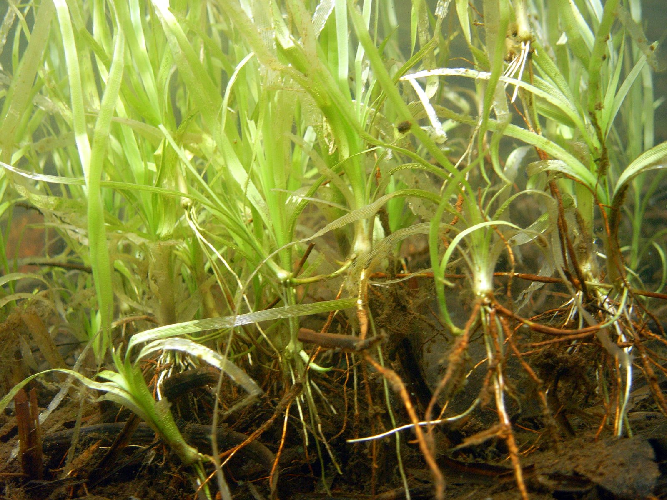
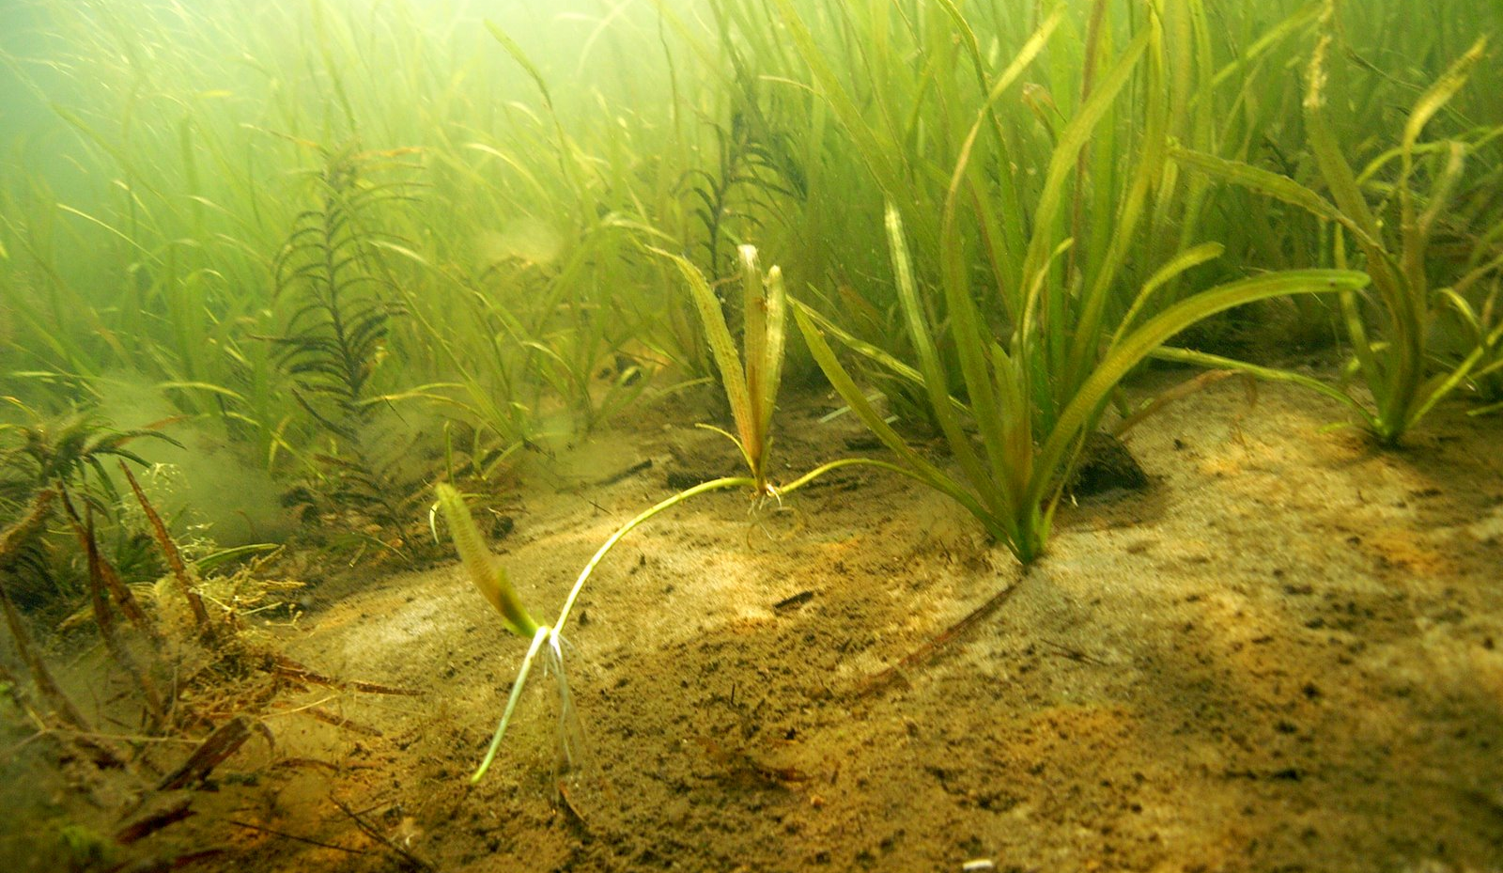
Eelgrass Vallisneria spp.
Notes:
Eelgrass (Vallisneria)species can look like water soldier, but only when small. When plants are mature, have long blade-shaped leaves that flow with current.
Plant is fully submersed. Leaves are not stiff and do not hold their position out of water, but do grow in bundles along runners, similar to water soldier.
Plants are dioecious, with the female flowers more visible on long stalks that retract after fertilization to pull the fruit underwater. The most common species of eelgrass is Vallisneria americana (American eelgrass, tape-grass)

Slide 11
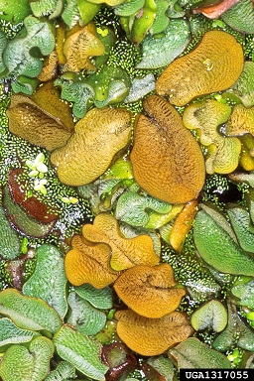
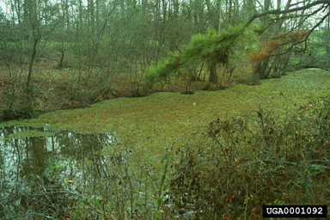
Giant Salvinia Salvinia molesta
Notes:
Native to South America – now found all over the world, including Africa, Europe, and the US. In the US, located across American south east, from Texas to Florida, and up to Virginia Not yet found in Maine
Actually an aquatic fern! Remains buoyant and floats in water. Floating fronds are irregularly shaped, with groove down the middle and with fine, hydrophobic hairs on surface. Hairs look like an egg-beater under magnification
Fertile fronds hang below water -Egg-shaped sporocarps Breaks and spread through Fragmentation. Fast grower! Floating mats can double in size every 2 days!

Slide 12
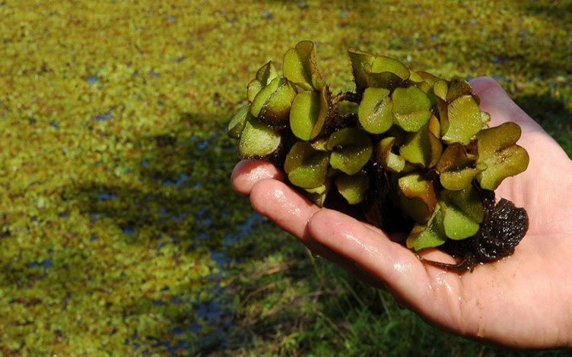
Notes:
Can see floating “roots” on bottom of hand, Rumpled shape. Nothing else looks like this!

Slide 13
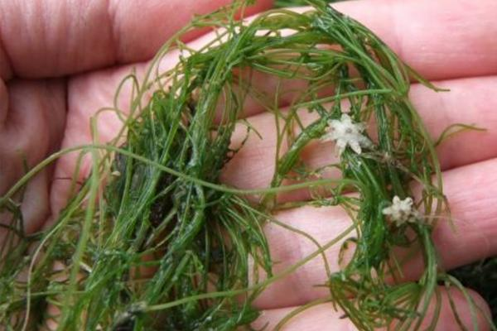
Starry Stonewort Nitellopsis obtusa
Notes:
STARRY STONEWORT – Native to northern europe and asia. Declared invasive in great lakes states and east- as close as northern vermont, new hampshire, ontario, and quebec. Not yet in Maine
Actually a MACROALGAE, not a true vascular plant. Mimics plant.
Whorled branchlets at each node – very distinct Reproduces itself through star-shaped bulbils, which are most distinguishing feature. Otherwise looks like native stoneworts.
Grows in deeper water than many other invasive plants, does not necessarily grow in littoral zone

Slide 14
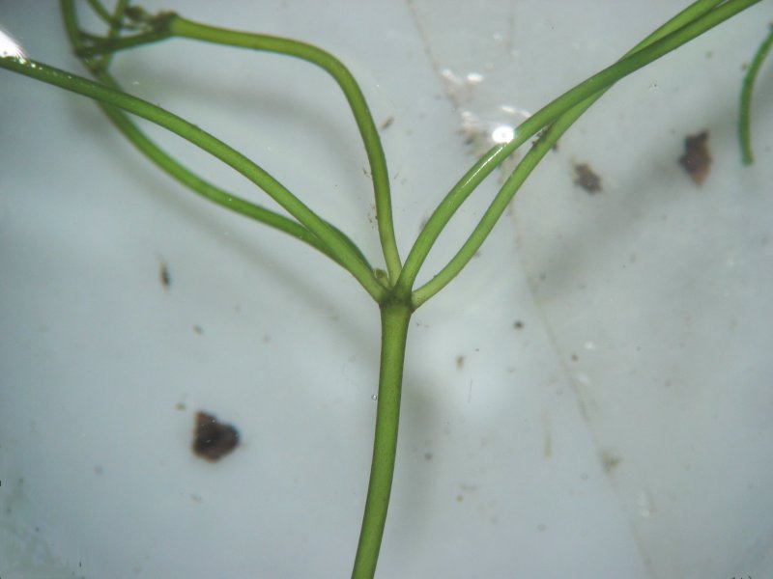
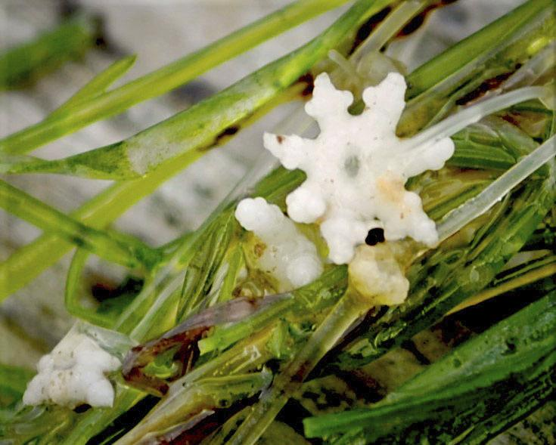
Notes:
Whorled branchlets off a node. Internode is actually one elongated cell!
Plant can be hard and calcified, not unlike horsetail

Slide 15
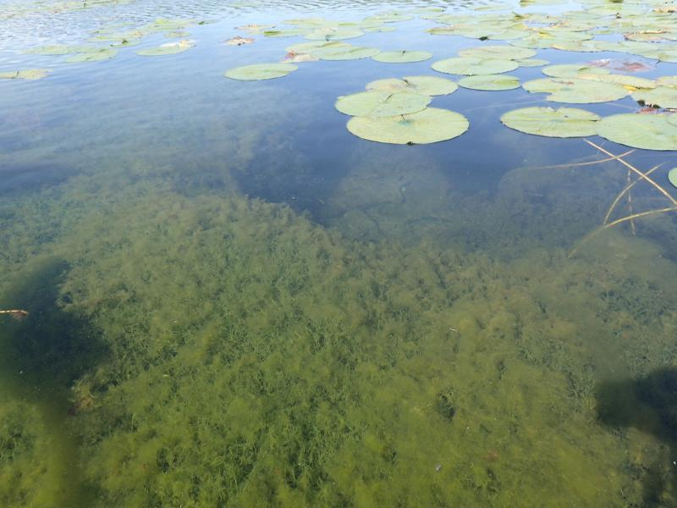
Notes:
Grows in dense mats just under surface, and can spread much deeper than littoral zone. Can spread on fishing tackle since plant can cloneitself!

Slide 16
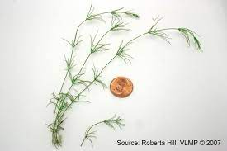
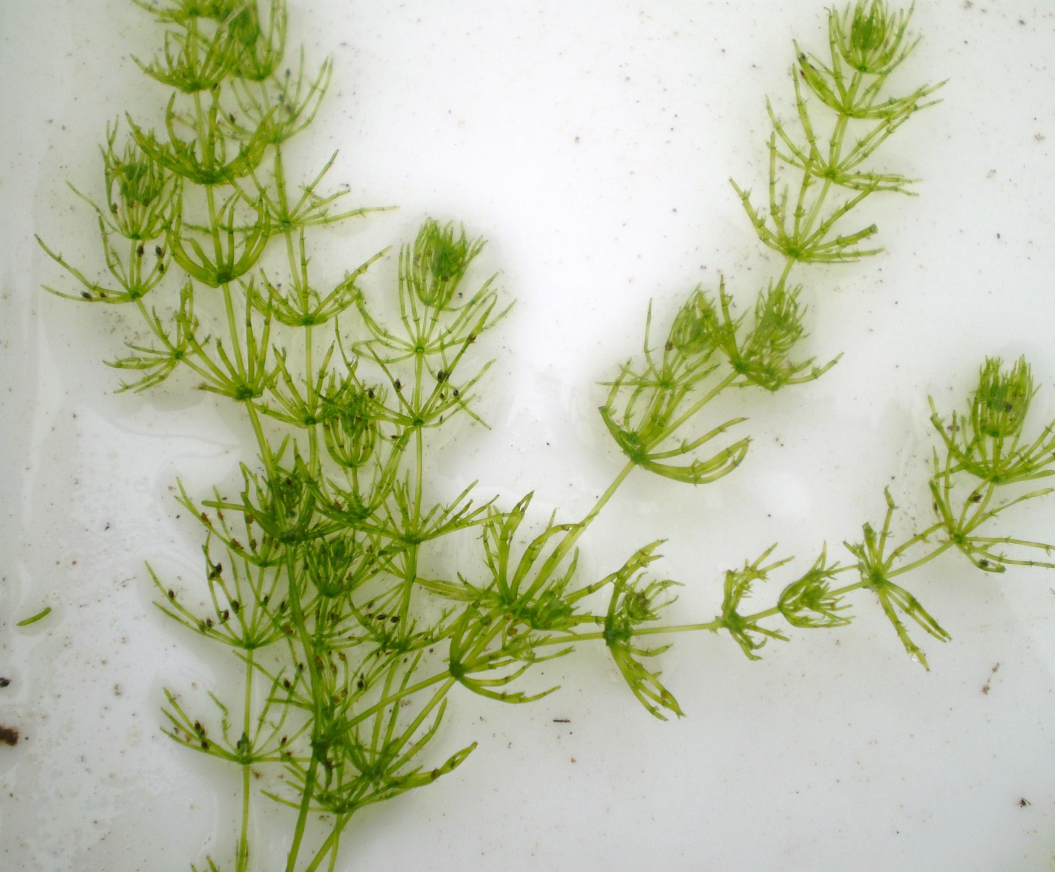
Native Stoneworts
Nitella spp.
Chara spp.
Notes:
Nitella (stonewort) and Chara (muskgrass) are two native stoneworts. Like starry stonewort they are both macroalgae, with stemlike and leaflike structure, and have a whorled branching pattern. Chara also known as skunkweed or muskgrass stinks like sulfur! Nitella doesn’t have the skunky odor.

Slide 17
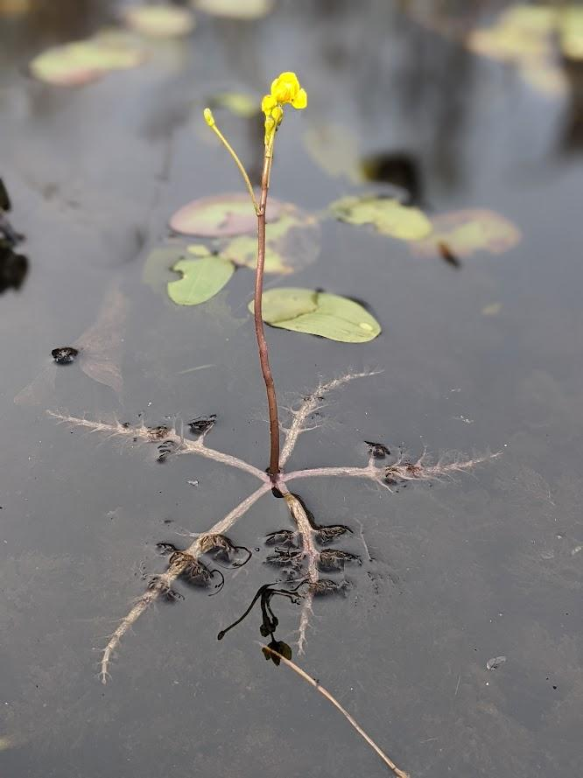
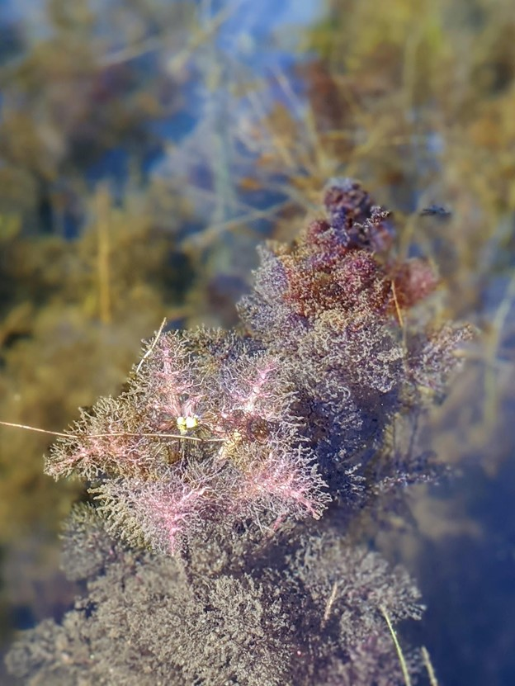
Swollen Bladderwort Utricularia inflata
Notes:
Swollen bladderwort – Curious in that it is native to lower US, but declared invasive in Washington state, New York, Connecticut, Massachusetts, Vermont, Maine came here from boat activity. Spreads quickly in new habitats, can get easier foothold in warming water temperatures. Can choke out native species of bladderwort, but also crowd out littoral zone!
Swollen bladderwort is invasive, and it outcompetes native species of bladderwort, as well as other plants. It grows fast and can easily take over entire coves. Inflata makes dense mats of vegetation, which when decomposing in fall can use up oxygen in the water. These dense mats also inhibit passage from many animals, can limit human use (such as motorized boats) or swimming
Much larger and bushier than radiata. Flat, foliage can be 4 to 10 inches across. New growth can be purple in color. Can look like a dense mat of chaotic vegetation. Habit is like radiata, size is like vulgaris; two closest lookalikes. In Maine, has been observed blooming in late spring, mid summer, and early autumn- but can change based on host climate

Slide 18
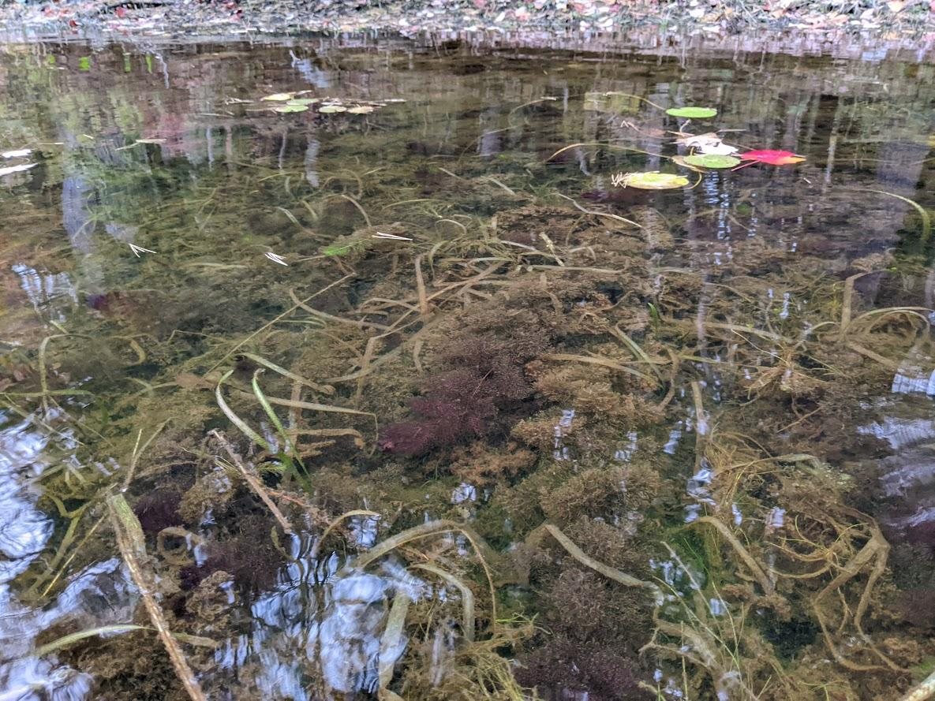
Swollen Bladderwort Now found at:
Horseshoe Pond (Chesterville, Franklin County)
Lake Arrowhead (Limerick, York County)
Mousam Lake (Acton/Shapleigh, York County)
Little Ossipee Lake (Waterboro, York County)
Tilton Pond (Fayette, Kennebec County)
Notes:
Swollen bladderwort now found at 5 locations in Maine. While horseshoe pond was a known and remote infestation, Lake Arrowhead was discovered in 2021. In 2023, infestations were discovered in Mousam, Little Ossippee, and Tilton LSM and DEP surveyed all lakes last year, discovered all were established infestations. Likely more to be discovered in 2024.

Slide 19
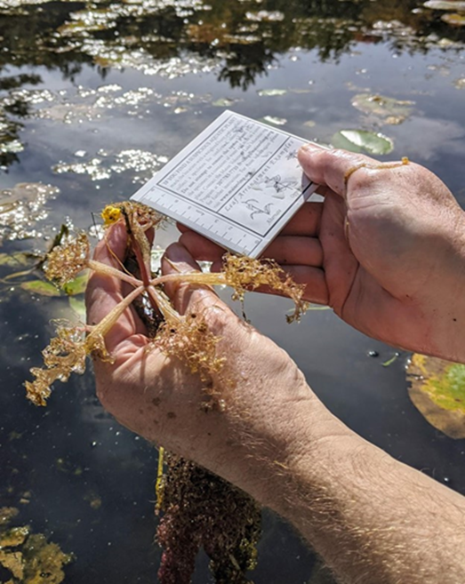
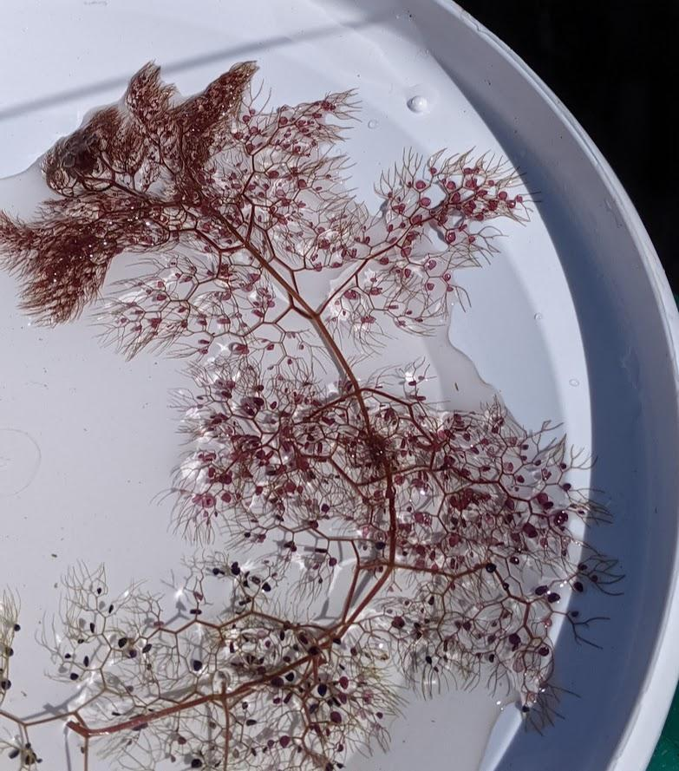
Swollen Bladderwort Utricularia inflata
Notes:
When floating flat, often has honeycomb like hexagonal structure in leaf divisions at roughly 120 degrees
Also note large flower float- tentacle like inflated leaves larger than on radiata – 4 to 10 inches across! Note that branches are very robust, with a tree-like shape. Radiata (floating bladderwort) has much less distinct at branch tips.

Slide 20
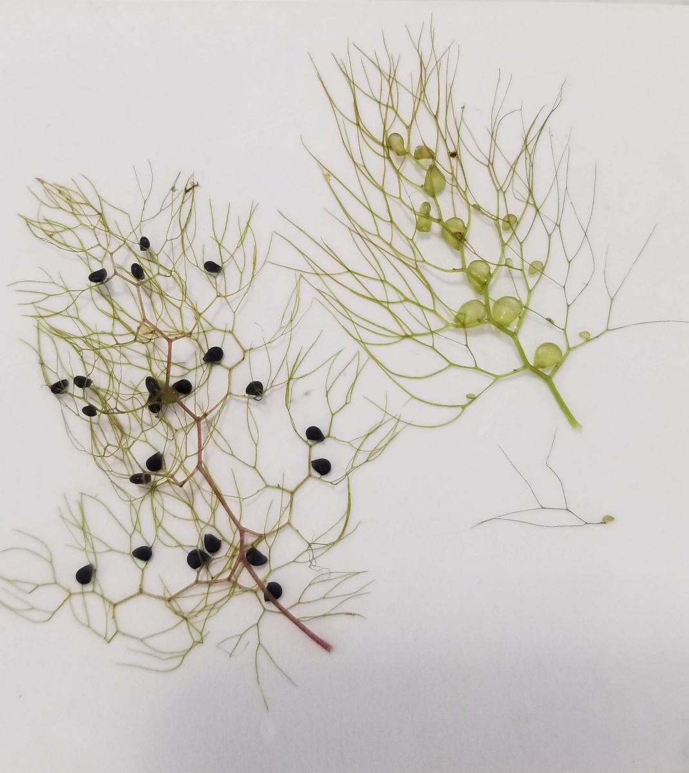
Swollen Bladderwort Utricularia inflata
Common bladderwort
Swollen bladderwort
Notes:
Bladders are smaller and more scattered on leaves than common, which has larger bladders situated towards central axis of leaves, arranged in more orderly fashion.
Divisions in leaves can sometimes be a wider angle in swollen bladderwort, making a honeycomb like shape. NOT DIAGNOSTIC, but sometimes can lead to the correct ID

Slide 21
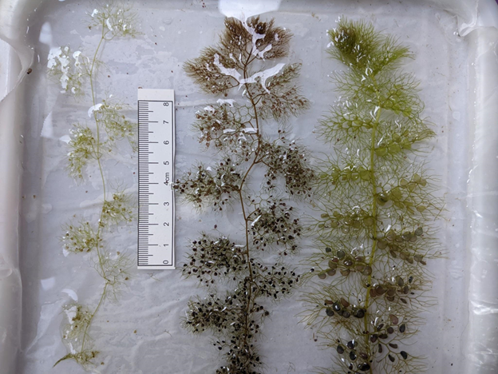
U. radiata
U. inflata
U. vulgaris
Notes:
Comparison between easily confused Swollen bladderwort with native Floating Bladderwort and Common Bladderwort. Note that this does not include northern or large purple bladderwort, as the are less likely to be confused by trained individuals Swollen has dense clustersof bladders which are more randomly scattered. Bladders are smaller than on vulgaris. Geometric, slightly hexagonal branching pattern of inflata visible here. Note radiata’s smaller, more delicate leaves.. Vulgaris has more orderly appearance with larger bladders. Vulgaris also has a thicker stem or stolon than inflata which is finer

Slide 22
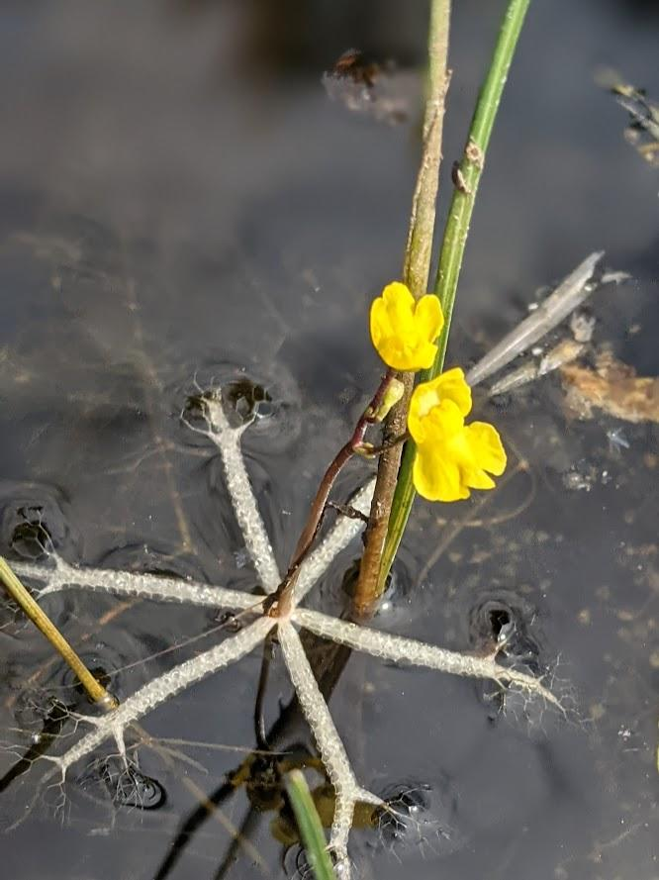
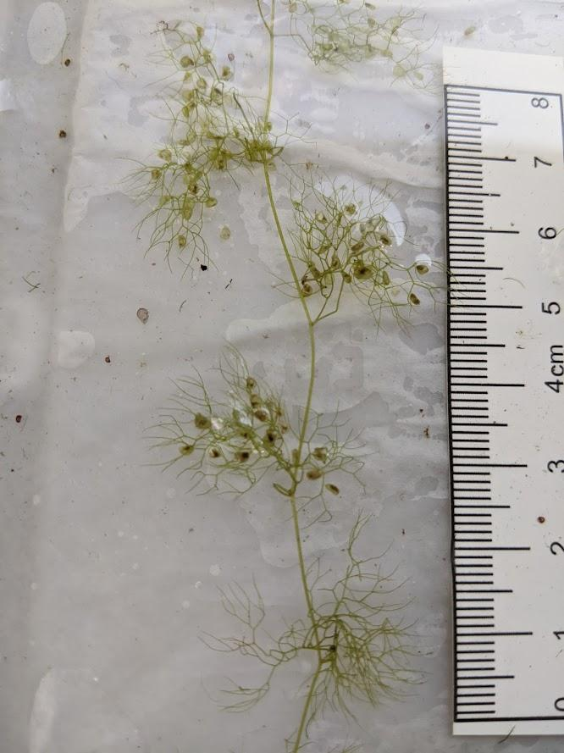
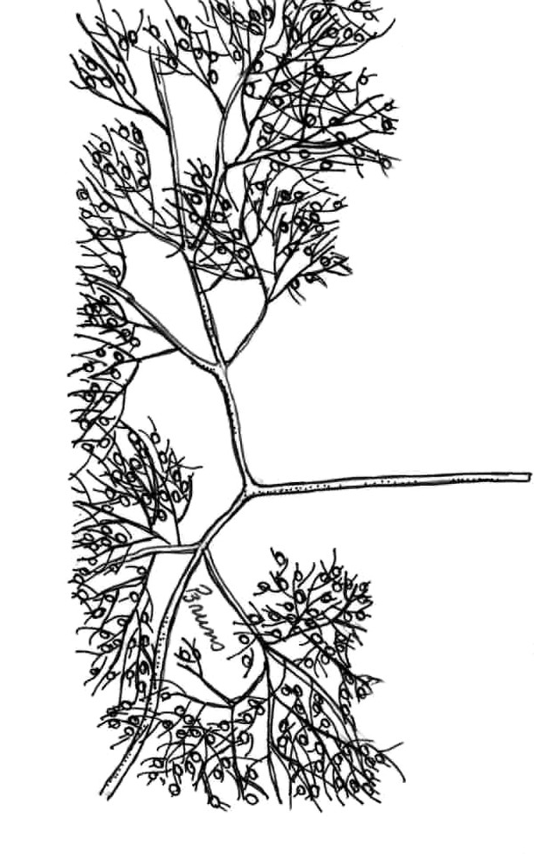
Floating Bladderwort Utricularia radiata
Notes:
Floating bladderwort – radiata – named after radiating float.
Very small and delicate, with dainty leaves and with a small flower with a raft. Flower raft is 1.5 to 3 inches across.
Alternately arranged leaves have a distinctive wide space between nodes on stem.

Slide 23
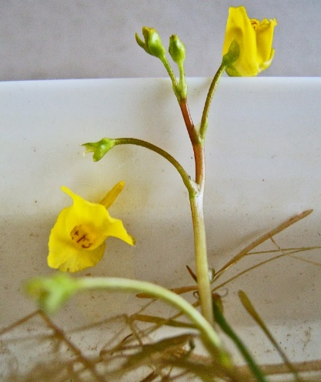
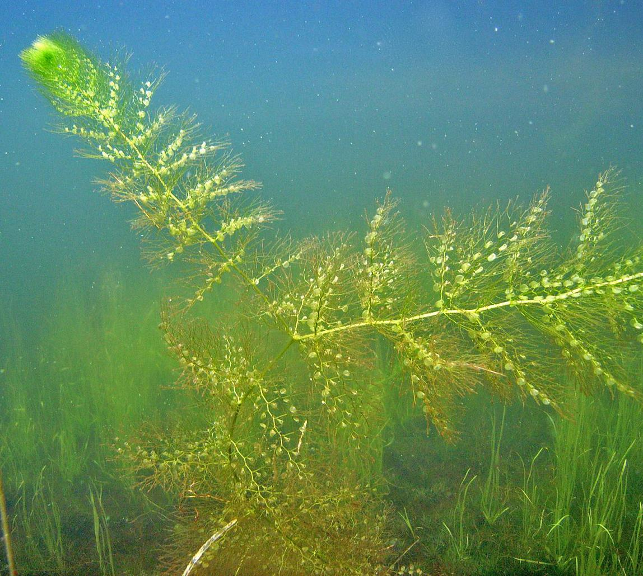
Common Bladderwort Utricularia vulgaris
Notes:
Common bladderwort – Utricularia vulgaris Found all over Maine. Very common and easily identified. Grows in “orderly” fashion Alternate growth finely divided leaves Bladders grow along central axis of leaves in strict alternate pattern new growth is bright green
Flowers above surface WITHOUT a float

Slide 24
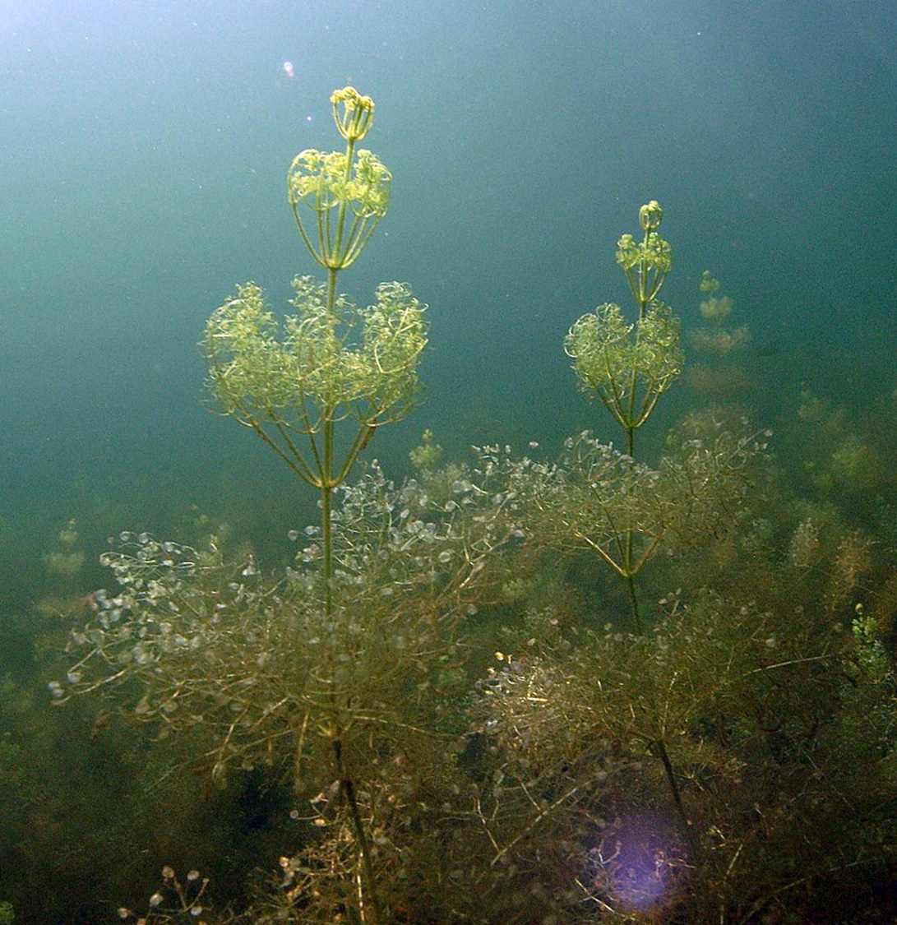
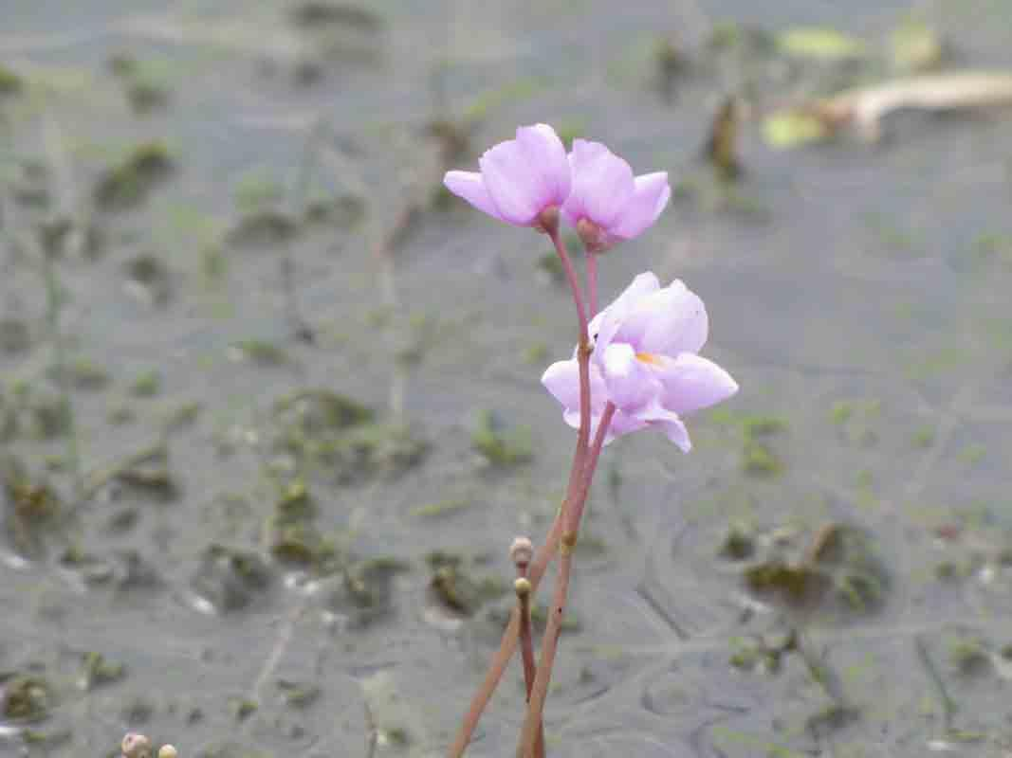
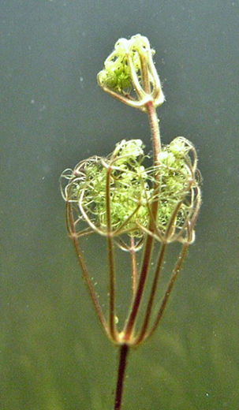
Large Purple Bladderwort Utricularia purpurea
Notes:
Lg prple bwort – named after its emergent purple flowers, without a raft VERY DISTINCT LEAF ARRANGEMENT – Whorls! Only bladderwort in Maine that does this
Can make thick mats of vegetation near bottom of water. Often goes unnoticed but will drift up when disturbed, Bladders are arranged at tips of leaves/leaflets. Terminal bud makes crown shape, or bird cage

Slide 25
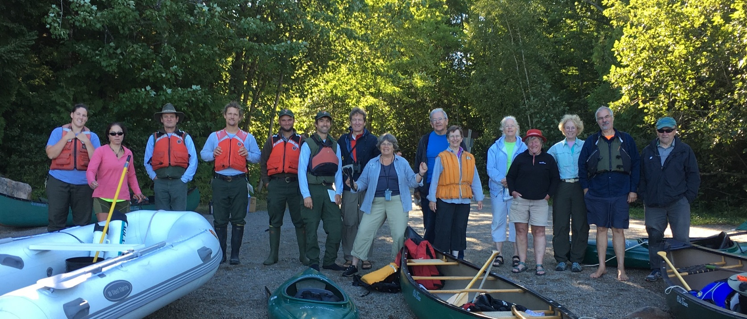
This is where YOU come in!
Invasive Plant Patrol Program
Notes:
Every person has a chance to make a big difference in preventing the spread of Aquatic Invasive Plants. LSM’s Invasive Plant Patrol (IPP) Volunteers are KEY in early detection, monitoring, and education about AIS.
Volunteer work and coordinated efforts from state and private partners have kept Maine’s infestations low. Every volunteer has a chance to make a big difference in preventing the spread of Aquatic Invasive Plants.

Slide 26
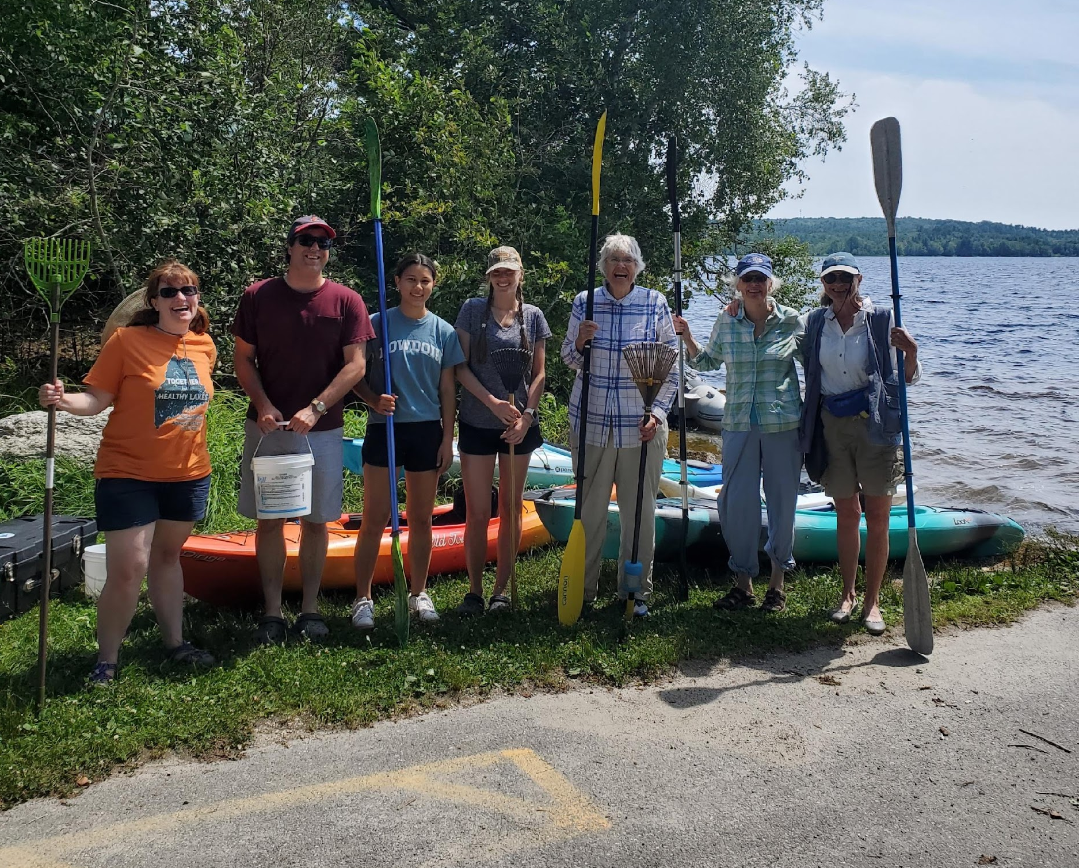
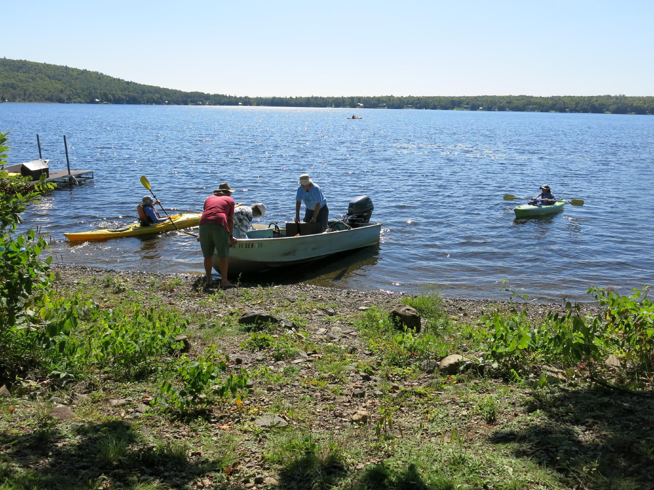
IPP Volunteers Monitor Maine’s Lakes for AIS
Notes:
IPP Volunteers- Volunteers monitor lakes for AIS, report findings to LSM, who proof data and submit to DEP. LSM has trained over 5000 individuals to monitor for AIS since the early 2000s.
LSM IPP TTrainings- Plant Paddles and Live Plant ID classes to teach volunteers how to look for, identify, and report potential invasive plants
IPP Travel Team – Which travel Maine to help with Rapid Response efforts, screening lakes, jumpstart IPP teams, and take native plant inventories
Northern Maine Initiative- which culminates all of the above to bring Travel Team to Aroostook County for training, surveying, outreach and education about AIS – raising awareness of invasive plants and zebra mussels, and jumpstarting local volunteer IPP teams

Slide 27
Certification Tiers
Tier 3: Advanced Plant ID & Written Test
Tier 2:
Live Plant ID & IPP 101
Tier 1: Attend a Plant Paddle
Notes:
Certification slide- We do these trainings so we can certify our volunteers. Each Tier represents a deeper understanding of aquatic plants and ecosystems By certifying our volunteers, LSM can trust that the data they submit at the end of the season is reliable and standardized, goes into public record held by LSM and Maine DEP Certified volunteers must recertify (by attending a plant paddle for Tier 1, or IPP 101 and Plant ID for Tier 2) every 3 years to stay current with aquatic threats and knowledge Volunteers do NOT need to be certified Tier 1 before Tier 2. ALL certified IPPers are valuable volunteers! LSM will reintroduce Tier 3 certification in 2025

Slide 28
Print Resources for IPP Volunteers
Notes:
Print Resources for IPPers – Updated to include the 4 new plants discussed today, as well as the other 11 plants and their native lookalikes
Quick Key
Field Guides Poster ID Cards

Slide 29
Want to Learn More or Volunteer?
May 9, 9 am – “IPP 101” webinar
May 16, 2 pm – “Survey123 for IPPers” webinar
Full Schedule of Plant Paddles & Live Plant ID Workshops:
Notes:
IPP 101 webinar – covers these plants and more – set for May 9 Sign up online Also, Plant Paddles and Live Plant ID happening around the state – look for schedule soon
More specific pre-recorded webinars online for bladderworts and floating leaf plants.

Slide 30
Brett Willard Aquatic Invasive Species Program Director
brett@lakestewardsme.org
207-783-7733
www.lakestewardsofmaine.org
www.lakesofmaine.org

