Slide 1
Maine DEP Updates 2024 AIS Summit
John McPhedran
Biologist, Invasive Aquatic Species Program
MAINE DEPARTMENT OF ENVIRONMENTAL PROTECTION
Protecting Maine’s Air, Land and Water
Notes:
Introduce staff and welcome Dakota.

Slide 2
DEP Updates
De-listing
Grant funding 2024
Legislation
Planning

Slide 3
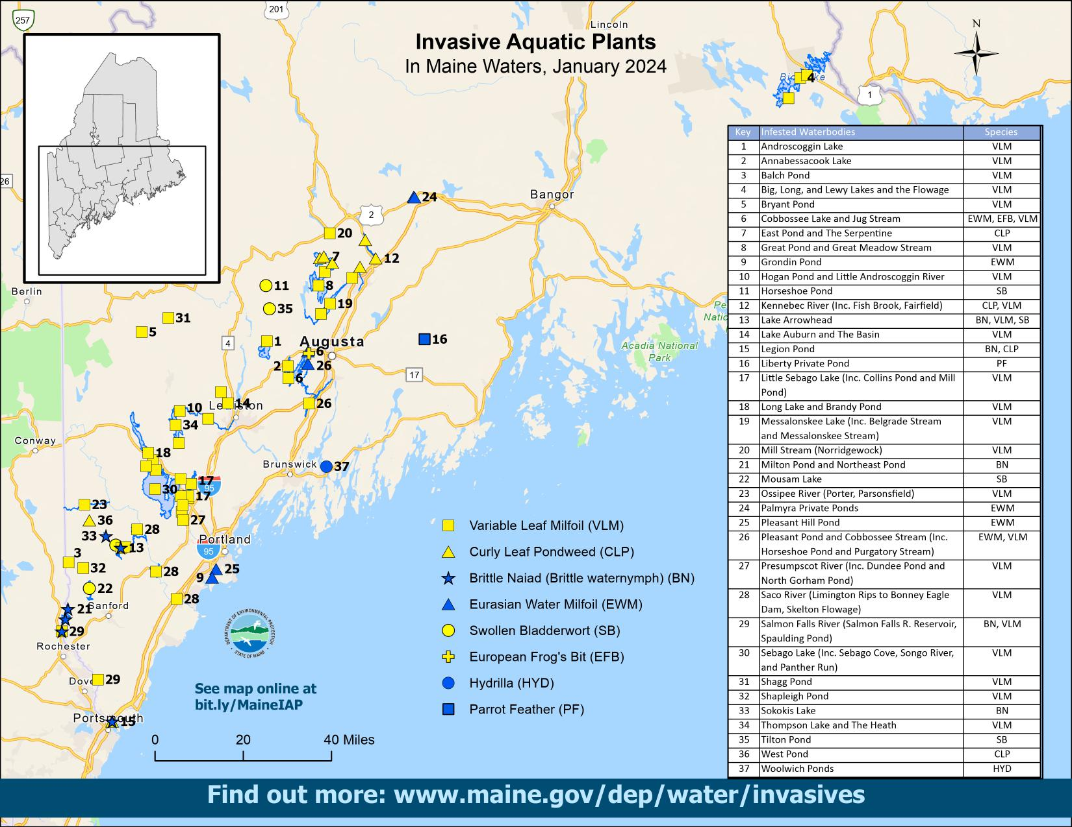
Notes:
We don’t typically talk about de-listing aquatic invasive species infestations, but it does happen. One very recent de-listing was of Alamoosook Lake. Genetic work on milfoil species found in the lake showed that they had one of the invasive milfoils. But the morphology of the plant didn’t match the genetic results. The lake association and DEP teamed to collect additional milfoil samples and Luc Bernacki at St. Joseph’s ran the analysis on number of these samples. Turns out that the plant is indeed a native milfoil, alternate flowering or M. alterniflorum. Thanks to Luc for getting to the bottom of this.

Slide 4
De-listings Since Program Start
Cushman Pond – Lovell
Middle Range Pond – Poland
Great East Lake – Acton
Pleasant Lake & Parker Pond – Casco/Otisfield
Salmon Lake – Belgrade (M. spicatum)
Damariscotta Lake – Jefferson (H. verticillata)
Pickerel Pond – Limerick (H. verticillata)
Notes:
Typically removing established invasive aquatic plants isn’t possible. But there has been some success with eradication in Maine. We use the term “functional eradication” of former colleague Mike Netherland from U of Fl and ACOE: we can’t survey all available habitat but we don’t see the plant on surveys, esp. in areas where we know the plant was. The circumstances for each delisting are unique and in most cases state/local collaboration is integral to the success.
We’re also hopeful that two small private ponds managed in 2022 will be removed from the list.

Slide 5
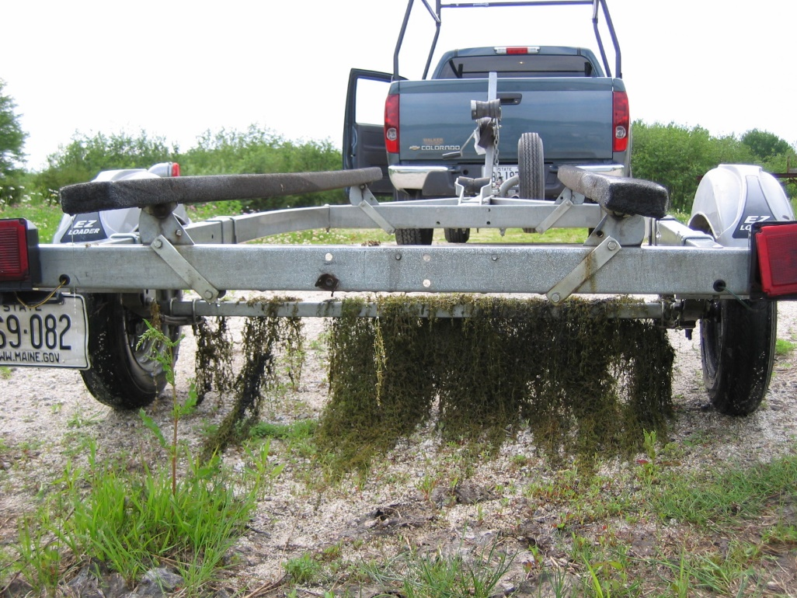
Grants Awarded 2024
Courtesy Boat Inspections
Competitive $182,678
Direct $159,147
Total $339,525
Notes:
Explain competitive v. direct grants

Slide 6
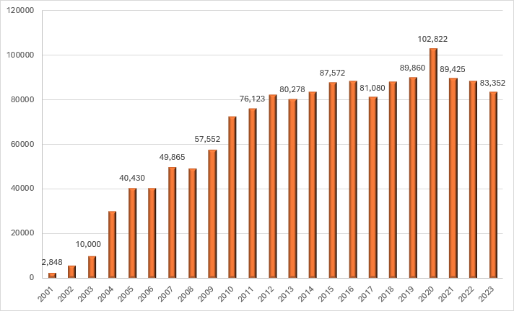
Courtesy Boat Inspections
Notes:
Note peak in 2020 inspections. 2023 inspection total likely a result of persistent rain last summer.
Trainings for CBIs, also for BASS tournaments and other boating events, are done by LEA with DEP and DIFW support.
Staffing inspection programs is becoming a challenge.

Slide 7
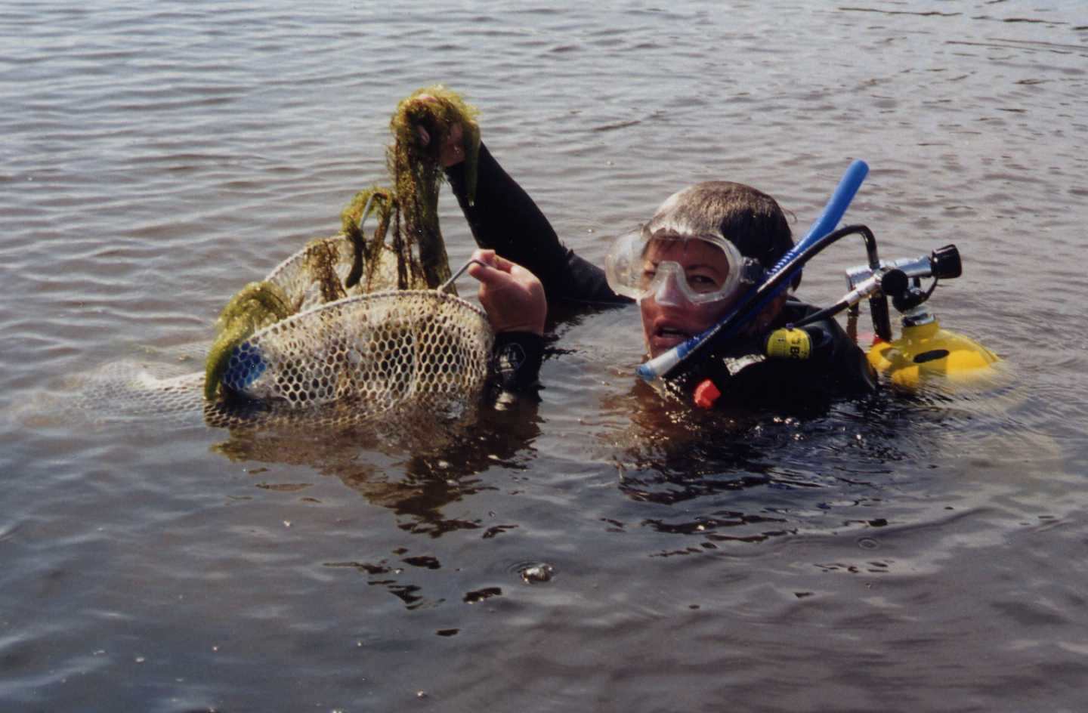
Grants Awarded 2024
Plant Removal Grants
One Year $199,283
Two Year $743,530
Total $942,813
Requests $1,057,001

Slide 8
Plant Control Grant Match 2020-2023
Notes:
Lake associations and watershed groups contribute more than half of the total dollar amount spent on plant removal projects

Slide 9
Funding Increase
Carry-over bill became law yesterday just over two weeks ago
Increased fees to motorized watercraft
Instate Out of State
Current $15 $45
Starting 2025 $25 $60
Starting 2028 $35 $75

Slide 10
Funding Increase
Adjusts distribution of revenue:
-Currently: 80% to DEP and 20% to DIFW
-Starting 2025: 70% to DEP and 30% to DIFW
DEP Annual Revenue starting 2028 ~ $2,898,937*
DIFW Annual Revenue starting 2028 ~ $1,242,402*
*estimate using current registrations/sticker sales
Notes:
What does this mean for program funding?

Slide 11
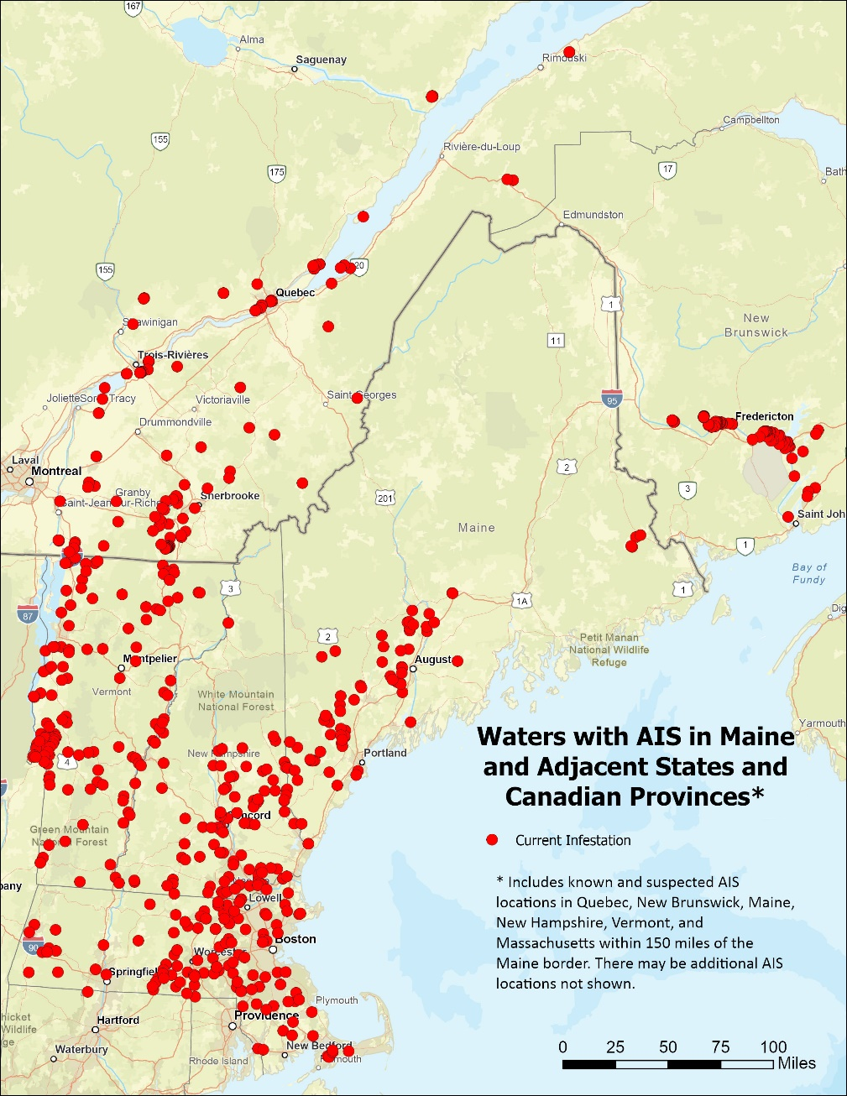
MAINE DEPARTMENT OF ENVIRONMENTAL PROTECTION www.maine.gov/dep
Notes:
The threat of more AIS will only increase with longer ice-free periods and people coming to Maine with our abundant water resources. We have a lot to protect in all parts of Maine but particularly in the more remote areas of the state.

Slide 12
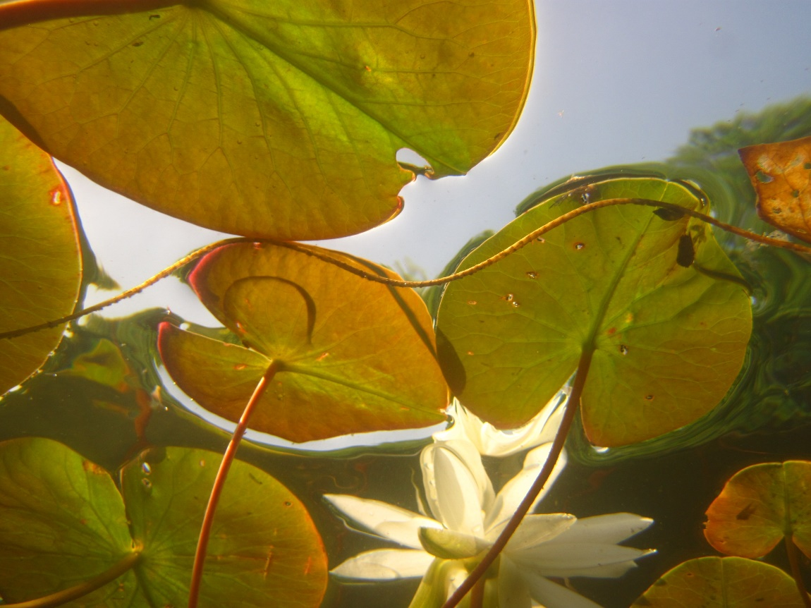
Where do we go from here?
Maine DEP AIS Unit
10-Year Strategic Goals:
Strong Communication &
Support to Partners
MAINE DEPARTMENT OF ENVIRONMENTAL PROTECTION www.maine.gov/dep
Notes:
In Fall 2023 our unit, with assistance from our Division Director Wendy Garland, embarked on a strategic planning process. I will briefly describe the crux of our approach. There is a draft plan that we will finalize by summer and we will distribute it at that point.
Note: the plan addresses submersed (v. wetland) invasive aquatic plant species but we recognize significant threats to wetlands by IAP.
Communication to partners
Our partners include:
1 We have been working closely with DIFW and that relationship will only increase since Dakota has come on board. There are likely opportunities for trained plant patrollers to assist with work DIFW is doing to detect zebra mussel; -also outreach opportunities with DIFW on many fronts
2. We will continue to work with and support our regional and statewide partners – LSM and LEA, also Laurie Callahan/YCSWCD-And work with lake associations and individuals.
3. We will continue to engage the TF and stakeholder group, e.g., review the 2006 RR Plan in 2024 and the SUR process.
-review the 2020 state plan update and formally submit it to the USFWS for review and acceptance.
4. This could include periodic needs assessments (one done recently), changing the summit to accommodate more people/other areas; all day summit?

Slide 13
Where do we go from here?
Maine DEP AIS Unit
10-Year Strategic Goals:
Strong Communication &
Support to Partners
Expand Program Reach
MAINE DEPARTMENT OF ENVIRONMENTAL PROTECTION www.maine.gov/dep
Notes:
Expand Program Reach
1. Currently there is much work being done in southern/central parts of the state. We need to expand to areas of the state with less infrastructure where we have a great deal to protect
2. Expanding prevention and early detection programs administered by the AIS Unit and NGO partners throughout the state is a key strategy in protecting the waters of the state.
3. The crux of expanding reach is having presence in remote parts of the state through development of IAS HUBs. Goal is to eventually establish 7 hubs throughout the state but this will take years.
4. Assess needs of underserved areas. Underserved areas with known or high risk to AIS infestations are those with limited AIS prevention and early detection resources, few to no organizations or individuals to promote those activities, or areas with limited historical AIS activities supported by the DEP.
IAS HUB in a nutshell:
-extend reach for prevention and ED throughout state.
-paid positions: state contractor.
-Ground work in 2024 for first hub. Have first hub up and running in 2025.
-proactive approach
-LSM and LEA trains the hubs
-Hub recruits and coordinates training in region, increases effort on high risk lakes, coordinates data collection…

Slide 14
Where do we go from here?
Maine DEP AIS Unit
10-Year Strategic Goals:
Strong Communication &
Support to Partners
Expand Program Reach
No New Infestations
MAINE DEPARTMENT OF ENVIRONMENTAL PROTECTION www.maine.gov/dep
Notes:
No new infestations – rather bold but why not?
1. Identify high risk lakes without CBI for coverage and seek individuals or groups on high-risk lakes who are willing and able to implement CBI on their lakes
2. If not getting interested in CBI (for ex. Due to lack of staffing), consider promoting plant paddles on high risk lakes.
Spread prevention
3. We will explore the use of strategically located wash station and how to staff and fund those. Down the road potential ACOE funding potential for wash stations.
4. Will work closely with DIFW on outreach for promote spread prevention measures.
5. Have a pending contract with firm to help identify barriers to desired behavior – Clean Drain Dry.
Early detection
6. meeting with groups on high risk waterbodies.
7. schedule or contract for survey of high risk waterbodies.
8. possible grant program for plant survey on high risk waterbodies.
9. LSM statewide trainings at IAS hubs.

Slide 15
Where do we go from here?
Maine DEP AIS Unit
10-Year Strategic Goals:
Strong Communication &
Support to Partners
Expand Program Reach
No New Infestations
Robust Management
MAINE DEPARTMENT OF ENVIRONMENTAL PROTECTION www.maine.gov/dep
Notes:
Robust Management
1. Many in this room know there is lots to consider in management: funding, monitoring, identification, spread prevention, method of control, etc
2. Review of RR Plan including SUR process.
3. Lake Management Plan for each waterbody – some still need updating.
4. Continue plant removal grant program.
5. DEP continues with RR efforts.
Set of last five bullets is to summarize in very broad terms.

Slide 16
Where do we go from here?
Maine DEP AIS Unit
10-Year Strategic Goals:
Strong Communication &
Support to Partners
Expand Program Reach
No New Infestations
Robust Management
Pro-active vs Re-active
We don’t know what we don’t know re infestations
Regional Approach
Focus more on early detection, expand CBI and prevention
Updated Management Plans for all existing infestations
RFP for Community Based Social Marketing
MAINE DEPARTMENT OF ENVIRONMENTAL PROTECTION www.maine.gov/dep
Notes:
Robust Management
1. Many in this room know there is lots to consider in management: funding, monitoring, identification, spread prevention, method of control, etc
2. Review of RR Plan including SUR process.
3. Lake Management Plan for each waterbody – some still need updating.
4. Continue plant removal grant program.
5. DEP continues with RR efforts.
Set of last five bullets is to summarize in very broad terms.

Slide 17
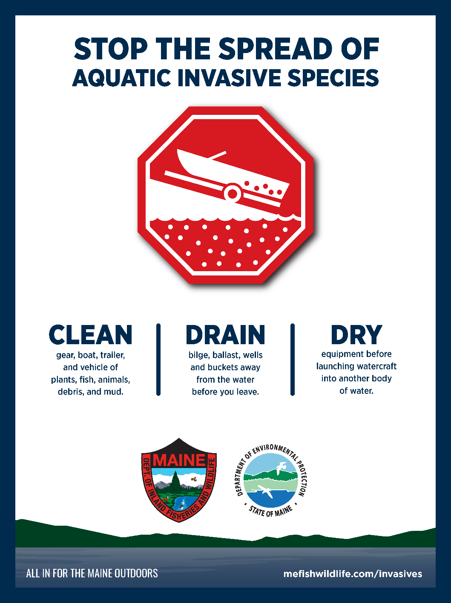
Clean Drain Dry
Notes:
New ramp signage was created, and sign installation began late summer 2022.

Slide 18
Denise Blanchette: denise.l.blanchette@maine.gov John McPhedran: john.mcphedran@maine.gov Toni Pied: toni.pied@maine.gov Chris Reily: chris.reily@maine.gov
Notes:
Mention Collaborations with:
LSM
LEA
YCSWCD
Regional Lake and Watershed Associations
Individual Associations
Uber volunteers esp. Uber IPPers at LSM

Slide 19
Draining bill became law June 2023
Prior to entering a water body and when preparing to leave launch sites, boaters are required to remove or open any devices designed for routine removal/opening (for example, hull drain plugs, bailers, live wells, ballast tanks) to encourage draining of areas containing water (excluding live bait containers).
This must be done in a way that does not allow drained water to enter any inland water of the state.
Notes:
In addition to the 4 plants added by the legislature last winter (and prohibitions on all Trapa, Cabomba and Myriohyllum not indigenous to Maine), the “Clean Drain Dry” bill became law in June. DIFW has done outreach on this law through social media and on their website.

