Slide 1



Courtesy Boat Inspector
Coordinator Training
Mary Jewett – Lakes Environmental Association
Chris Reily- Maine Department of Environmental Protection

Slide 2
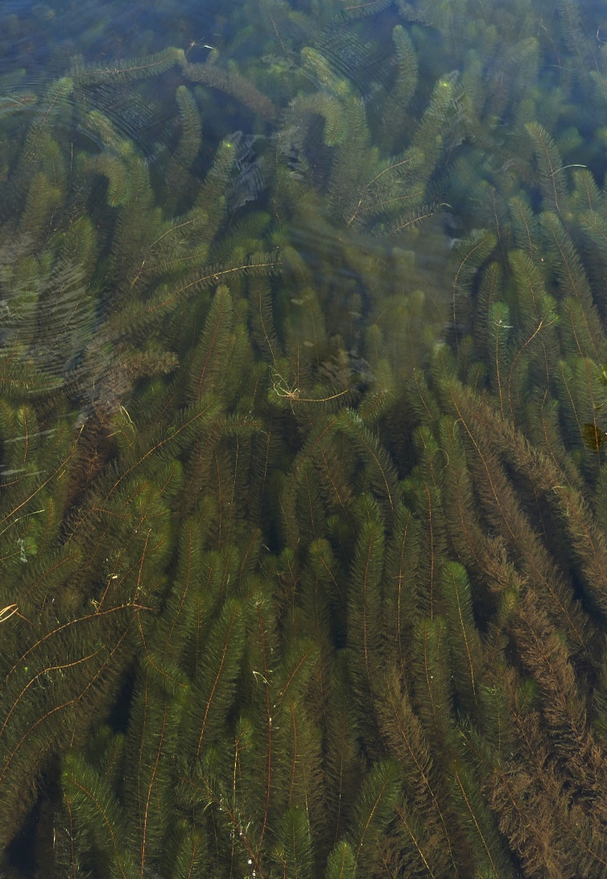
Why are aquatic invasive species (AIS) a threat to lakes, ponds, rivers and streams?
AIS have multiple reproductive strategies & no natural enemies; grow vigorously; out-compete natives.
Blanket lake surface, impeding recreational uses; lower property values; change ecology
Can rarely be eradicated; are expensive to manage (an “everafter” cost); threaten all other fresh waters.

Slide 3
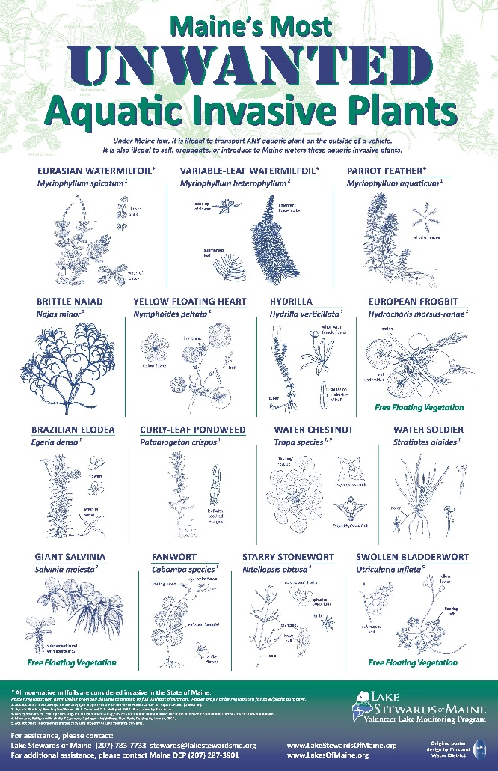
Maine AIS Law
MRS Title 38 Subsection 419-c
Prohibition.
A person may not:
Transport any aquatic plant or plant part on the outside of any vessel on a public road
Posses, import, cultivate, transport, or distribute any invasive plant (15 on list)
Drain or release water into any inland water source
Draining of watercraft and equipment.
Just prior to launching and when removing a watercraft a person:
Shall remove or open any hull drain plugs, bailers, valves, live wells, ballast tanks, and other devices designed for routine removal or opening and closing to encourage water to drain

Slide 4
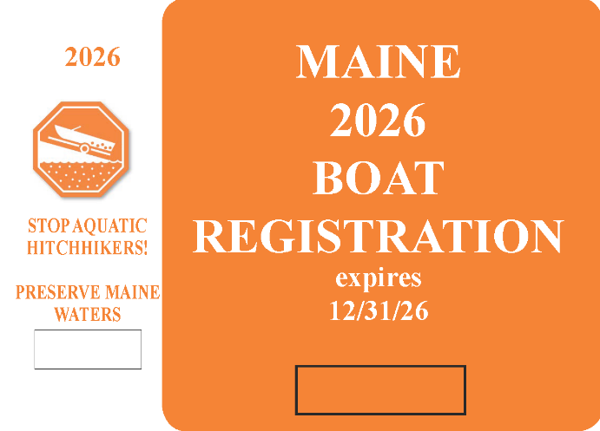
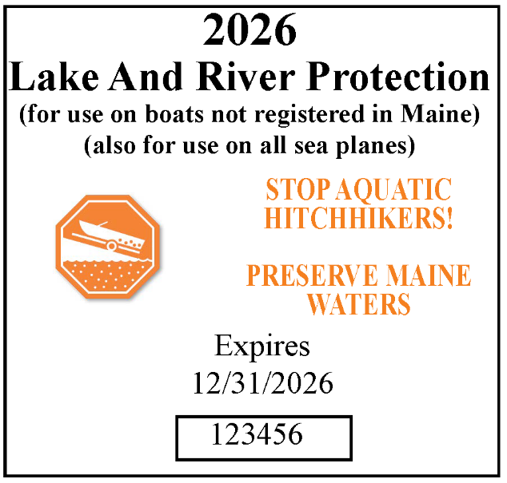
Maine AIS Law
Penalties.
Violations may result in fines up to $500, and $2500 for subsequent violations. This includes fines for failure to display the current years Lake and River Protection Sticker.
Funding.
Funding Mechanism: Sticker revenue goes into dedicated state fund, 70% to DEP, 30% to DIFW. Funds are used for plant removal, early detection, and invasives prevention

Slide 5
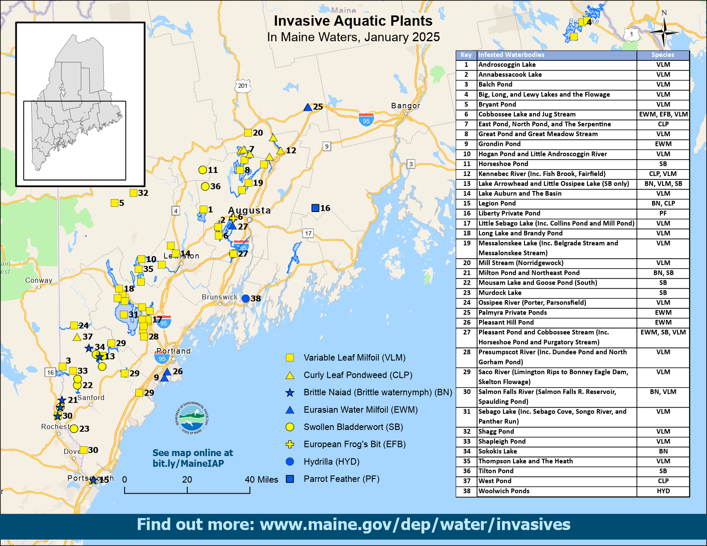

Slide 6
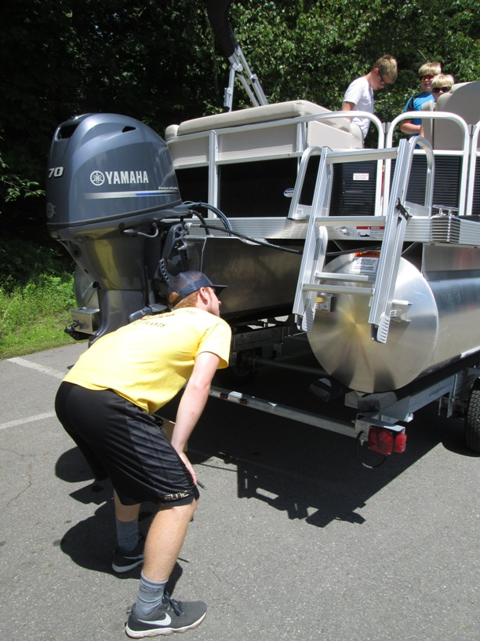
What makes a good inspection?
Be courteous
Be informative but not overwhelming.
Do a thorough inspection:
  Inspectors will need to crouch down in order to see the entire underside of the boat - just the prop is not enough!
  Ask if you can look inside boat – did they drop anchor?
  Is the drain plug pulled?
Stickerless motorized boats: tell boater about penalty and where to get stickers locally.
Boater refuses inspection: politely ask them to do it and step aside

Slide 7
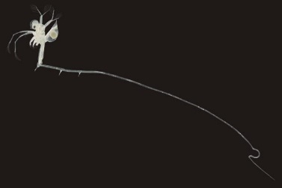
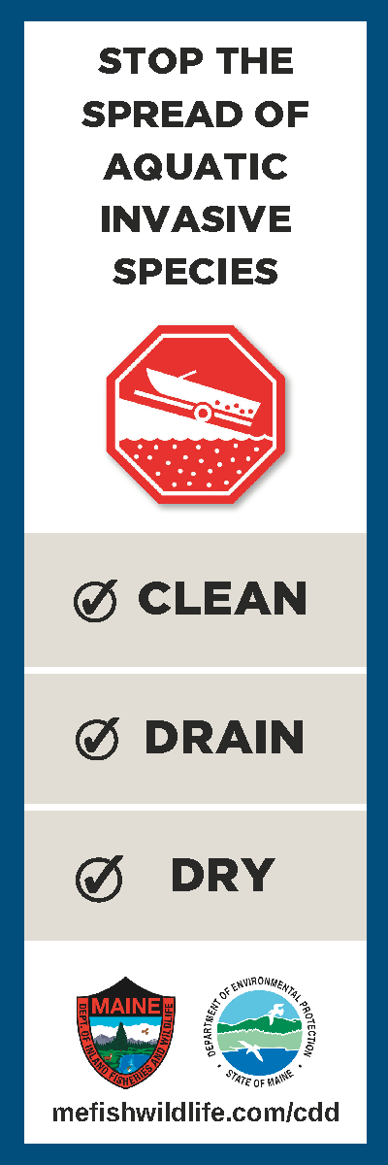
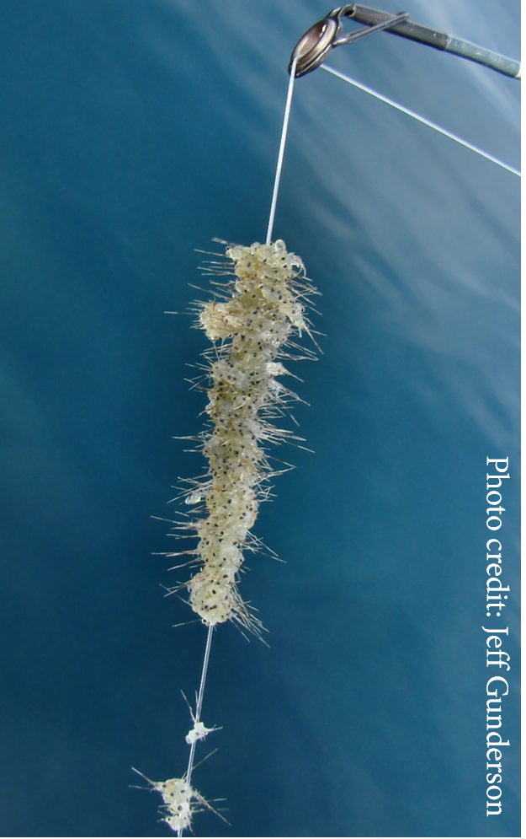
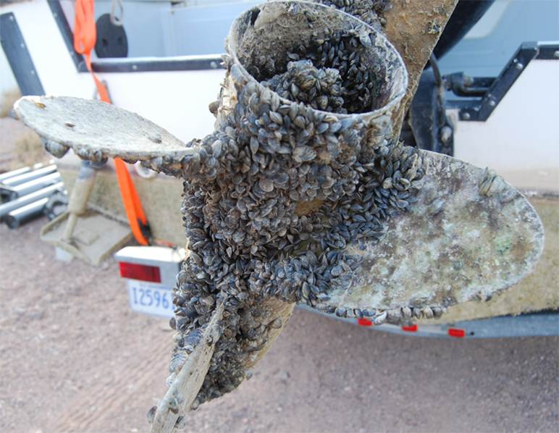
Clean, Drain, Dry

Slide 8
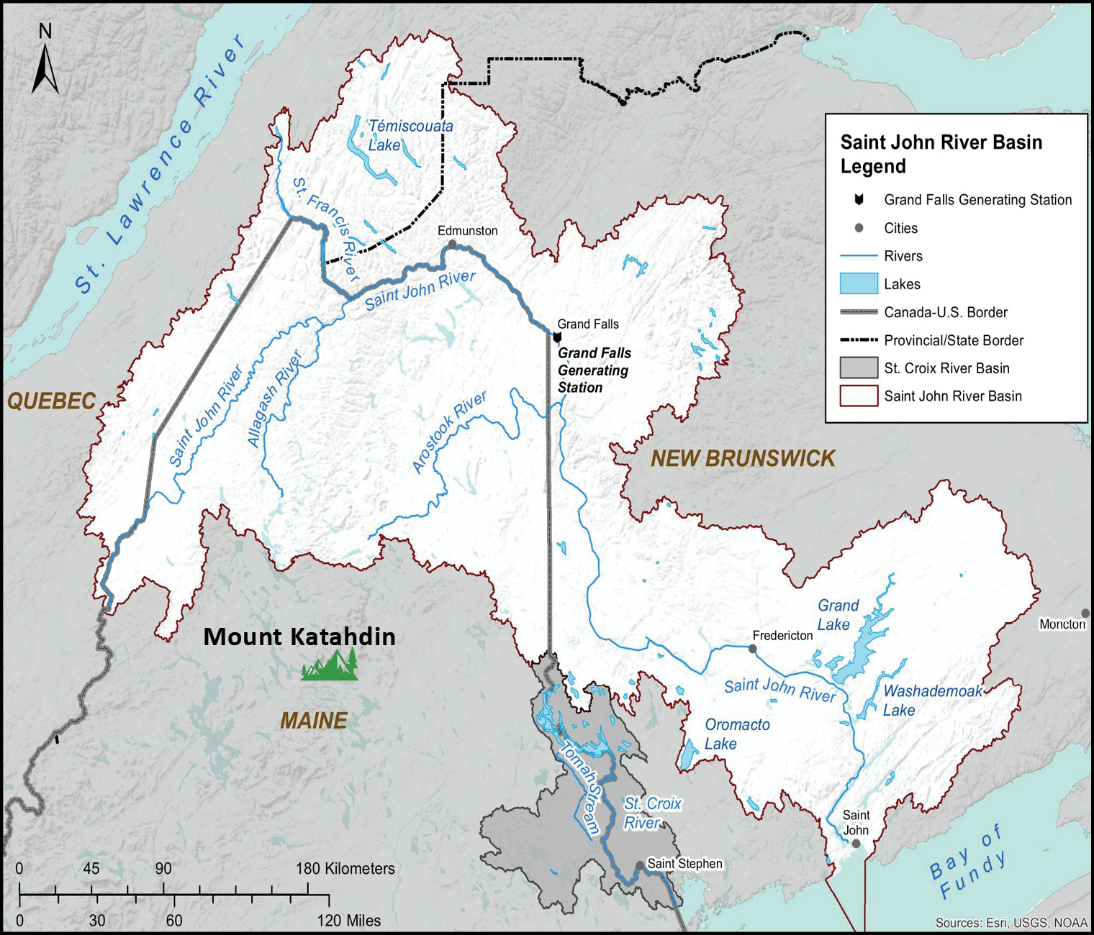
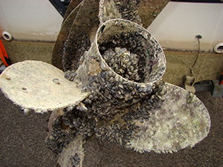
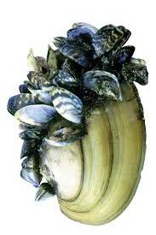
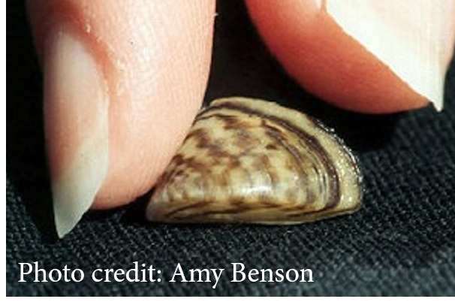
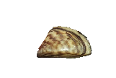
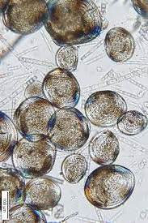

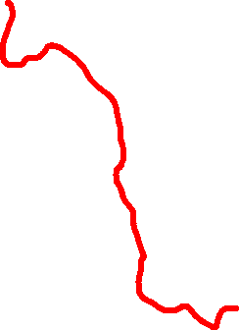
Zebra Mussels
Small freshwater mussel
Filter feeder
Attach to surfaces
Colonizers – up to 750,000 per square foot
Veligers are difficult to detect
Wherever water goes, so can Zebra Mussels!

Slide 9
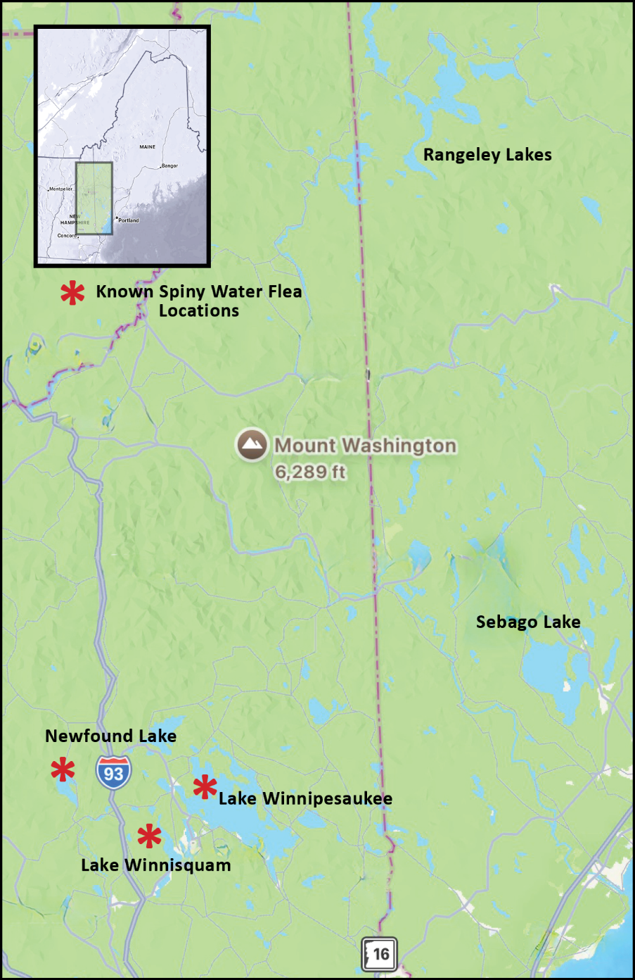
Spiny Water Flea
Not a flea – Tiny crustacean
Feeds on zooplankton
Impedes feeding for small fish
Builds up on fishing lines and gear
Reproduces asexually

Slide 10
Graphic: Aquatic Nuisance Species Task Force

Slide 11
Graphic: Aquatic Nuisance Species Task Force

Slide 12
Graphic: Aquatic Nuisance Species Task Force

Slide 13
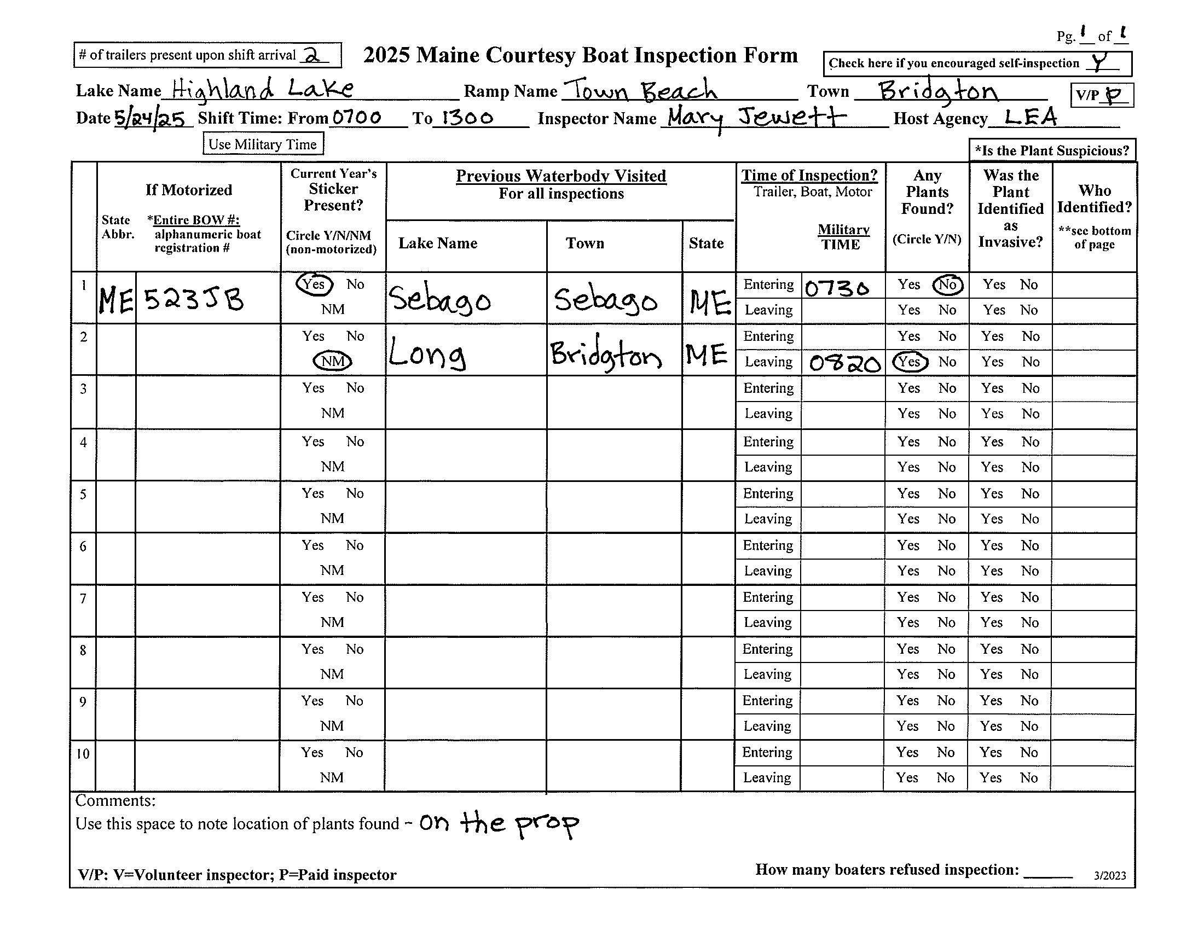

Slide 14
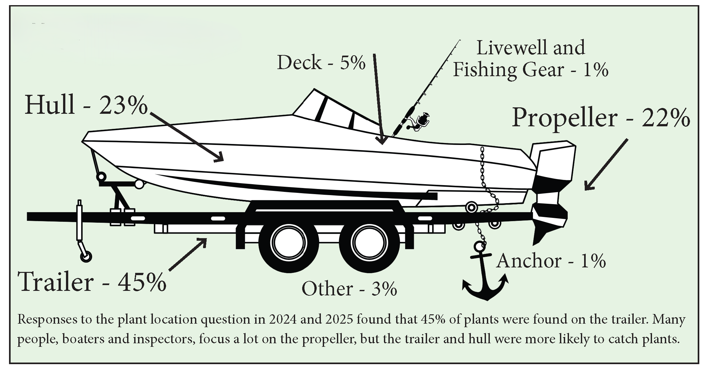

Slide 15
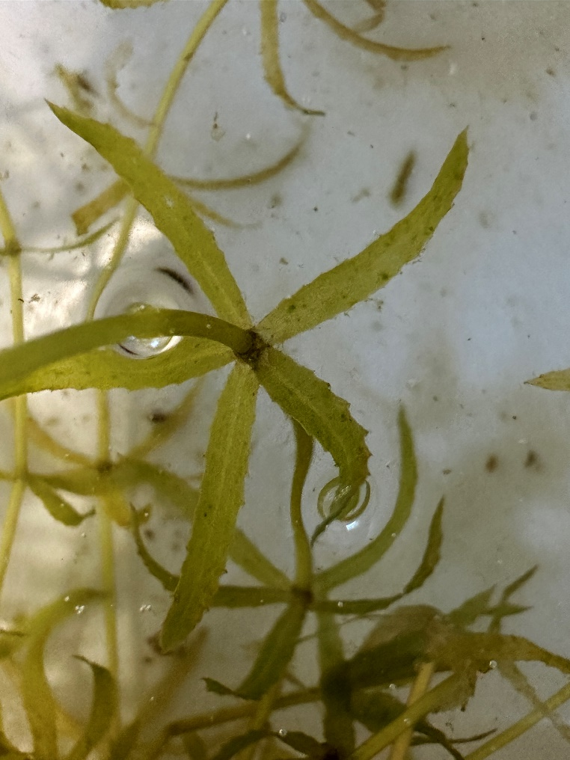
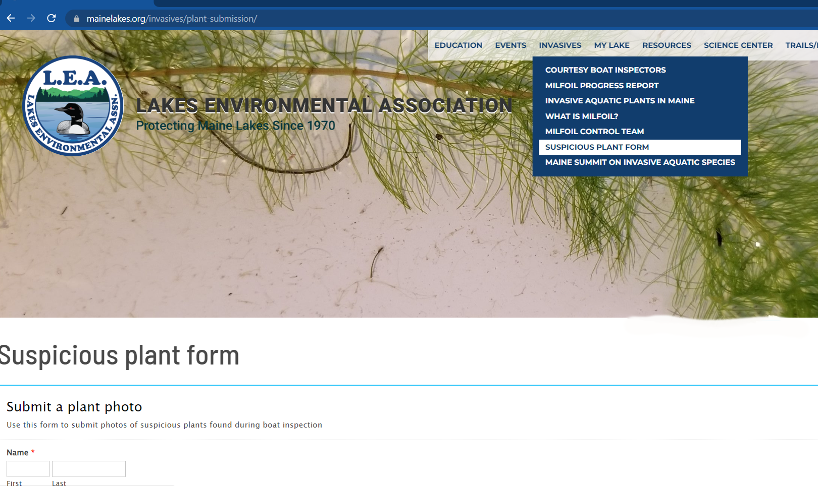
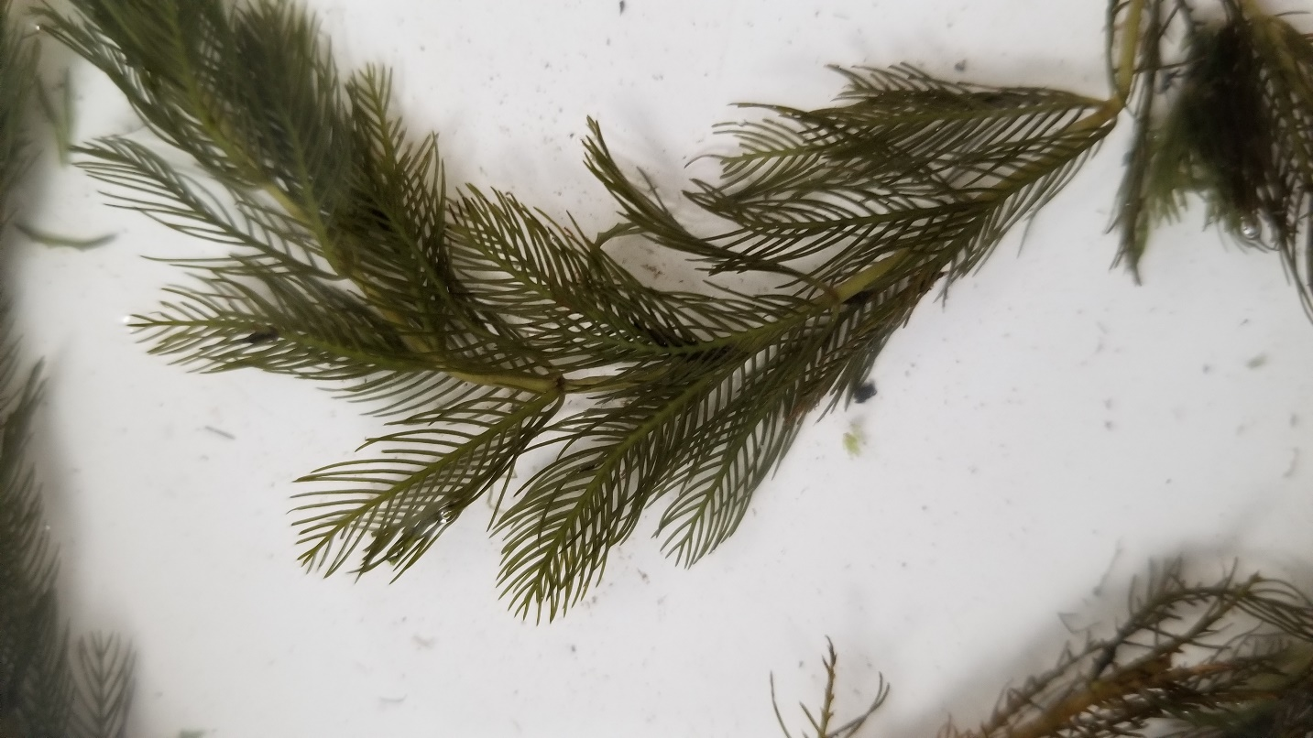

Suspicious Plant Found
Inspector decides if it’s suspicious
Gives plant sample to coordinator
If coordinator can’t ID – send photo to LEA
Go to photo submission page on LEA website
Keep sample in fridge

Slide 16
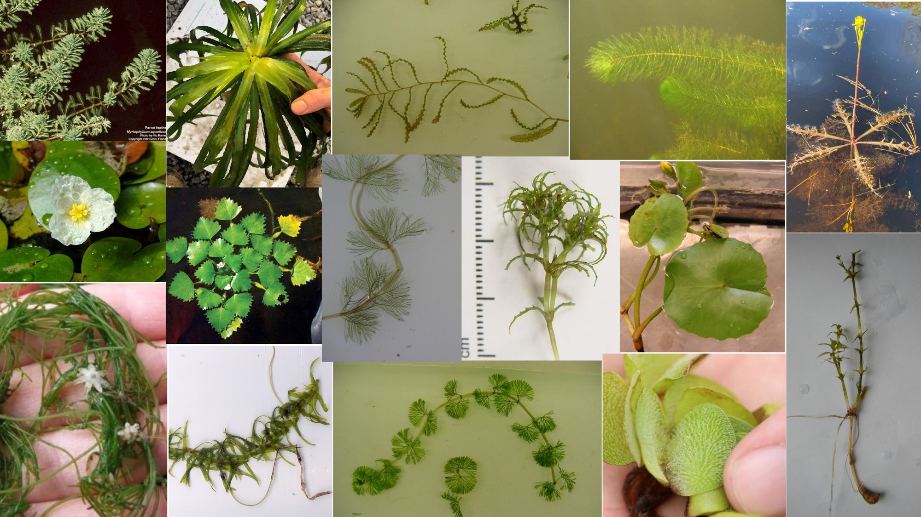
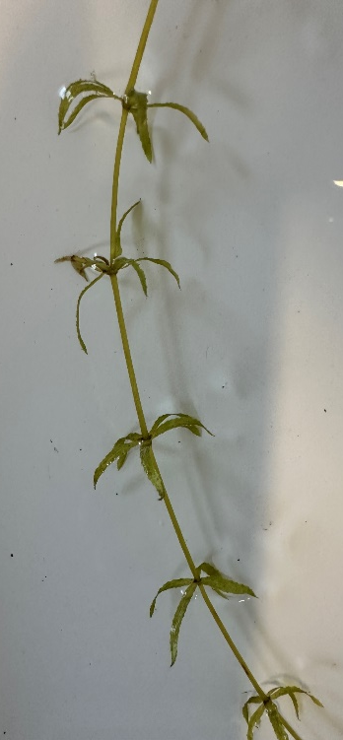
15 Most Unwanted Plants

Slide 17
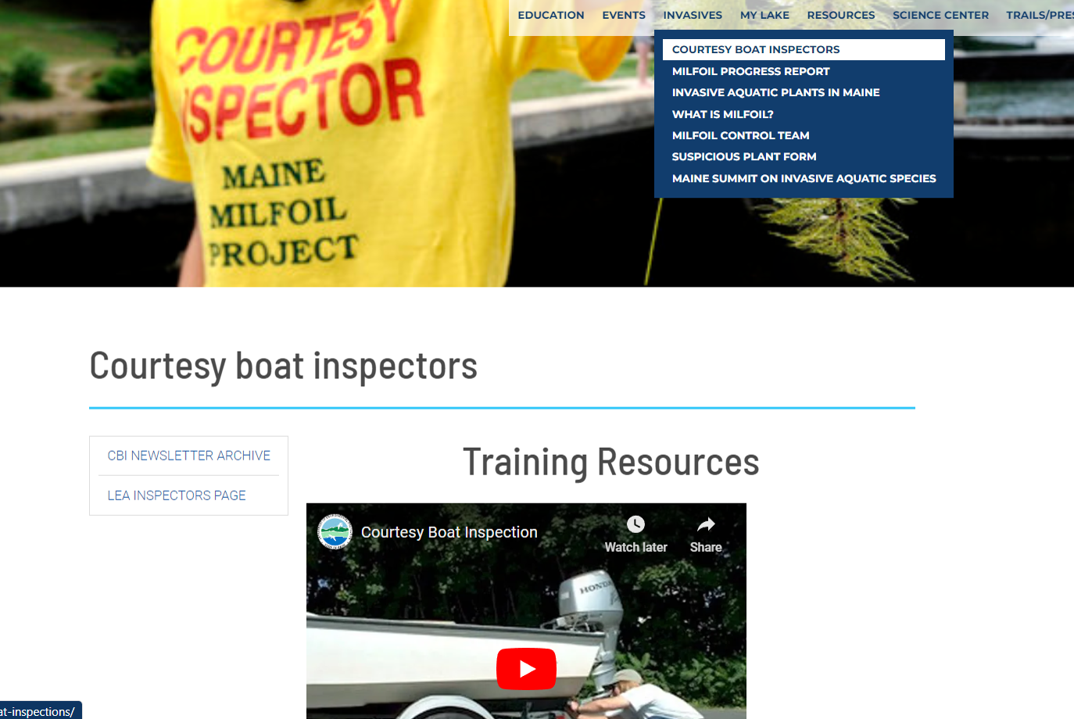

Slide 18
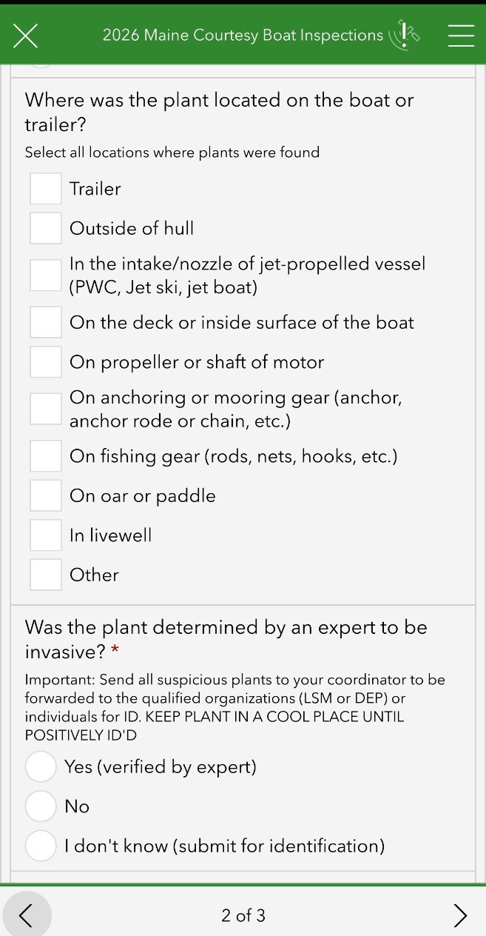
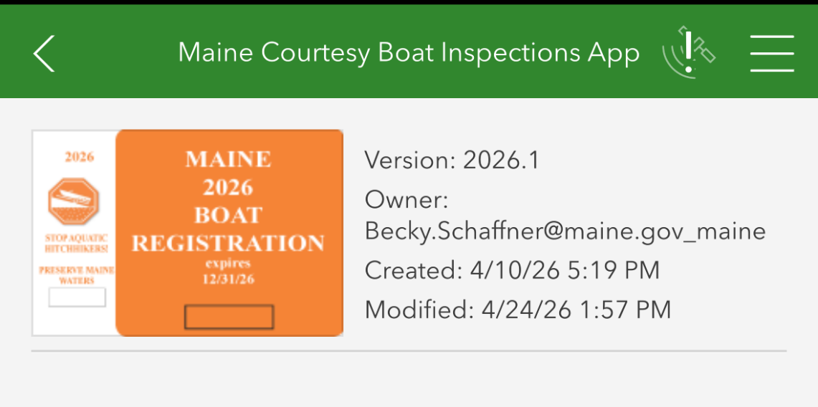

CBI App Training
Monday, May 11 @6PM

Slide 19
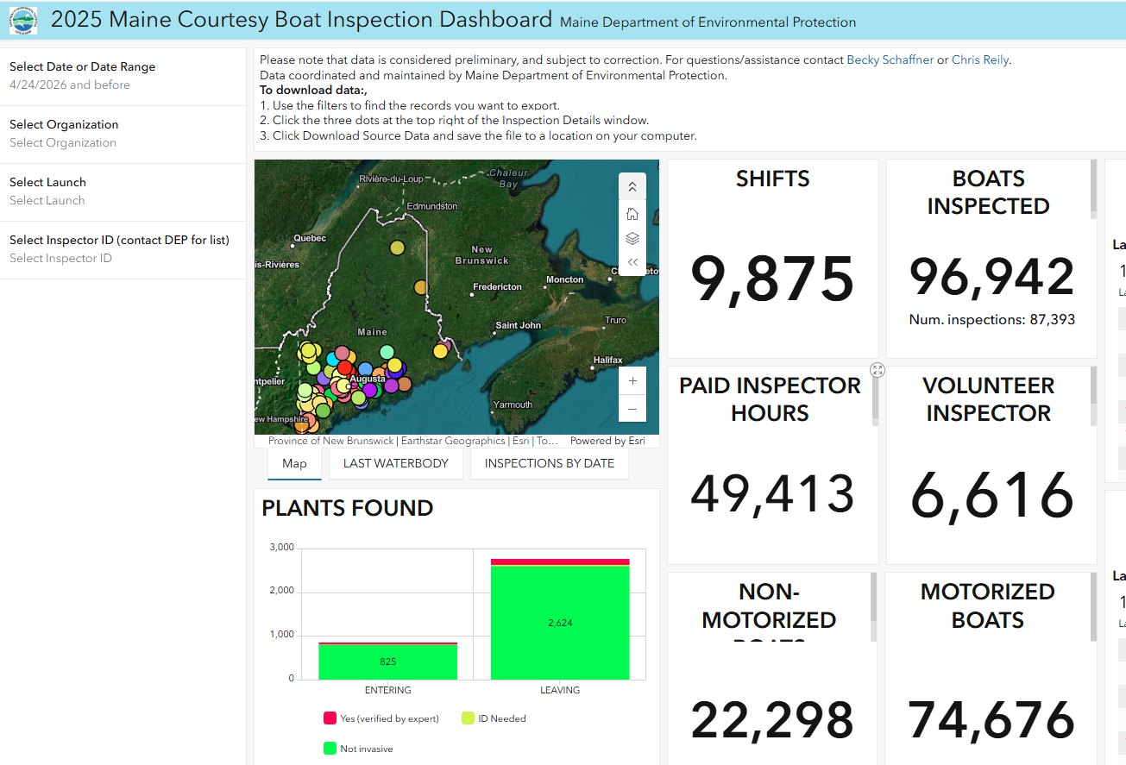
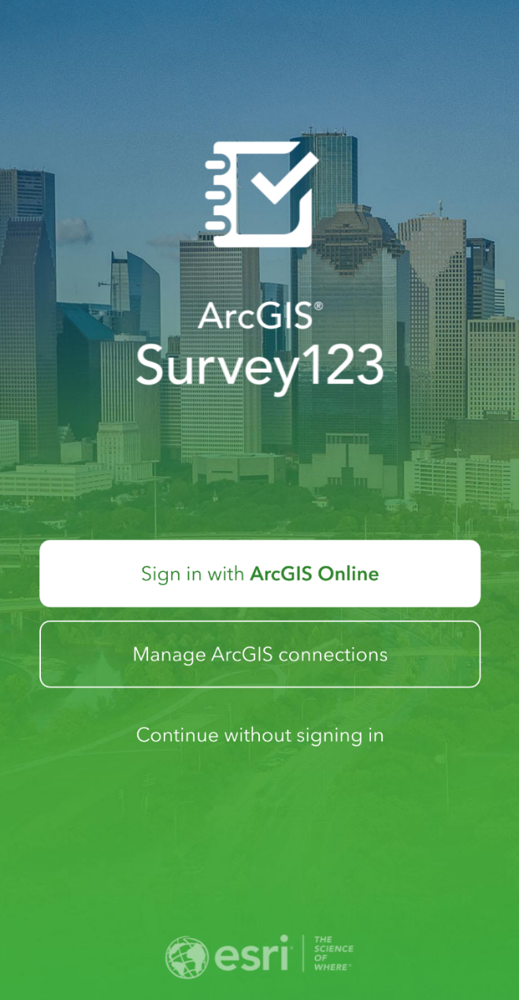
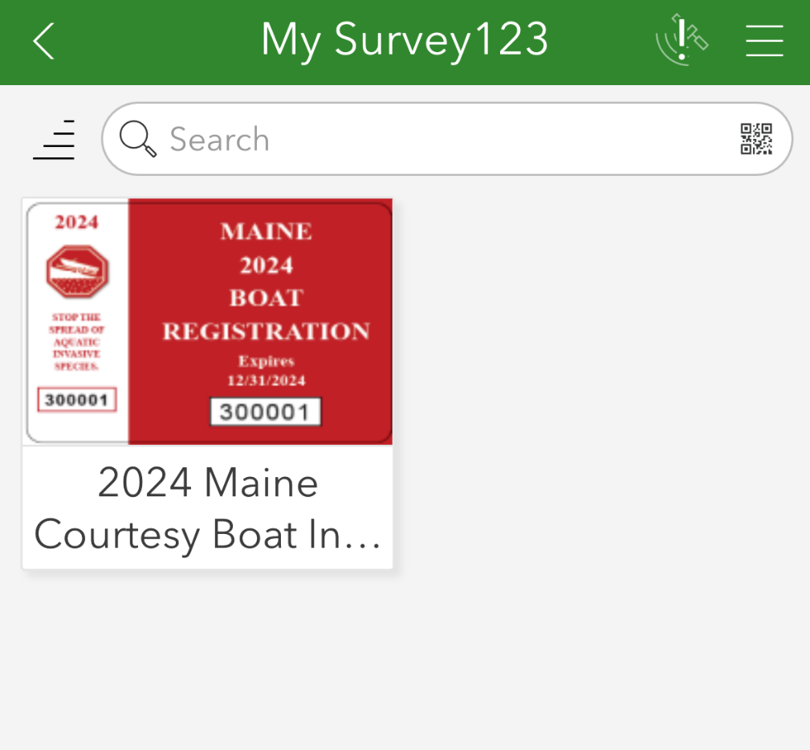
Data Collection App
CBI App Training
Monday, May 11th at 6pm

Slide 20
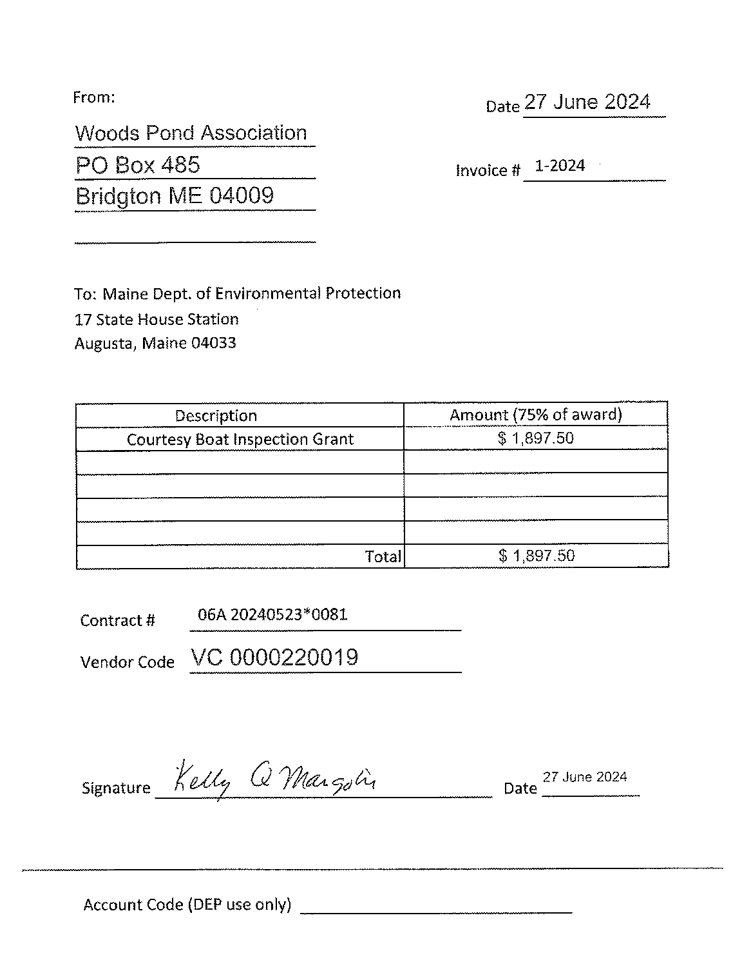
CBI Grant Invoicing
EFT doesn’t mean you don’t need an invoice
First invoice should be submitted by July 17
Invoices received after will be paid at the end of the season
No names on invoice
Organization name and address must match vendor form
Invoice should be printed, signed, scanned, and sent or
Signed electronically via Adobe
No photos

